Slide 1
Heterogeneous Computing using openCL lecture 1
F21DP Distributed and Parallel Technology
Sven-Bodo Scholz

Slide 2
My Coordinates
Office EM G.27
email: S.Scholz@hw.ac.uk
contact time:
  Thursday after the lecture or
  on appointment

Slide 3
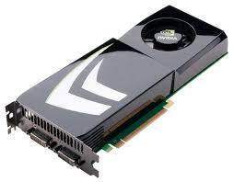
The Big Picture
Introduction to Heterogeneous Systems
OpenCL Basics
Memory Issues
Scheduling
Optimisations

Slide 4

Reading
+ all about
openCL

Slide 5
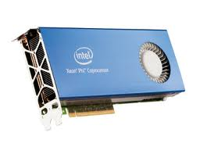
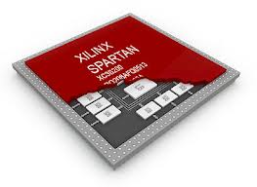
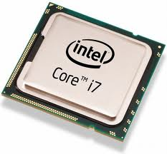
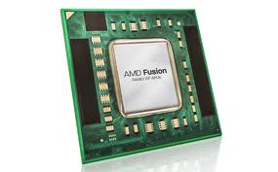
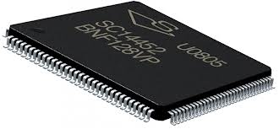
Heterogeneous Systems
A Heterogeneous System is a Distributed System containing different kinds of hardware to jointly solve problems.

Slide 6

Focus
Hardware: SMP + GPUs:
Programming Model: Data Parallelism

Slide 7
Recap Concurrency
“Concurrency describes a situation where two or more activities happen in the same time interval and we are not interested in the order in which it happens”

Slide 8
Recap Parallelism
“In CS we refer to Parallelism if two or more concurrent activities are executed by two or more physical processing entities”

Slide 9
Recap Data-Parallelism
1 | 2 | 2 | 3 | 3 | 4 | 4 | 5
1 | 1.75 | 2.25 | 2.75 | 3.25 | 3.75 | 4.25 | 9
b[i] = .25 * a[i-1] + 0.5 * a[i] + 0.25 * a[i+1]
b[i] = a[i]

Slide 10
A Peek Preview ☺
= loop iteration
Single-threaded (CPU)
// there are N elements
for(i = 0; i < N; i++)
C[i] = A[i] + B[i]
Time
T0
0
1
2
3
4
5
6
7
8
9
10
15
Multi-threaded (CPU)
// tid is the thread id
// P is the number of cores
for(i = 0; i < tid*N/P; i++)
C[i] = A[i] + B[i]
T0
0
1
2
3
T1
4
5
6
7
T2
8
9
10
11
T3
12
13
14
15
Massively Multi-threaded (GPU)
// tid is the thread id
C[tid] = A[tid] + B[tid]
T0
0
T1
1
T2
2
T3
3
T15
15

Slide 11
Conventional CPU Architecture
Space devoted to control logic instead of ALU
CPUs are optimized to minimize the latency of a single thread
  Can efficiently handle control flow intensive workloads
Multi level caches used to hide latency
Limited number of registers due to smaller number of active threads
Control logic to reorder execution, provide ILP and minimize pipeline stalls
Conventional CPU Block Diagram
Control Logic
L2 Cache
L3 Cache
ALU
L1 Cache
~ 25GBPS
System Memory
A present day multicore CPU could have more than one ALU ( typically < 32) and some of the cache hierarchy is usually shared across cores

Slide 12
Modern GPGPU Architecture
Generic many core GPU
  Less space devoted to control logic and caches
  Large register files to support multiple thread contexts
Low latency hardware managed thread switching
Large number of ALU per “core” with small user managed cache per core
Memory bus optimized for bandwidth
  ~150 GBPS bandwidth allows us to service a large number of ALUs simultaneously
High Bandwidth
bus to ALUs
On Board System Memory
Simple ALUs
Cache

Slide 13
Typical System
Host
GPU
PCI-Express
GPU
Host initiated memory transfers
Host initiated computations on the GPU (kernels)

Slide 14
Nvidia GPUs
Fermi Architecture
GTX 480 - Compute 2.0 capability
  15 cores or Streaming Multiprocessors (SMs)
  Each SM features 32 CUDA processors
  480 CUDA processors
Global memory with ECC
Instruction Cache
Warp Scheduler
Warp Scheduler
Dispatch Unit
Dispatch Unit
Register File 32768 x 32bit
Core
Core
Core
Core
LDST
SFU
LDST
Core
Core
Core
Core
LDST
LDST
Core
Core
Core
Core
LDST
SFU
LDST
Core
Core
Core
Core
LDST
LDST
Core
Core
Core
Core
LDST
SFU
LDST
Core
Core
Core
Core
LDST
CUDA Core
LDST
Core
Core
Core
Core
LDST
Dispatch Port
LDST
SFU
Core
Core
Core
Core
LDST
Operand Collector
LDST
FP Unit
Int Unit
Interconnect Memory
L1 Cache / 64kB Shared Memory
L2 Cache
Result Queue

Slide 15
Nvidia GPUs
Fermi Architecture
SM executes threads in groups of 32 called warps.
  Two warp issue units per SM
Concurrent kernel execution
  Execute multiple kernels simultaneously to improve efficiency
CUDA core consists of a single ALU and floating point unit FPU
Instruction Cache
Warp Scheduler
Warp Scheduler
Dispatch Unit
Dispatch Unit
Register File 32768 x 32bit
Core
Core
Core
Core
LDST
SFU
LDST
Core
Core
Core
Core
LDST
LDST
Core
Core
Core
Core
LDST
SFU
LDST
Core
Core
Core
Core
LDST
LDST
Core
Core
Core
Core
LDST
SFU
LDST
Core
Core
Core
Core
LDST
CUDA Core
LDST
Core
Core
Core
Core
LDST
Dispatch Port
LDST
SFU
Core
Core
Core
Core
LDST
Operand Collector
LDST
Interconnect Memory
FP Unit
Int Unit
L1 Cache / 64kB Shared Memory
L2 Cache
Result Queue

Slide 16
SIMD vs SIMT
SIMT denotes scalar instructions and multiple threads sharing an instruction stream
  HW determines instruction stream sharing across ALUs
  E.g. NVIDIA GeForce (“SIMT” warps), AMD Radeon architectures (“wavefronts”) where all the threads in a warp /wavefront proceed in lockstep
  Divergence between threads handled using predication
SIMT instructions specify the execution and branching behavior of a single thread
SIMD instructions exposes vector width,
  E.g. of SIMD: explicit vector instructions like x86 SSE

Slide 17
SIMT Execution Model
SIMD execution can be combined with pipelining
  ALUs all execute the same instruction
  Pipelining is used to break instruction into phases
    When first instruction completes (4 cycles here), the next instruction is ready to execute
SIMD Width
Add
Mul
Add
Mul
Add
Mul
Add
Mul
Add
Mul
Add
Mul
Add
Mul
Add
Mul
…
Add
Mul
Add
Mul
Add
Mul
Add
Mul
Add
Mul
Add
Mul
Add
Mul
Add
Mul
Add
Mul
Add
Mul
Add
Mul
Wavefront
Add
Mul
Add
Mul
Add
Mul
Add
Mul
Add
Mul
Add
Mul
Add
Mul
Add
Mul
Add
Mul
Add
Mul
Add
Mul
Add
Mul
Add
Mul
Cycle
…
1 | 2 | 3 | 4 | 5 | 6 | 7 | 8 | 9

Slide 18
NVIDIA Memory Hierarchy
L1 cache per SM configurable to support shared memory and caching of global memory
  48 KB Shared / 16 KB of L1 cache
  16 KB Shared / 48 KB of L1 cache
Data shared between work items of a group using shared memory
Each SM has a 32K register bank
L2 cache (768KB) that services all operations (load, store and texture)
  Unified path to global for loads and stores
Registers
Thread Block
Shared Memory
L1 Cache
L2 Cache
Global Memory

Slide 19
NVIDIA Memory Model in OpenCL
Like AMD, a subset of hardware memory exposed in OpenCL
Configurable shared memory is usable as local memory
  Local memory used to share data between items of a work group at lower latency than global memory
Private memory utilizes registers per work item
Private
Memory
Private
Memory
Private
Memory
Private
Memory
Workitem 1
Workitem 1
Workitem 1
Workitem 1
Compute Unit 1
Compute Unit N
Local Memory
Local Memory
Global / Constant Memory Data Cache
Compute Device
Global Memory
Compute Device Memory

Slide 20
Mapping Threads to Data
Consider a simple vector addition of 16 elements
  2 input buffers (A, B) and 1 output buffer (C) are required
Array Indices
Vector Addition:
0 | 1 | 2 | 3 | 4 | 5 | 6 | 7 | 8 | 9 | 10 | 11 | 12 | 13 | 14 | 15
A
+
B
=
C

Slide 21
Mapping Threads to Data
Create thread structure to match the problem
  1-dimensional problem in this case
Thread Code:
C[tid] = A[tid] + B[tid]
Thread IDs
Thread Structure
0 | 1 | 2 | 3 | 4 | 5 | 6 | 7 | 8 | 9 | 10 | 11 | 12 | 13 | 14 | 15
Vector Addition:
0 | 1 | 2 | 3 | 4 | 5 | 6 | 7 | 8 | 9 | 10 | 11 | 12 | 13 | 14 | 15
A
+
B
=
C

Slide 22
Thread Structure
OpenCL’s thread structure is designed to be scalable
Each instance of a kernel is called a work-item (though “thread” is commonly used as well)
Work-items are organized as work-groups
  Work-groups are independent from one-another (this is where scalability comes from)
An index space defines a hierarchy of work-groups and work-items

Slide 23
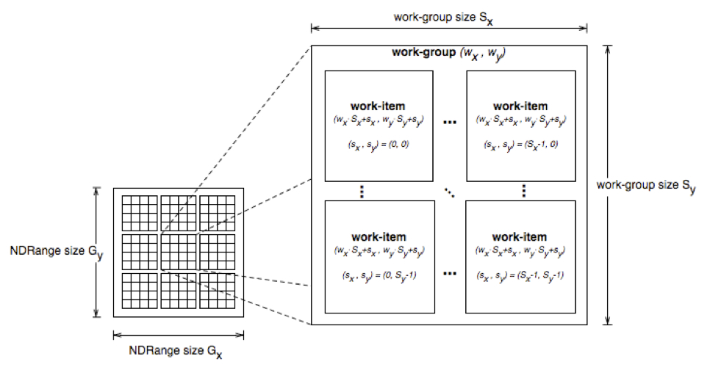
Thread Structure
Work-items can uniquely identify themselves based on:
  A global id (unique within the index space)
  A work-group ID and a local ID within the work-group

Slide 24
If you are excited.....
you can get started on your own ☺
google AMD openCL
or Intel openCL
or Apple openCL
or Khronos
download an SDK and off you go!

