Slide 1
Heterogeneous Computing using openCL lecture 2
F21DP Distributed and Parallel Technology
Sven-Bodo Scholz

Slide 2
Example: Squares
1 | 2 | 2 | 3 | 3 | 4 | 4 | 5
1 | 4 | 4 | 9 | 9 | 16 | 16 | 25
result[i] = data[i] * data[i]

Slide 3
Selecting a Platform
Each OpenCL implementation (i.e. an OpenCL library from AMD, NVIDIA, etc.) defines platforms which enable the host system to interact with OpenCL-capable devices
Currently each vendor supplies only a single platform per implementation

Slide 4
Selecting Devices
Once a platform is selected, we can then query for the devices that it knows how to interact with
We can specify which types of devices we are interested in (e.g. all devices, CPUs only, GPUs only)
This call is performed twice as with clGetPlatformIDs
The first call is to determine the number of devices, the second retrieves the device objects

Slide 5
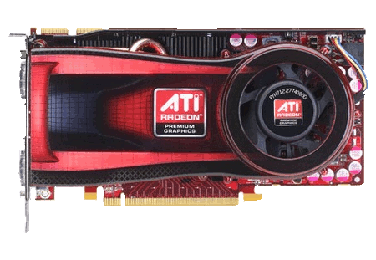
Contexts
Is an abstract execution environment
Context
Empty context

Slide 6
Command Queues
Command queues associate a context with a device
Context
Command queues

Slide 7
Lucky You !☺
/*********************************************************************
* initGPU : sets up the openCL environment for using a GPU.
* Note that the system may have more than one GPU in which case
* the one that has been pre-configured will be chosen.
* If anything goes wrong in the course, error messages will be
* printed to stderr and the last error encountered will be returned.
* *********************************************************************/
extern cl_int initGPU ();
Choses platform and device and creates
a context and a command queue for you ☺

Slide 8
Memory Objects
Uninitialized OpenCL memory objects—the original
data will be transferred later to/from these objects
Context
Original input/output data
(not OpenCL memory objects)

Slide 9
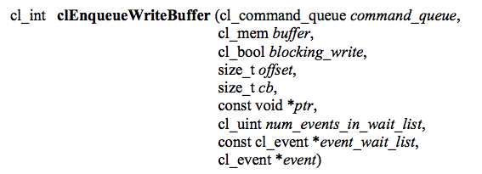
Transferring Data
The images are
redundant here to
show that they are
both part of the
context (on the
host) and
physically on the
device
Context
Images are written to a device

Slide 10
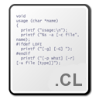
Programs
Program
Context

Slide 11
Compiling Programs
This function compiles and links an executable from the program object for each device in the context
If device_list is supplied, then only those devices are targeted
Optional preprocessor, optimization, and other options can be supplied by the options argument

Slide 12
Kernels
Kernels
Context

Slide 13
Runtime Compilation
There is a high overhead for compiling programs and creating kernels
Each operation only has to be performed once (at the beginning of the program)
The kernel objects can be reused any number of times by setting different arguments
Read source code into an array
clCreateProgramWithSource
clBuildProgram
clCreateKernel
clCreateProgramWithBinary

Slide 14
Kernel Arguments
Context
Data (e.g. images) are set as kernel arguments

Slide 15
Lucky you II ☺
/*******************************************************************************
*
* setupKernel : this routine prepares a kernel for execution. It takes the
* following arguments:
* - the kernel source as a string
* - the name of the kernel function as string
* - the number of arguments (must match those specified in the
* kernel source!)
* - followed by the actual arguments. Each argument to the kernel
* results in two or three arguments to this function, depending
* on whether these are pointers to float-arrays or integer values:
*
* legal argument sets are:
* FloatArr::clarg_type, num_elems::int, pointer::float *, and
* IntConst::clarg_type, number::int
*
typedef enum {
FloatArr,
IntConst
} clarg_type;

Slide 16
Lucky you II cont.
* If anything goes wrong in the course, error messages will be
* printed to stderr. The pointer to the fully prepared kernel
* will be returned.
*
* Note that this function actually performs quite a few openCL
* tasks. It compiles the source, it allocates memory on the
* device and it copies over all float arrays. If a more
* sophisticated behaviour is needed you may have to fall back to
* using openCL directly.
*
******************************************************************************/
extern cl_kernel setupKernel( const char *kernel_source, char *kernel_name, int num_args, ...);
count = 1024;
kernel = setupKernel( KernelSource, "square", 3, FloatArr, count, data,
FloatArr, count, results,
IntConst, count);

Slide 17
Lucky you II cont.
const char *KernelSource = "\n"
"__kernel void square( \n"
" __global float* input, \n"
" __global float* output, \n"
" const unsigned int count) \n"
"{ \n"
" int i = get_global_id(0); \n"
" output[i] = input[i] * input[i]; \n"
"} \n”;
data = (float *) malloc (count * sizeof (float));
results = (float *) malloc (count * sizeof (float));
for (int i = 0; i < count; i++)
data[i] = rand () / (float) RAND_MAX;
kernel = setupKernel( KernelSource, "square", 3, FloatArr, count, data,
FloatArr, count, results,
IntConst, count);

Slide 18
Executing the Kernel
Context
An index space of
threads is created
(dimensions match
the data)

Slide 19
Executing the Kernel
A thread structure defined by the index-space that is created
Each thread executes the same kernel on different data
Context
Each thread executes the kernel
SIMT = Single Instruction
Multiple Threads

Slide 20
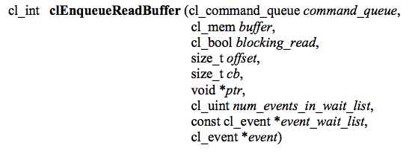
Copying Data Back
Context
Copied back
from GPU

Slide 21
Lucky you III ☺
/*******************************************************************************
*
* runKernel : this routine executes the kernel given as first argument.
* The thread-space is defined through the next two arguments:
* <dim> identifies the dimensionality of the thread-space and
* <globals> is a vector of length <dim> that gives the upper
* bounds for all axes. The argument <local> specifies the size
* of the individual warps which need to have the same dimensionality
* as the overall range.
* If anything gows wrong in the course, error messages will be
* printed to stderr and the last error encountered will be returned.
*
* Note that this function not only executes the kernel with the given
* range and warp-size, it also copies back *all* arguments from the
* kernel after the kernel's completion. If a more sophisticated
* behaviour is needed you may have to fall back to using openCL directly.
*
******************************************************************************/
extern cl_int runKernel( cl_kernel kernel, int dim, size_t *global, size_t *local);
size_t global[1] = {1024};
size_t local[1] = {32};
runKernel( kernel, 1, global, local);

Slide 22
Finally: Release the Resources
/*******************************************************************************
*
* freeDevice : this routine releases all acquired ressources.
* If anything gows wrong in the course, error messages will be
* printed to stderr and the last error encountered will be returned.
*
******************************************************************************/
extern cl_int freeDevice();

Slide 23
OpenCL Timing
cl_event event_timer;
clEnqueueNDRangeKernel(
myqueue , myKernel,
2, 0, globalws, localws,
0, NULL, &event_timer);
OpenCL provides “events” which can be used for timing kernels
Events will be discussed in detail in Lecture 11
We pass an event to the OpenCL enqueue kernel function to capture timestamps
Code snippet provided can be used to time a kernel
Add profiling enable flag to create command queue
By taking differences of the start and end timestamps we discount overheads like time spent in the command queue
unsigned long starttime, endtime;
clGetEventProfilingInfo( event_time,
CL_PROFILING_COMMAND_START,
sizeof(cl_ulong), &starttime, NULL);
clGetEventProfilingInfo(event_time, CL_PROFILING_COMMAND_END,
sizeof(cl_ulong), &endtime, NULL);
unsigned long elapsed =
(unsigned long)(endtime - starttime);

