Slide 1
Data-Parallel Programming using SaC lecture 1
F21DP Distributed and Parallel Technology
Sven-Bodo Scholz

Slide 2
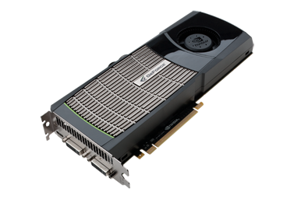
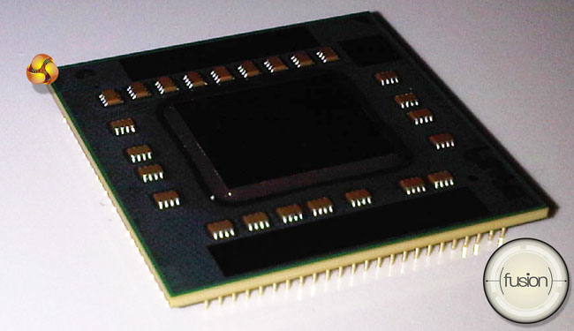
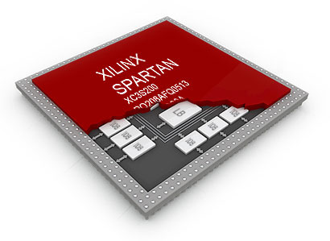
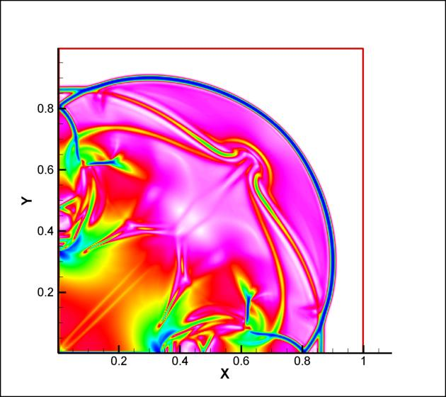

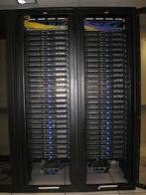
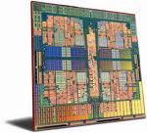
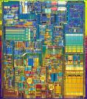
The Multicore Challenge
performance?
sustainability?
affordability?

Slide 3
Typical Scenario
☹
VHDL
μTC
OpenCL
MPI/
OpenMP
algorithm

Slide 4

Tomorrow’s Scenario
OpenCL
VHDL
μTC
algorithm
MPI/OpenMP

Slide 5
The High-Portability Vision
☺
OpenCL
compiler
VHDL
μTC
algorithm
MPI/OpenMP

Slide 6
What is Data-Parallelism?
actor
actor
actor
data structure
concurrent operations on a single data structure

Slide 7
Data-Parallelism, More Concretly
Formulate algorithms in space rather than time!
prod = prod( iota( 10)+1)
prod = 1;
for( i=1; i<=10; i++) {
prod = prod*i;
}

Slide 8
Why is Space Better than Time?

Slide 9
Another Example: Fibonacci Numbers
if( n<=1)
return n;
} else {
return fib( n-1) + fib( n-2);
}

Slide 10
Another Example: Fibonacci Numbers
if( n<=1)
return n;
} else {
return fib( n-1) + fib( n-2);
}

Slide 11
Fibonacci Numbers – now linearised!
if( n== 0)
return fst;
else
return fib( snd, fst+snd, n-1)

Slide 12
Fibonacci Numbers – now data-parallel!
matprod( genarray( [n], [[1, 1], [1, 0]])) [0,0]

Slide 13
Everything is an Array
Think Arrays!
Vectors are arrays.
Matrices are arrays.
Tensors are arrays.
........ are arrays.

Slide 14
Everything is an Array
Think Arrays!
Vectors are arrays.
Matrices are arrays.
Tensors are arrays.
........ are arrays.
Even scalars are arrays.
Any operation maps arrays to arrays.
Even iteration spaces are arrays

Slide 15
Multi-Dimensional Arrays

Slide 16
Index-Free Combinator-Style Computations
sqrt( sum( square( A)))
L2 norm:
Convolution step:
Convergence test:
W1 * shift(-1, A) + W2 * A + W1 * shift( 1, A)
all( abs( A-B) < eps)

Slide 17
Shape-Invariant Programming
l2norm( [1,2,3,4] )
sqrt( sum( sqr( [1,2,3,4])))
sqrt( sum( [1,4,9,16]))
sqrt( 30)
5.4772

Slide 18
Shape-Invariant Programming
l2norm( [[1,2],[3,4]] )
sqrt( sum( sqr( [[1,2],[3,4]])))
sqrt( sum( [[1,4],[9,16]]))
sqrt( [5,25])
[2.2361, 5]

Slide 19
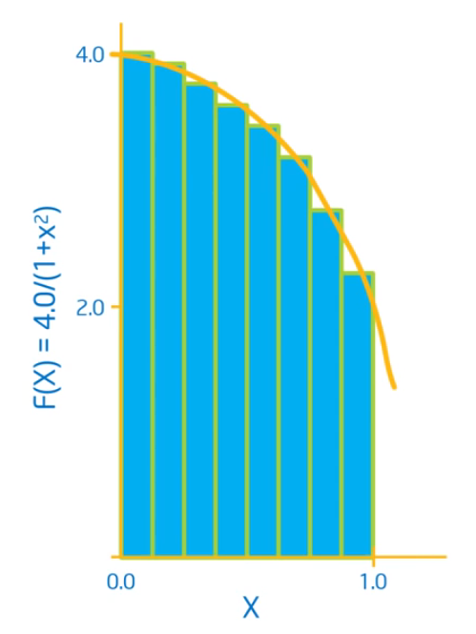
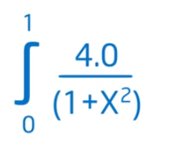
Computation of π

Slide 20
Computation of π
double f( double x)
{
return 4.0 / (1.0+x*x);
}
int main()
{
num_steps = 10000;
step_size = 1.0 / tod( num_steps);
x = (0.5 + tod( iota( num_steps))) * step_size;
y = { iv-> f( x[iv])};
pi = sum( step_size * y);
printf( " ...and pi is: %f\n", pi);
return(0);
}

Slide 21
Programming in a Data-Parallel Style - Consequences
much less error-prone indexing!
combinator style
increased reuse
better maintenance
easier to optimise
huge exposure of concurrency!

