Slide 1
Data-Parallel Programming using SaC lecture 4
F21DP Distributed and Parallel Technology
Sven-Bodo Scholz

Slide 2
Looking at Entire Programs:

Slide 3
Multi-Threaded Execution on SMPs
data parallel operation

Slide 4
SMP Ideal: Coarse Grain!

Slide 5
Multi-Threaded Execution on GPGPUs
data parallel operation

Slide 6
GPGPU Ideal: Homogeneous Flat Coarse Grain

Slide 7
GPUs and synchronous memory transfers

Slide 8
GPGPU Naive Compilation
PX = { [i,j] -> PX[ [i,j] ] + sum( VY[ [.,i] ] * CX[ [i,j] ]) };
CUDA
kernel
PX_d = host2dev( PX);
CX_d = host2dev( CX);
VY_d = host2dev( VY);
PX_d = { [i,j] -> PX_d[ [i,j] ] + sum( VY_d[ [.,i] ] * CX_d[ [i,j] ]) };
PX = dev2host( PX_d);

Slide 9
Hoisting memory transfers out of loops
for( i = 1; i< rep; i++) {
PX_d = host2dev( PX);
CX_d = host2dev( CX);
VY_d = host2dev( VY);
PX_d = { [i,j] -> PX_d[ [i,j] ] + sum( VY_d[ [.,i] ] * CX_d[ [i,j] ]) };
PX = dev2host( PX_d);
PX_d = host2dev( PX);
CX_d = host2dev( CX);
VY_d = host2dev( VY);
PX_d = { [i,j] -> PX_d[ [i,j] ] + sum( VY_d[ [.,i] ] * CX_d[ [i,j] ]) };
PX = dev2host( PX_d);
}

Slide 10
Retaining Arrays on the Device
CX_d = { [i,j] -> ..... } ;
CX = dev2host( CX_d);
CX = dev2host( CX_d);
PX_d = host2dev( PX);
CX_d = host2dev( CX);
VY_d = host2dev( VY);
PX_d = host2dev( PX);
CX_d = host2dev( CX);
VY_d = host2dev( VY);
PX_d = host2dev( PX);
VY_d = host2dev( VY);
for( i = 1; i< rep; i++) {

Slide 11
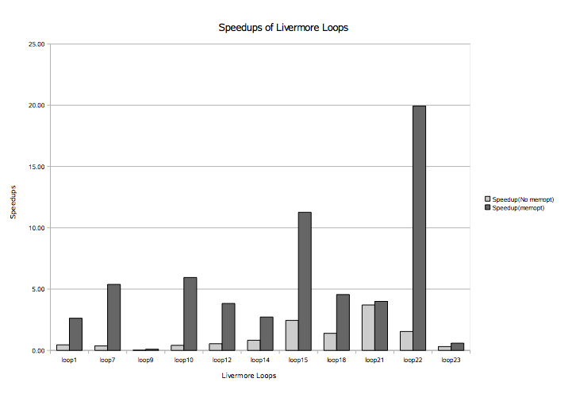
The Impact of Redundant Memory Transfers

Slide 12
Challenge: Memory Management: What does the λ-calculus teach us?
conceptual copies
f( a, b , c)
f( a, b ,c )
{
... a..... a....b.....b....c...
}

Slide 13
How do we implement this? – the scalar case
conceptual copies
f( a, b , c)
f( a, b ,c )
{
... a..... a....b.....b....c...
}
operation | implementation
read | read from stack
funcall | push copy on stack

Slide 14
How do we implement this? – the non-scalar case naive approach
conceptual copies
f( a, b , c)
f( a, b ,c )
{
... a..... a....b.....b....c...
}
operation | non-delayed copy
read | O(1) + free
update | O(1)
reuse | O(1)
funcall | O(1) / O(n) + malloc

Slide 15
How do we implement this? – the non-scalar case widely adopted approach
conceptual copies
f( a, b , c)
f( a, b ,c )
{
... a..... a....b.....b....c...
}
GC
operation | delayed copy + delayed GC
read | O(1)
update | O(n) + malloc
reuse | malloc
funcall | O(1)

Slide 16
How do we implement this? – the non-scalar case reference counting approach
conceptual copies
f( a, b , c)
f( a, b ,c )
{
... a..... a....b.....b....c...
}
operation | delayed copy + non-delayed GC
read | O(1) + DEC_RC_FREE
update | O(1) / O(n) + malloc
reuse | O(1) / malloc
funcall | O(1) + INC_RC

Slide 17
How do we implement this? – the non-scalar case a comparison of approaches
operation | non-delayed copy | delayed copy + delayed GC | delayed copy + non-delayed GC
read | O(1) + free | O(1) | O(1) + DEC_RC_FREE
update | O(1) | O(n) + malloc | O(1) / O(n) + malloc
reuse | O(1) | malloc | O(1) / malloc
funcall | O(1) / O(n) + malloc | O(1) | O(1) + INC_RC

Slide 18
Avoiding Reference Counting Operations
a = [1,2,3,4];
b = a[1];
c = f( a, 1);
d= a[2];
e = f( a, 2);
clearly, we can avoid RC here!
we would like to avoid RC here!
and here!
BUT, we cannot avoid RC here!

Slide 19
NB: Why don’t we have
RC-world-domination?
1
1
2
3
3

Slide 20
Going Multi-Core
single-threaded
data-parallel
rc-op
rc-op
rc-op
rc-op
rc-op
rc-op
rc-op
rc-op
...
...
rc-op
rc-op
rc-op
rc-op
local variables do not escape!
relatively free variables can only benefit from reuse in 1/n cases!
☺
=> use thread-local heaps
=> inhibit rc-ops on rel-free vars

Slide 21
Bi-Modal RC:
fork
local
norc
join

Slide 22
Conclusions
There are still many challenges ahead, e.g.
  Non-array data structures
  Arrays on clusters
  Joining data and task parallelism
  Better memory management
  Application studies
If you are interested in joining the team:
  talk to me ☺

Slide 23
Going Multi-Core II
single-threaded
task-parallel
rc-op
rc-op
rc-op
rc-op
rc-op
rc-op
rc-op
rc-op
rc-op
local variables do escape!
relatively free variables can benefit from reuse in 1/2 cases!
☹
=> use locking....

Slide 24

Going Many-Core
256 cores
500 threads in HW each
functional programmers
paradise, no?!
nested DP and TP
parallelism

Slide 25
RC in Many-Core Times
computational thread(s)
rc-op
RC-thread
rc-op
rc-op
rc-op

Slide 26
and here the runtimes

Slide 27
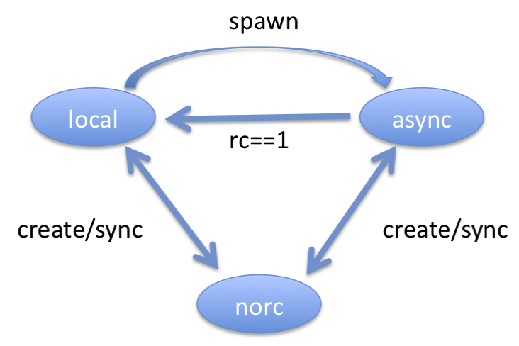
Multi-Modal RC:
spawn

Slide 28
new runtimes:

