Slide 1
MEng Software Engineering Year 4 Overview and Placement
Mehran Sharghi
MEng Placement Coordinator
Dept of Computer Science
Original slides provided by Hans-Wolfgang Loidl

Slide 2

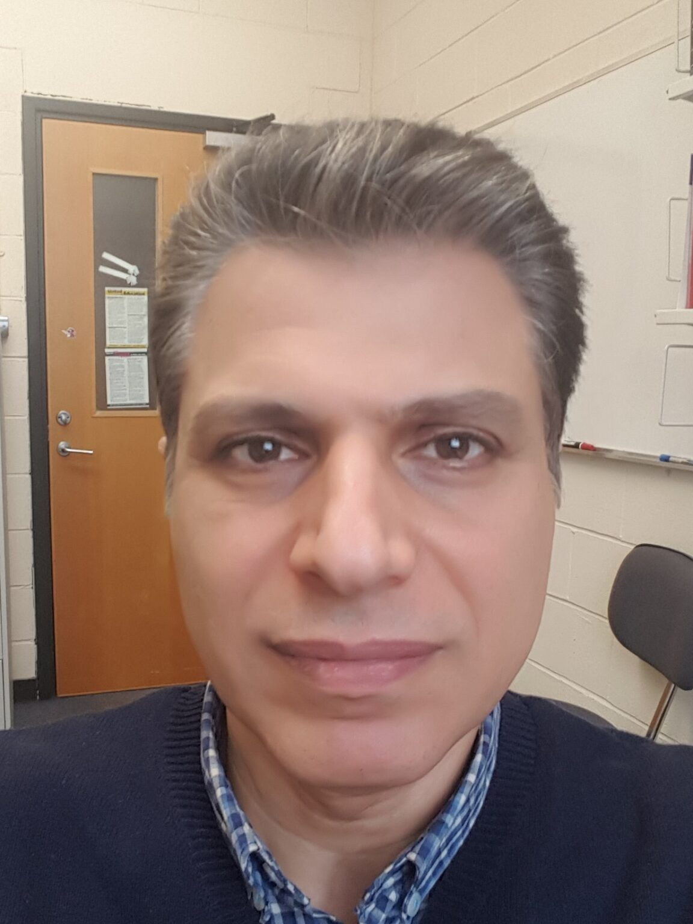

Greetings
Stefano Padilla,
Programme Director
Mehran Sharghi,
MEng Placement Coordinator
Hans-Wolfgang Loidl,
Previous MEng Placement Coordinator

Slide 3
What you have achieved so far
Year 1-3 provide the core of a CS degree
Most courses are shared with BSc Computer Science
Year 4 offers more choice and options
Mandatory (Hons) project (F20PA/B/C)
3 options in Semester 1 + 2 options in Semester 2

Slide 4
Roadmap for MEng Placement
Sep-Jan (year4): look for placement opportunities:
We provide a list of companies and of portals
You need to apply and secure a placement
MUST be in the Software Engineering sector
Can be anywhere, either in-person or remote
Placement should be 6 months (normally June-December)
Minimum duration is 3 months

Slide 5
Roadmap for MEng Placement
Jan-May (year 4): sort out details of placement:l
Fill in Step 1 – 3 forms, to vet company and ensure a suitable working environment
Placements are usually paid: negotiate with the host company
June-December (year4 & year5): the placement itself:
Keep a weekly diary of activities and of learning
Write a reflective summary report before finishing
Submit diary and report by last Friday before Christmas

Slide 6
Finding a Placement
We provide a list of companies that regularly take on our students
You need to reach out and apply for internship positions
Placement can be anywhere
Nature of the placement must be in Software Engineering
Polish your CV, and customise to the job / company
Put in many application, don’t rely on one specific one to come through

Slide 7
Internship Opportunities
Here is an initial list of companies:
Cadence, Edinburgh www
VITEC (was Exterity), Dalgety Bay www
CAS Ltd www
ST Microelectronics www
Ciena www
Wavecrest www
BAE Systems www
More:
Seebyte
IntelliDigest
Codethink
Keysight
Millersoft
Scott Logic
Codeplay

Slide 8
Upcoming Events
Interview and Placement Tips
Lindsay Wilson, Careers Services,
Date & Venue: TBC
Interview coaching
Careers Services,
Date & Venue: TBC

Slide 9
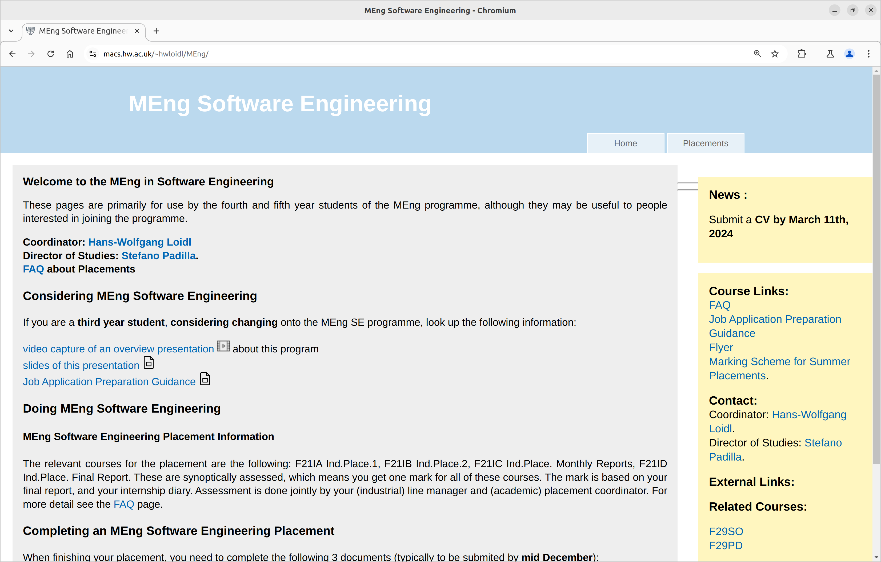
More Information
https://www.macs.hw.ac.uk/~hwloidl/MEng/

Slide 10
Questions?

