Slide 1
Presentation of ECDC, modelling networks and data availability
Tommi Asikainen, Surveillance and Response Support
European Centre for Disease Prevention and Control
ICMS, Edinburgh, 14 September 2011

Slide 2
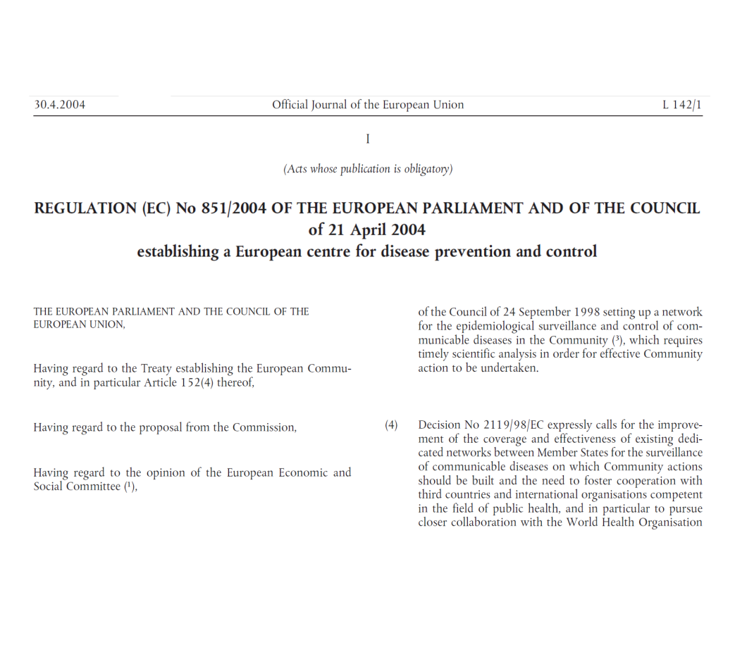
An EU agency dedicated to the prevention and control of communicable diseases
European Centre for Disease Prevention and Control (ECDC) operational May 2005
Located in Stockholm, Sweden
Director Marc Sprenger
Member States EU-27 and EEA countries
Founding regulation EC/851/2004

Slide 3
Organisational structure
Director
and
Director's Office
Office of the Chief Scientist
Surveillance
and Response Support
Public Health Capacity and Communication
Resource Management and Coordination

Slide 4







What is an EU agency?
Similar concept as in
national agencies or institutes:
technical body for specific area slightly outside government sphere;
a certain degree of independence; and
own budget.
4
Notes:
Public health is not the monopoly of ECDC.
We are not the only player in Europe,
we are part of a larger network of EU agencies.
EEA European Environment Agency
EMCDDA European Monitoring Centre for Drugs and Drug Addiction
EMA European Medicines Agency
EU-OSHA European Agency for Safety and Health at Work
EFSA European Food Safety Authority
ECHA European Chemicals Agency
Note: "A certain degree of independence" – Source: The European Commission 2003, ‘Meta evaluation of the Community’s Agency System’, DG Budget

Slide 5
Epidemiological background

Slide 6
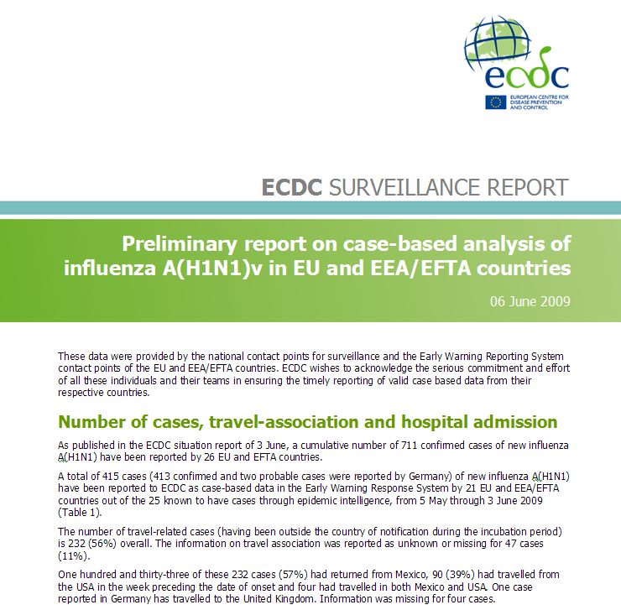
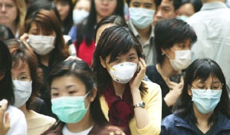
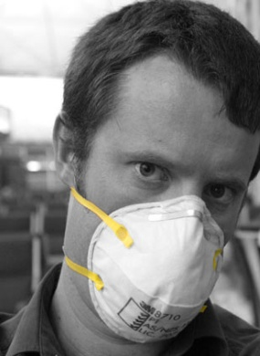


Epidemics still happen in our era
SARS in 2003 spread internationally at an alarming speed.
20th century saw influenza pandemics in 1918–19, 1957, and 1968.
In June 2009, the WHO confirmed the A(H1N1) influenza epidemic as a global pandemic.

Slide 7
ECDC's areas of activity
Disease surveillance;
event and disease monitoring

Slide 8
Before the creation of TESSy, the European Surveillance System
Data
Centre
Data
Centre
Data
Centre
Data
Centre
Data
Centre
Data
Centre
Data
Centre
Data
Centre
Data upload
Data upload
Data upload
Data upload
Data upload
Member
States
Member
States
Member
States
Notes:
Before the creation of ECDC, Member States reported their data to many different data centres.

Slide 9


The European surveillance system: a one-stop shop
Data upload and access by Member States.
Data access by:
Data users in
Member States
National institutes
Disease experts
General public
Data upload
Data upload
Data upload
Advisory Forum
members
Management Board members
WHO
EMCDDA
Member
States
Member
States
Member
States
EFSA
Others
Notes:
With ECDC and TESSy, there is now just one hub, where we collect all data into a single database.
TESSy – The European Surveillance System – lets epidemiologists analyse trends in infectious diseases,
so national health officials can take action to protect the citizens of Europe and their families.
This is an added value we provide at the European level.

Slide 10
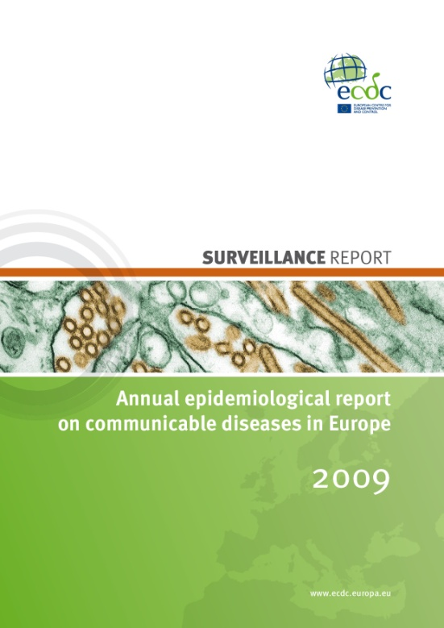
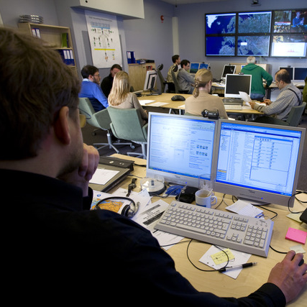
Disease and event monitoring: our health radar
TESSy¹
Disease monitoring
EWRS²
Event monitoring
Cases
Events
collect,
analyse,
interpret
capture,
filter,
validate
Signal
assess
Alert
investigate
disseminate
Communicate
and control
¹ The European Surveillance System – a database system
² Early Warning Response System
Notes:
ECDC's mission is to identify, assess and communicate current and emerging threats to human health posed by infectious diseases.
We also support and help coordinate European Union countries’ preparedness and response capacities.
With TESSy and EWRS, ECDC established a two-way approach to disease surveillance and monitoring:
EWRS is our system for real-time event monitoring.
And TESSy is our database system for long-term disease monitoring and analysis.
EWRS relies largely on reports from the Member States.
It proved particularly effective at the start of the influenza pandemic in 2009, and ensured real-time dissemination of this emerging health threat.

Slide 11
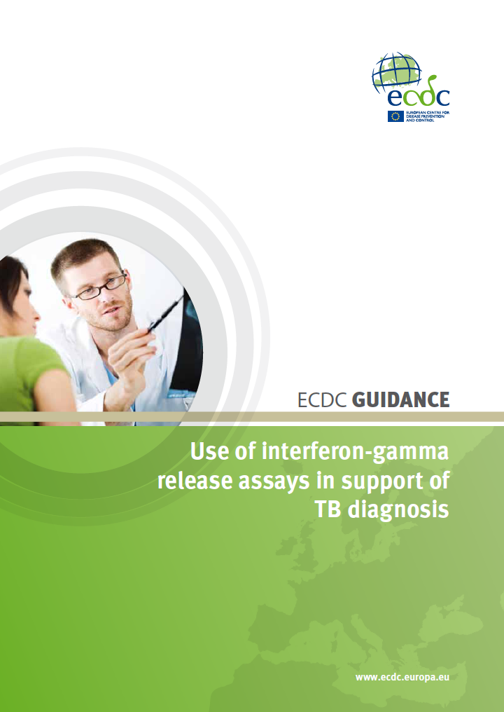
Expert advice
According to the ECDC founding regulation, 'the Centre shall provide independent scientific opinions and scientific and technical assistance'.
Scientific panels assist ECDC in this role. They are set up on an ad hoc basis.
Results are published and disseminated.

Slide 12
ECDC's areas of activity
Modelling networks

Slide 13
Strategies
ECDC can initiate own projects to fill gaps in research:
  Meaning and interpretation of generation times
  Varicella vaccination
  HIV prevalence estimates
Calls are published on ECDC homepage and Official Journal of EU

Slide 14
Larger scale (min. 5 countries)modelling projects
ECDC collaborates with European Commission and provides proposals for future modelling work
  3-5 year projects
ECDC cannot be a partner but liaises with the projects
  Steering committee
  Involve the project on EU scale
  Put in contact with experts in other fields
  Assist with data availability issues

Slide 15
Special case: H1N1 outbreak 2009
Countries were doing their own work
  Need for coordination and information sharing
ECDC created a network of modellers from EU countries
  Collaboration with WHO informal H1N1 modelling network
van Kerkhove (PLOS Medicine 2010): Studies needed to address public health challenges of the 2009 H1N1 influenza pandemic: insights from modeling.
  2 meetings at ECDC and several teleconferences
  Involving EU funded modelling networks

Slide 16
Special case: H1N1 outbreak 2009
Working group on early analysis from several countries
  Working group led by HPA Colindale
    Participation by 12 countries
    Problem with data access
  Flasche et al (Epidemics 2011): Different transmission patterns in the early stages of the influenza A(H1N1)v pandemic: a comparative analysis of 12 European countries.

Slide 17
ECDC's areas of activity
Data availability

Slide 18
Data availability
Data is not owned by ECDC – still country data
Procedure for applying access to data from Tessy
  info@ecdc.europa.eu

Slide 19
Data availability
Need to specify for what purpose and which countries data is of interest

Slide 20
Categories
ECDC personnel, EU Member States contact points, EC and EU Agencies Staff, WHO-EURO Staff
may have direct access to TESSy data and downloads after training and awareness of confidentiality issues
EU Agencies:
(e.g. EMEA, EFSA, ECHA and the Commission Scientific Committees)
may also request downloads of subset of data for own use directly after signature of confidentiality declaration or with agreement if outsourced to third parties

Slide 21
Categories
Third parties:
(e.g. Universities, Public Health institutions, Private Companies)
May request downloads of subset of data for own use after approval by “Peer Review Group” and signature of specific agreement including confidentiality declaration.
Data ”just for modelling” probably not enough argument

Slide 22
THANK YOU FOR YOUR ATTENTION

