Slide 1
Data Mining and Machine Learning
Boosting, bagging and ensembles.
The good of the many outweighs the good of the one

Slide 2
Classifier 1 Classifier 2 Classifier 3
Actual Class | Predicted Class
A | A
A | A
A | B
B | B
B | B
Actual Class | Predicted Class
A | A
A | A
A | A
B | A
B | B
Actual Class | Predicted Class
A | B
A | B
A | A
B | B
B | A

Slide 3
Actual Class | Predicted Class
A | A
A | A
A | B
B | B
B | B
Actual Class | Predicted Class
A | A
A | A
A | A
B | A
B | B
Actual Class | Predicted Class
A | B
A | B
A | A
B | B
B | A
Actual Class | Predicted Class
A | A
A | A
A | A
B | B
B | B
Classifier 4
An ‘ensemble’ of
classifier 1,2, and 3,
which predicts by
majority vote

Slide 4
Combinations of Classifiers
Usually called ‘ensembles’
When each classifier is a decision tree, these are called ‘decision forests’
Things to worry about:
  How exactly to combine the predictions into one?
  How many classifiers?
  How to learn the individual classifiers?
A number of standard approaches ...

Slide 5
Basic approaches to ensembles:
Simply averaging the predictions (or voting)
‘Bagging’ - train lots of classifiers on randomly different versions of the training data, then basically average the predictions
‘Boosting’ – train a series of classifiers – each one focussing more on the instances that the previous ones got wrong. Then use a weighted average of the predictions

Slide 6
What comes from the basic maths
Simply averaging the predictions works best when:
  Your ensemble is full of fairly accurate classifiers
  ... but somehow they disagree a lot (i.e. When they’re wrong, they tend to be wrong about different instances)
  Given the above, in theory you can get 100% accuracy with enough of them.
  But, how much do you expect ‘the above’ to be given?
  ... and what about overfitting?

Slide 7
Bagging

Slide 8
Bootstrap aggregating

Slide 9
Bootstrap aggregating
New version made by random
resampling with replacement
Instance | P34 level | Prostate cancer
1 | High | Y
2 | Medium | Y
3 | Low | Y
4 | Low | N
5 | Low | N
6 | Medium | N
7 | High | Y
8 | High | N
9 | Low | N
10 | Medium | Y
Instance | P34 level | Prostate cancer
3 | High | Y
10 | Medium | Y
2 | Low | Y
1 | Low | N
3 | Low | N
1 | Medium | N
4 | High | Y
6 | High | N
8 | Low | N
3 | Medium | Y

Slide 10
Bootstrap aggregating
Instance | P34 level | Prostate cancer
1 | High | Y
2 | Medium | Y
3 | Low | Y
4 | Low | N
5 | Low | N
6 | Medium | N
7 | High | Y
8 | High | N
9 | Low | N
10 | Medium | Y
Generate a collection of
bootstrapped versions ...

Slide 11
Bootstrap aggregating
Learn a classifier from each
ndividual bootstrapped dataset

Slide 12
Bootstrap aggregating
The ‘bagged’ classifier is the ensemble,
with predictions made by voting or averaging

Slide 13
BAGGING ONLY WORKS WITH ‘UNSTABLE’ CLASSIFIERS

Slide 14
Unstable? The decision surface can be very different each time. e.g. A neural network trained on same data could produce any of these ...
A
A
A
A
A
A
A
B
A
B
A
B
A
A
A
B
B
B
B
B
B
A
A
A
A
A
A
A
B
A
B
A
B
A
A
A
B
B
B
B
B
B
Same with DTs, NB, ..., but not KNN

Slide 15
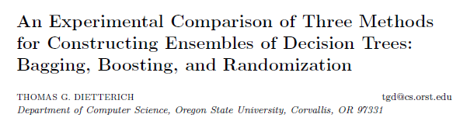
Example improvements from bagging
www.csd.uwo.ca/faculty/ling/cs860/papers/mlj-randomized-c4.pdf

Slide 16
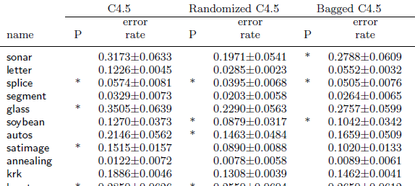
Example improvements from bagging
Bagging improves over straight C4.5 almost every time
(30 out of 33 datasets in this paper)

Slide 17
Randomized C4.5 is also an ensemble method
… better than C4.5 on 26 of the 33 datasets in this paper

Slide 18
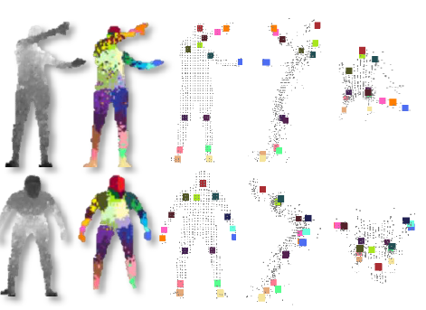

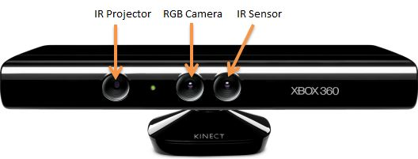
Kinect uses bagging

Slide 19
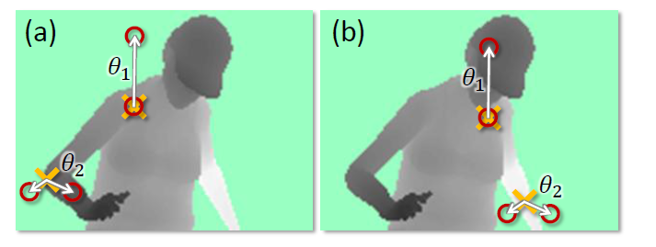
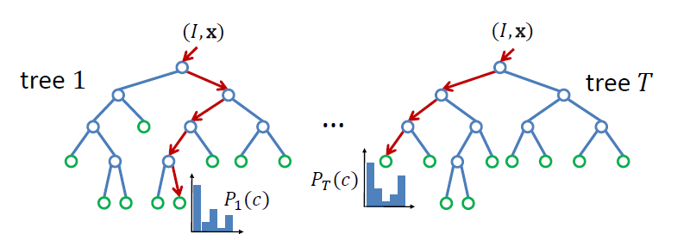
Depth feature / decision trees
Each tree node is a
“depth difference feature”
e.g. branches may be:
θ1 < 4.5 , θ1 >=4.5
Each leaf is a
distribution over
body part labels

Slide 20
The classifier Kinect uses
(in real time, of course)
Is an ensemble of (possibly 3) decision trees;
.. each with depth ~ 20;
… each trained on a separate collection of ~1M depth images with labelled body parts;
…the body-part classification is made by simply averaging over the tree results, and then taking the most likely body part.

Slide 21
Boosting

Slide 22
Boosting
Instance | Actual Class | Predicted Class
1 | A | A
2 | A | A
3 | A | B
4 | B | B
5 | B | B
Learn Classifier 1

Slide 23
Boosting
Instance | Actual Class | Predicted Class
1 | A | A
2 | A | A
3 | A | B
4 | B | B
5 | B | B
Learn Classifier 1
C1

Slide 24
Boosting
Instance | Actual Class | Predicted Class
1 | A | A
2 | A | A
3 | A | B
4 | B | B
5 | B | B
Assign weight to Classifier 1
C1
W1=0.69

Slide 25
Boosting
Instance | Actual Class
1 | A
2 | A
3 | A
3 | A
4 | B
5 | B
Instance | Actual Class | Predicted Class
1 | A | A
2 | A | A
3 | A | B
4 | B | B
5 | B | B
Construct new dataset that gives
more weight to the ones
misclassified last time
C1
W1=0.69

Slide 26
Boosting
Instance | Actual Class | Predicted Class
1 | A | B
2 | A | B
3 | A | A
3 | A | A
4 | B | B
5 | B | B
Learn classifier 2
C1
W1=0.69
C2

Slide 27
Boosting
Instance | Actual Class | Predicted Class
1 | A | B
2 | A | B
3 | A | A
3 | A | A
4 | B | B
5 | B | B
Get weight for classifier 2
C1
W1=0.69
C2
W2=0.35

Slide 28
Boosting
Instance | Actual Class
1 | A
1 | A
2 | A
2 | A
3 | A
4 | B
5 | B
Instance | Actual Class | Predicted Class
1 | A | B
2 | A | B
3 | A | A
3 | A | A
4 | B | B
5 | B | B
Construct new dataset with more weight
on those C2 gets wrong ...
C1
W1=0.69
C2
W2=0.35

Slide 29
Boosting
Instance | Actual Class | Predicted Class
1 | A | A
1 | A | A
2 | A | A
2 | A | A
3 | A | A
4 | B | A
5 | B | B
Learn classifier 3
C1
W1=0.69
C2
W2=0.35
C3

Slide 30
Boosting
Instance | Actual Class | Predicted Class
1 | A | A
1 | A | A
2 | A | A
2 | A | A
3 | A | A
4 | B | A
5 | B | B
And so on ... Maybe 10 or 15 times
Learn classifier 3
C1
W1=0.69
C2
W2=0.35
C3

Slide 31
The resulting ensemble classifier
C1
W1=0.69
C2
W2=0.35
C3
W3=0.8
C4
W4=0.2
C5
W5=0.9

Slide 32
The resulting ensemble classifier
New unclassified instance
C1
W1=0.69
C2
W2=0.35
C3
W3=0.8
C4
W4=0.2
C5
W5=0.9

Slide 33
Each weak classifier makes a prediction
New unclassified instance
C1
W1=0.69
C2
W2=0.35
C3
W3=0.8
C4
W4=0.2
C5
W5=0.9
A A B A B

Slide 34
Use the weight to add up votes
New unclassified instance
C1
W1=0.69
C2
W2=0.35
C3
W3=0.8
C4
W4=0.2
C5
W5=0.9
A A B A B
A gets 1.24, B gets 1.7
Predicted class: B

Slide 35
Some notes
The individual classifiers in each round are called ‘weak classifiers’
... Unlike bagging or basic ensembling, boosting can work quite well with ‘weak’ or inaccurate classifiers
The classic (and very good) Boosting algorithm is ‘AdaBoost’ (Adaptive Boosting)

Slide 36
original AdaBoost / basic details
Assumes 2-class data and calls them −1 and 1
Each round, it changes weights of instances
(equivalent(ish) to making different numbers of copies of different instances)
Prediction is weighted sum of classifiers – if weighted sum is +ve, prediction is 1, else −1

Slide 37
Boosting
Instance | Actual Class | Predicted Class
1 | A | A
2 | A | A
3 | A | B
4 | B | B
5 | B | B
Assign weight to Classifier 1
C1
W1=0.69

Slide 38
Boosting
Instance | Actual Class | Predicted Class
1 | A | A
2 | A | A
3 | A | B
4 | B | B
5 | B | B
The weight of the classifier
is always:
½ ln( (1 – error )/ error)
Assign weight to Classifier 1
C1
W1=0.69

Slide 39
Adaboost
Instance | Actual Class | Predicted Class
1 | A | A
2 | A | A
3 | A | B
4 | B | B
5 | B | B
The weight of the classifier
is always:
½ ln( (1 – error )/ error)
Assign weight to Classifier 1
C1
W1=0.69
Here, for example, error is 1/5 = 0.2

Slide 40
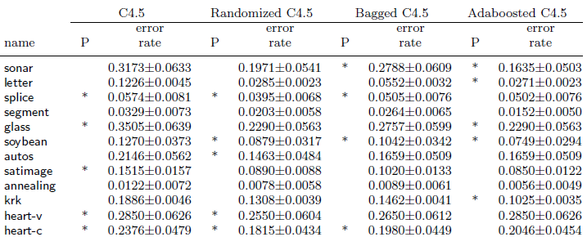
How good is adaboost?

Slide 41
Usually better than bagging
Almost always better than not doing anything
Used in many real applications – eg. The Viola/Jones face detector, which is used in many real-world surveillance applications

Slide 42
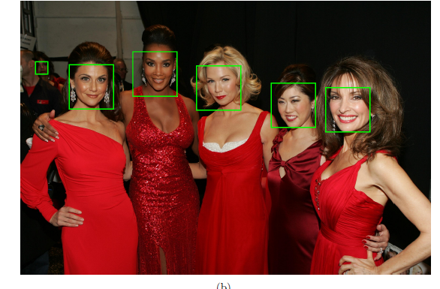
Viola-Jones face detector
http://www.ipol.im/pub/art/2014/104/

Slide 43
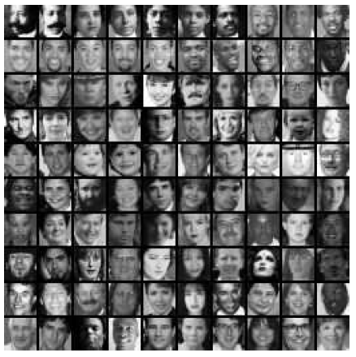
Viola-Jones face detector

Slide 44
Viola-Jones face detector

Slide 45
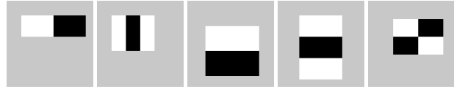
Viola-Jones face detector

Slide 46




The Viola-Jones detector is a cascade of simple ‘decision stumps’
C1
W1=0.69
C2
W2=0.35
C3
W3=0.8
~C40
W5=0.9
…
< 0.8
> 1.4
< 0.3
< 0.7

Slide 47
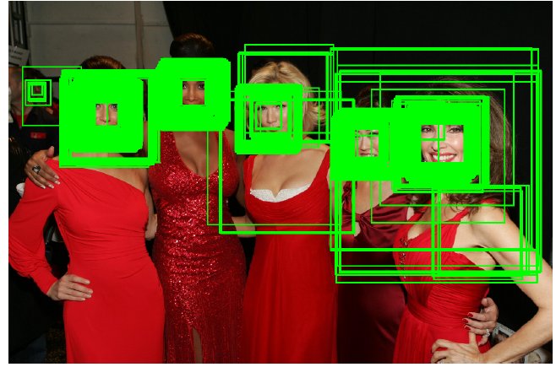
The Viola-Jones detector is a cascade of simple ‘decision stumps’
C1
W1=0.69
C2
W2=0.35
C3
W3=0.8
~C40
W5=0.9
…
< 0.8
> 1.4
< 0.3
< 0.7

Slide 48

Later

Slide 49
Adaboost: constructing next dataset from previous

Slide 50
Adaboost: constructing next dataset from previous
Each instance i has a weight D(i,t) in round t.
D(i, 1) is always normalised, so they add up to 1
Think of D(i, t) as a probability – in each round, you
can build the new dataset by choosing (with
replacement) instances according to this probability
D(i, 1) is always 1/(number of instances)

Slide 51
Adaboost: constructing next dataset from previous
D(i, t+1) depends on three things:
D(i, t) -- the weight of instance i last time
- whether or not instance i was correctly
classified last time
w(t) – the weight that was worked out for
classifier t

Slide 52
Adaboost: constructing next dataset from previous
D(i, t+1) is
D(i, t) x e^{−w(t)} if correct last time
D(i, t) x e^{w(t)} if incorrect last time
(when done for each i , they won’t
add up to 1, so we just normalise them)

Slide 53
Why those specific formulas for the classifier weights and the instance weights?

Slide 54
Why those specific formulas for the classifier weights and the instance weights?
Well, in brief ...
Given that you have a set of classifiers with different
weights, what you want to do is maximise:
where yi is the actual and pred(c,i) is the predicted
class of instance i, from classifier c, whose weight is w(c)
Recall that classes are either -1 or 1, so when predicted
Correctly, the contribution is always +ve, and when incorrect
the contribution is negative

Slide 55
Why those specific formulas for the classifier weights and the instance weights?
Maximising that is the same as minimizing:
... having expressed it in that particular way, some
mathematical gymnastics can be done, which ends
up showing that an appropriate way to change the
classifier and instance weights is what we saw on
the earlier slides.

Slide 56
Further details:
Original adaboost paper:
http://www.public.asu.edu/~jye02/CLASSES/Fall-2005/PAPERS/boosting-icml.pdf
A tutorial on boosting:
http://www.cs.toronto.edu/~hinton/csc321/notes/boosting.pdf

