Slide 1
Evaluating optimization algorithms: bounds on the performance of optimizers on unseen problems
David Corne, Alan Reynolds

Slide 2
My wonderful new algorithm,
Bee-inspired Orthogonal Local Linear Optimal Covariance Kinetics Solver
Beats CMA-ES on 7 out of 10 test problems !!

Slide 3
My wonderful new algorithm,
Bee-inspired Orthogonal Local Linear Optimal Covariance Kinetics Solver
Beats CMA-ES on 7 out of 10 test problems !!
SO WHAT ?

Slide 4
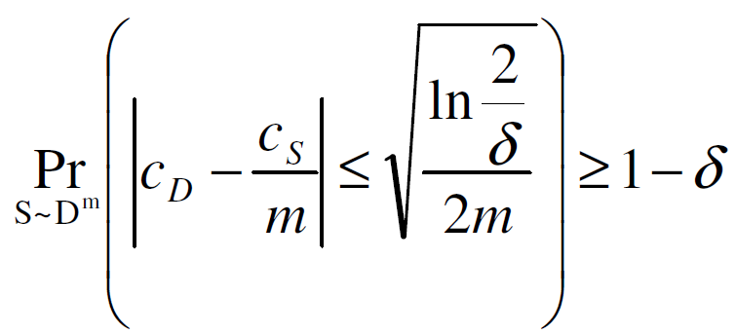
Upper& Lower test set bounds - Langford’s approximation

Slide 5
Upper& Lower test set bounds - Langford’s approximation
Trained / Learned Classifier

Slide 6
Upper& Lower test set bounds - Langford’s approximation
Trained / Learned Classifier
Unseen Test set with m examples

Slide 7
Upper& Lower test set bounds - Langford’s approximation
Trained / Learned Classifier
Unseen Test set with m examples
Gives
Error rate C_{S}

Slide 8
Upper& Lower test set bounds - Langford’s approximation
Trained / Learned Classifier
Unseen Test set with m examples
Gives
Error rate C_{S}

Slide 9
Upper& Lower test set bounds - Langford’s approximation
Trained / Learned Classifier
Unseen Test set with m examples
Gives
Error rate C_{S}
True error C_{D} is bounded by [x, y] with prob 1―δ

Slide 10
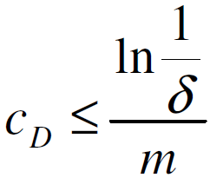
An easily digested special case
Suppose we get ZERO error on the test set. Then, for any given δ we can say the following is true with probability 1―δ :

Slide 11
Suppose unseen test set has m examples, and your classifier predicted all of them correctly. Here are the upper bounds on generalisation performance
 | 5 | 10 | 20 | 50 | 100 | 200 | 500
0.001 | 1 | 0.69 | 0.35 | 0.14 | 0.069 | 0.035 | 0.014
0.005 | 1 | 0.53 | 0.26 | 0.11 | 0.053 | 0.026 | 0.011
0.01 | 0.92 | 0.46 | 0.23 | 0.09 | 0.046 | 0.023 | 0.009
0.05 | 0.60 | 0.30 | 0.15 | 0.06 | 0.030 | 0.015 | 0.006
0.1 | 0.46 | 0.23 | 0.12 | 0.05 | 0.023 | 0.012 | 0.005

Slide 12
Learning theory → Reasoning about the performance of optimisers on a test suite

Slide 13
Learning theory → Reasoning about the performance of optimisers on a test suite
Suppose unseen test set has m examples, and your classifier predicted all of them correctly. Here are the upper bounds on generalisation performance
Suppose test problem suite has m problems, and your new algorithm A beats algorithm B on all of them ...

Slide 14
Learning theory → Reasoning about the performance of optimisers on a test suite
 | 5 | 10 | 20 | 50 | 100 | 200 | 500
0.001 | 1 | 0.69 | 0.35 | 0.14 | 0.069 | 0.035 | 0.014
0.005 | 1 | 0.53 | 0.26 | 0.11 | 0.053 | 0.026 | 0.011
0.01 | 0.92 | 0.46 | 0.23 | 0.09 | 0.046 | 0.023 | 0.009
0.05 | 0.60 | 0.30 | 0.15 | 0.06 | 0.030 | 0.015 | 0.006
0.1 | 0.46 | 0.23 | 0.12 | 0.05 | 0.023 | 0.012 | 0.005

Slide 15
http://is.gd/evalopt

Slide 16
http://is.gd/evalopt
99.9 99.5 99 95 90
0 0.498 0.411 0.369 0.258 0.205
1 0.623 0.544 0.504 0.394 0.336
2 0.718 0.648 0.611 0.506 0.449
3 0.795 0.735 0.702 0.606 0.551
4 0.858 0.809 0.781 0.696 0.645
5 0.91 0.871 0.849 0.777 0.732
6 0.95 0.923 0.906 0.849 0.812
7 0.978 0.962 0.952 0.912 0.884
8 0.995 0.989 0.984 0.963 0.945
9 1 1 0.998 0.994 0.989

Slide 17
http://is.gd/evalopt
Algorithm A beats CMA-ES on
7 of a suite of 10 test problems
99.9 99.5 99 95 90
0 0.498 0.411 0.369 0.258 0.205
1 0.623 0.544 0.504 0.394 0.336
2 0.718 0.648 0.611 0.506 0.449
3 0.795 0.735 0.702 0.606 0.551
4 0.858 0.809 0.781 0.696 0.645
5 0.91 0.871 0.849 0.777 0.732
6 0.95 0.923 0.906 0.849 0.812
7 0.978 0.962 0.952 0.912 0.884
8 0.995 0.989 0.984 0.963 0.945
9 1 1 0.998 0.994 0.989
We can say with 95% confidence
that it is better than CMA-ES on
>=40% of problems’in general’

Slide 19
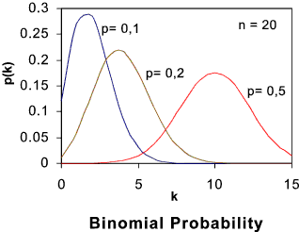
Test set error

Slide 20
NOTE
... The bounds are valid for problems that come from the same distribution as the test set ... (discuss)
if you trained on the problem suite, bounds are trickier (involving priors), but still possible to derive
Can use this theory base to derive appropriate parameters for experimental design, such as number of test probs, number of comparative algs, target performance

Slide 21
10 test problems, and you want to have 95% confidence that your alg is better than the other alg >50% of the time
99.9 99.5 99 95 90
0 0.498 0.411 0.369 0.258 0.205
1 0.623 0.544 0.504 0.394 0.336
2 0.718 0.648 0.611 0.506 0.449
3 0.795 0.735 0.702 0.606 0.551
4 0.858 0.809 0.781 0.696 0.645
5 0.91 0.871 0.849 0.777 0.732
6 0.95 0.923 0.906 0.849 0.812
7 0.978 0.962 0.952 0.912 0.884
8 0.995 0.989 0.984 0.963 0.945
9 1 1 0.998 0.994 0.989

Slide 22
10 test problems, and you want to have 90% confidence that your alg is better than the other alg >50% of the time
99.9 99.5 99 95 90
0 0.498 0.411 0.369 0.258 0.205
1 0.623 0.544 0.504 0.394 0.336
2 0.718 0.648 0.611 0.506 0.449
3 0.795 0.735 0.702 0.606 0.551
4 0.858 0.809 0.781 0.696 0.645
5 0.91 0.871 0.849 0.777 0.732
6 0.95 0.923 0.906 0.849 0.812
7 0.978 0.962 0.952 0.912 0.884
8 0.995 0.989 0.984 0.963 0.945
9 1 1 0.998 0.994 0.989

Slide 23
Evaluating optimization algorithms: bounds on the performance of optimizers on unseen problems
David Corne, Alan Reynolds

