Slide 1
Two topics in R:
Simulation and goodness-of-fit
HWU - GS

Slide 2
Some useful distributions
Used with insurance and financial data:
Exponential: Exp(λ)
Gamma(α,β)
Log-normal: LN(μ,σ²)
Weibull(ν,λ)
etc etc …

Slide 3

Exponential: Exp(λ)
$$Y\sim \text{Exp}\left(λ\right)$$
$$f\left(y\right)= λe^{−λy}, y,λ>0$$
$$E\left(Y\right)=1/λ, Var\left(Y\right)=1/λ^{2}$$
Can simulate in R using:
lambda = 2.0
y1 = rexp(200, rate = lambda)

Slide 4
Exp(λ) (cont.)
Distribution of values can then be plotted in R:
par(mfrow=c(1,2))
hist(y1, col="cyan",main="Histogram of Y1 ~ Exp(2)")
boxplot(y1, horizontal=T, col="cyan",main="Boxplot of Y1")

Slide 5
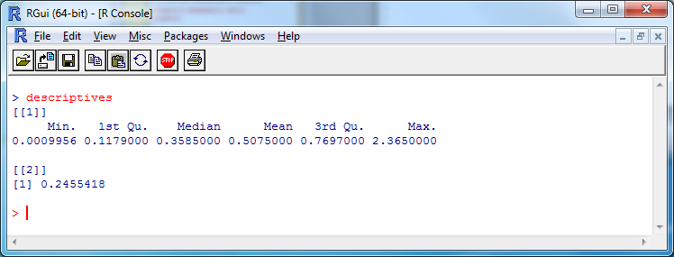
Exp(λ) (cont.)
And summary statistics can be computed:
descriptives <- list(summary(y1), var(y1))

Slide 6
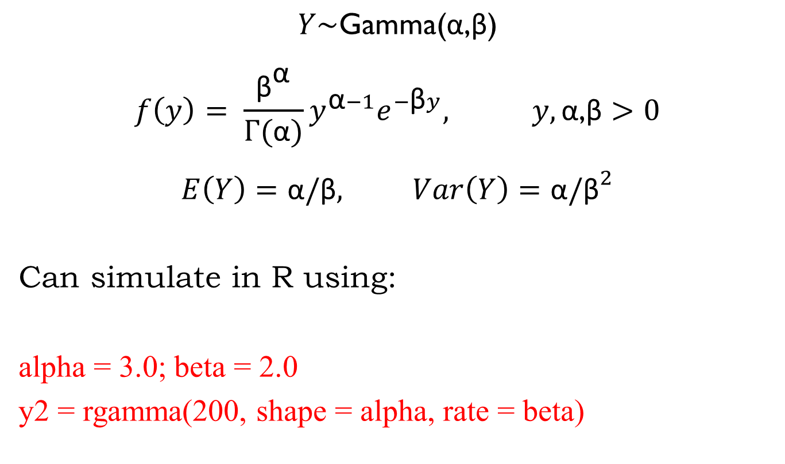
Gamma(α,β)
$$Y\sim \text{Gamma}\text{(}\text{α}\text{,}\text{β}\text{)}$$
$$f\left(y\right)= \frac{{\text{β}}^{\text{α}}}{Γ(\text{α})}{y^{\text{α}−1}e}^{−\text{β}y}, y,\text{α}\text{,}\text{β}>0$$
$$E\left(Y\right)=\text{α}/\text{β}, Var\left(Y\right)=\text{α}/{\text{β}}^{2}$$
Can simulate in R using:
alpha = 3.0; beta = 2.0
y2 = rgamma(200, shape = alpha, rate = beta)

Slide 7
Gamma(α,β) (cont.)
To obtain
> descriptives
[[1]]
Min. 1st Qu. Median Mean 3rd Qu. Max.
0.07146 0.84280 1.32800 1.46500 1.81000 4.29400
[[2]]
[1] 0.7236336

Slide 8
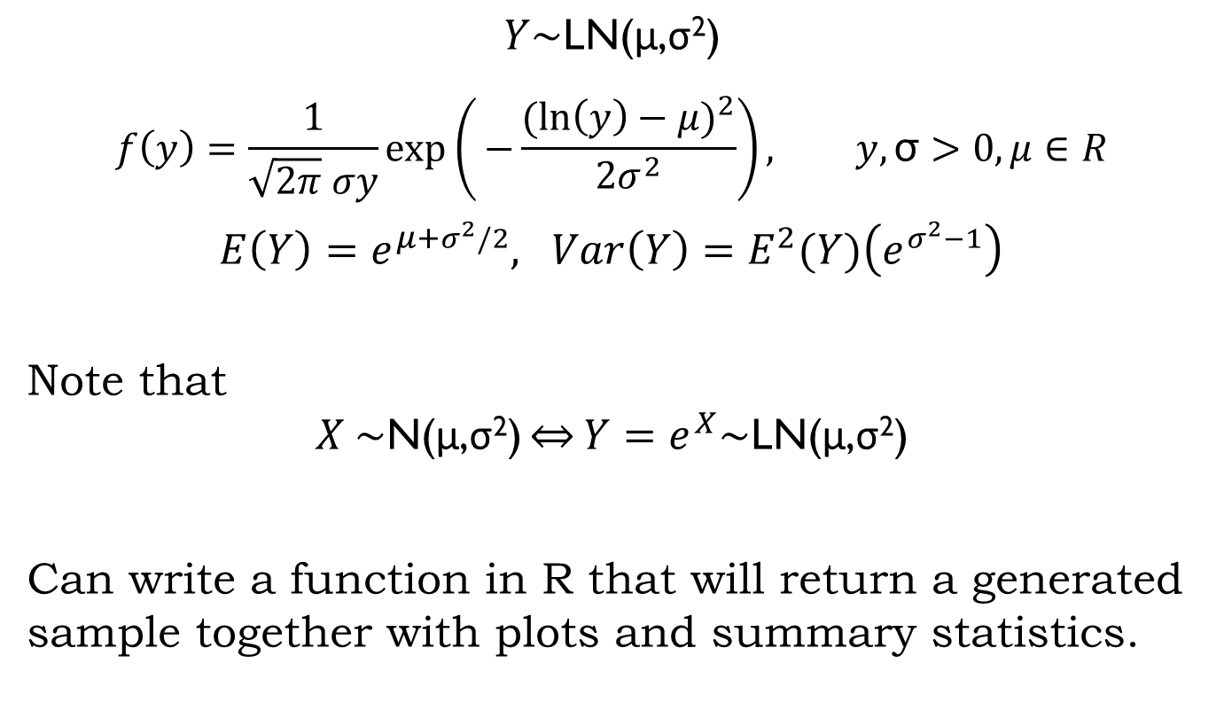
Log-normal: LN(μ,σ²)
$$Y\sim \text{LN}\text{(}\text{μ}\text{,}\text{σ}\text{2}\text{)}$$
$$f\left(y\right)=\frac{1}{\sqrt{2π} σy}exp\left(⁡−\frac{{(\ln\left(y\right)−μ)}^{2}}{2σ^{2}}\right), y,\text{σ}>0, μ∈R$$
$$E\left(Y\right)=e^{μ+σ^{2}/2}, Var\left(Y\right)=E^{2}(Y)\left(e^{σ^{2}−1}\right)$$
Note that
$$X \sim \text{N}\text{(}\text{μ}\text{,}\text{σ}\text{2}\text{)}\overset{⇔}{}Y=e^{X}\sim \text{LN}\text{(}\text{μ}\text{,}\text{σ}\text{2}\text{)}$$
Can write a function in R that will return a generated sample together with plots and summary statistics.

Slide 9
Log-normal: LN(μ,σ²) (cont.)
simulate.ln.f <- function(n,mu,sigma2){
y3 = exp(rnorm(n, mean=mu, sd=sqrt(sigma2)))
#
par(mfrow=c(1,2))
hist(y3, col="cyan",
main=paste("Histogram of Y3 ~ LN(", mu, ",", sigma2,")"))
boxplot(y3, horizontal=T, col="cyan",main="Boxplot of Y3")
#
descriptives <- list(summary(y3), var(y3));
#
return(descriptives)
}

Slide 10
Log-normal: LN(μ,σ²) (cont.)
> simulate.ln.f(n=200, mu=0, sigma2=0.1)
[[1]]
Min. 1st Qu. Median Mean 3rd Qu. Max.
0.4495 0.8096 0.9791 1.0490 1.2250 2.2520
[[2]]
[1] 0.1084844

Slide 11
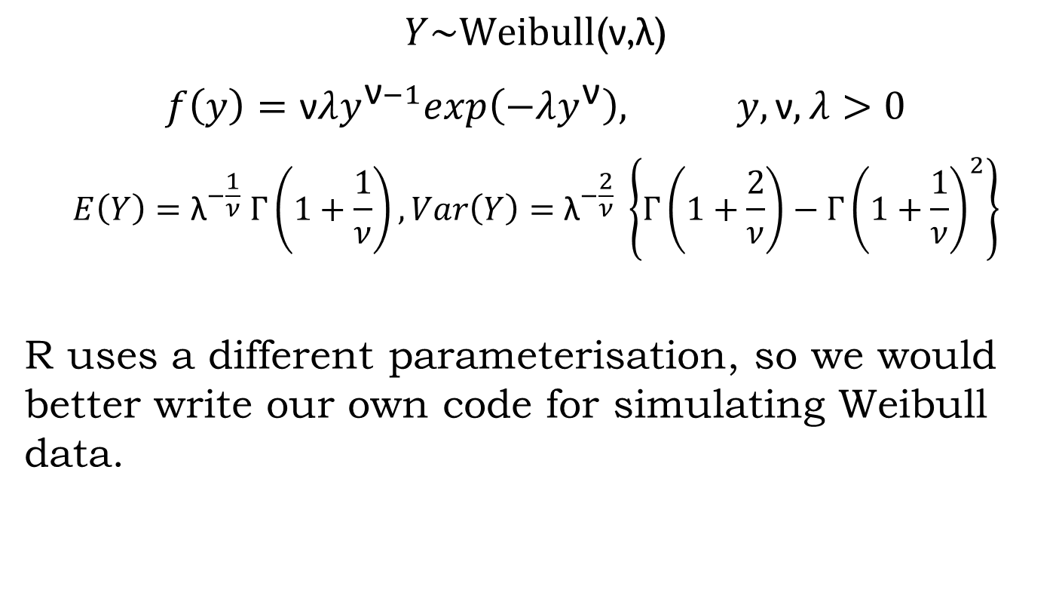
Weibull(ν,λ)
$$Y\sim \text{Weibull}\text{(}\text{ν}\text{,}\text{λ}\text{)}$$
$$f\left(y\right)=\text{ν}λy^{\text{ν}−1}exp\left(−λy^{\text{ν}}\right), y,\text{ν},λ>0$$
$$E\left(Y\right)={\text{λ}}^{−\frac{1}{ν}} Γ\left(1+\frac{1}{ν}\right), Var\left(Y\right)={\text{λ}}^{−\frac{2}{ν}} \left\{Γ\left(1+\frac{2}{ν}\right)−{Γ\left(1+\frac{1}{ν}\right)}^{2}\right\}$$
R uses a different parameterisation, so we would better write our own code for simulating Weibull data.

Slide 12
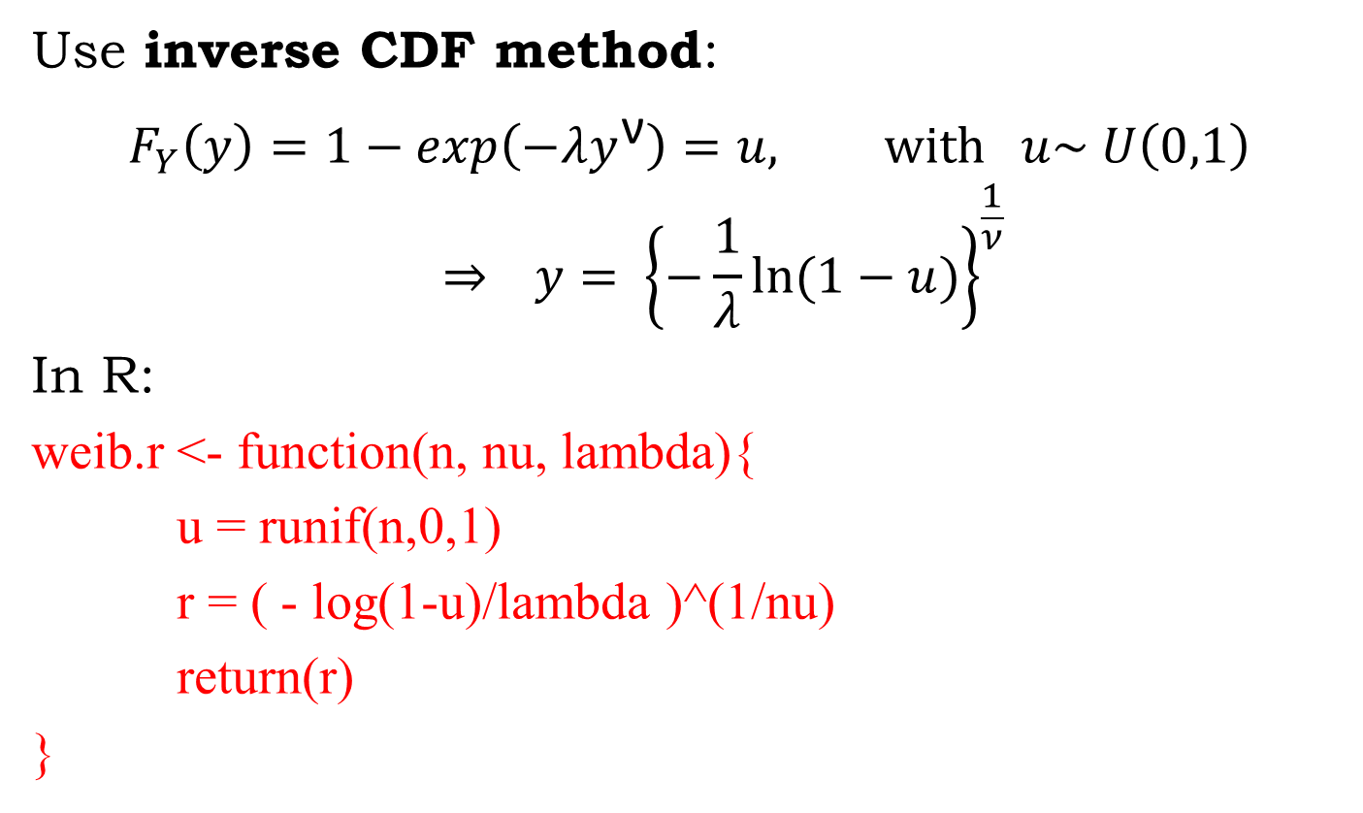
Weibull(ν,λ) (cont.)
Use inverse CDF method:
$$F_{Y}\left(y\right)=1−exp\left(−λy^{\text{ν}}\right)=u, \text{with} u\sim U\left(0,1\right)$$
$$\underset{⇒}{ } y= {\left\{−\frac{1}{λ}ln⁡(1−u)\right\}}^{\frac{1}{ν}}$$
In R:
weib.r <- function(n, nu, lambda){
u = runif(n,0,1)
r = ( - log(1-u)/lambda )^(1/nu)
return(r)
}

Slide 13
Weibull(ν,λ) (cont.)
And put all of this in a function:
simulate.weib.f <- function(n, nu, lambda){
y4 = weib.r(n,nu,lambda)
#
par(mfrow=c(1,2))
hist(y4, col="cyan”,
main=paste("Histogram of Y4 ~ Weib(", nu, ",", lambda,")"))
boxplot(y4, horizontal=T, col="cyan",main="Boxplot of Y4")
#
descriptives <- list(summary(y4), var(y4));
#
return(list(y4,descriptives))
}

Slide 14
Weibull(ν,λ) (cont.)
> simulate.weib.f(n=200, nu=2, lambda=0.5)
Min. 1st Qu. Median Mean 3rd Qu. Max.
0.0484 0.7738 1.1680 1.2510 1.6500 3.1460
[1] 0.425532

Slide 15
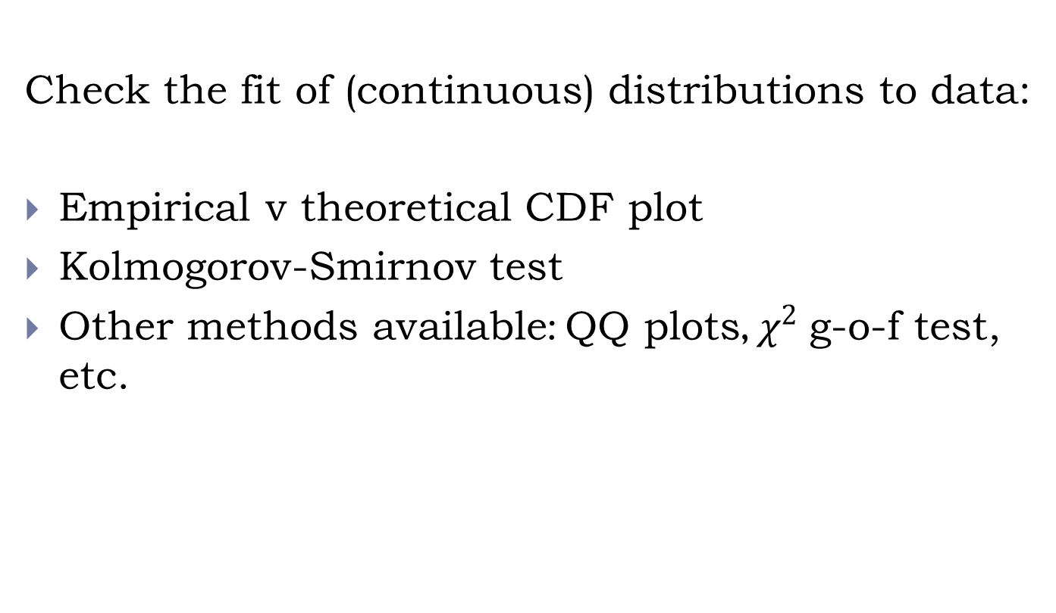
Goodness of fit

Slide 16
Empirical v theoretical CDF plot
Consider the Weibull(2, 0.5) example from before.
If the data are truly form this distn, then their empirical CDF should be close to the theoretical CDF of the Weibull(2, 0.5).
Plot these 2 in R and compare visually.

Slide 17
Empirical v theoretical CDF plot (cont.)
We will need the cdf of the Weibull distn:
weib.cdf <- function(q, nu, lambda){
cdf = 1- exp(-lambda*q^nu)
return(cdf)
}
Then generate some data:
weib.data = simulate.weib.f(n=200, nu=2, lambda=0.5)[[1]]

Slide 18
Empirical v theoretical CDF plot (cont.)
Then produce the plot:
grid.x = seq(min(weib.data), max(weib.data), length=100)
plot(grid.x,weib.cdf(grid.x,nu,lambda),type="l",col="red", ylim=c(0,1))
s = c(1:length(weib.data))
lines(sort(weib.data), s/length(weib.data), type="s")
legend("bottomright", legend=c("cdf","ecdf"),col=c("red","black"),lty=c(1,1))
title(main="Empirical v theoretical CDF")

Slide 19
Kolmogorov-Smirnov g-o-f test
We can quantify the significance of the difference between cdf and ecdf using the KS test.
H0: the data follow a specified (continuous) distn
v. H1: they don’t follow the specified distribution
Use test statistic:
Reject H0 at significance level α if D_{n} > critical value associated with the sampling distribution of D_{n} (obtained by tables) or use p-value provided in R.
More details in: Daniel, W.W. (1990) Applied nonparametric statistics, 2nd ed., PWS-Kent

Slide 20
Kolmogorov-Smirnov g-o-f test (cont.)
Put KS test and cdf/ecdf plot in a single R function:
ks.weib.f <- function(data, nu, lambda){
# Perform test
ks <- ks.test(data,weib.cdf,nu,lambda)
# Plot ecdf and cdf
grid.x = seq(min(data), max(data), length=100)
par(mfrow=c(1,1))
plot(grid.x, weib.cdf(grid.x,nu,lambda), type="l",col="red", ylim=c(0,1))
s = c(1:length(data))
lines(sort(data),s/length(data), type="s")
title(main="Empirical v theoretical CDF")
legend("bottomright", legend=c("cdf","ecdf"),col=c("red","black"),lty=c(1,1))
#
return(ks)
}

Slide 21
Kolmogorov-Smirnov g-o-f test (cont.)
Run it for some data:
> weib.data = simulate.weib.f(n=200, nu=2, lambda=0.5)[[1]]
> ks.weib.f(weib.data, nu=2, lambda=0.5)
One-sample Kolmogorov-Smirnov test
D = 0.0428, p-value = 0.8573

Slide 22
Kolmogorov-Smirnov g-o-f test (cont.)
Run it for a different distribution:
> weib.data = simulate.weib.f(n=200, nu=2, lambda=0.5)[[1]]
> ks.weib.f(weib.data, nu=2, lambda=0.4)
One-sample Kolmogorov-Smirnov test
D = 0.1533, p-value = 0.0001663

