Slide 1
ICCEs I, II and Sabrac
Computer Conservation Society
Science Museum
London
16 December 1999
M M Lehman
Department of Computing
Imperial College of Science Technology and Medicine
London SW7 2BZ
+44 207 594 8214
fax. +44 207 594 8215
mml@doc.ic.ac.uk
http://www-dse.doc.ic.ac.uk/~mml/

Slide 2
Pre-history - ICCE I
1947 - (Prof.) Tony Brooker on his appointment as an Assistant Lecturer charged by Prof. Hyman Levy with development of a "computing engine"
1949 - 20-bit AU, based on Siemens relays, operational
Tony then left IC to join Prof. Maurice Wilkes in Cambridge and later Drs Newman and Turing in Manchester
(Prof.) Sid Michaelson appointed in his place to continue development of ICCE I
Was joined by shortly thereafter by Dr Keith Tocher, statistician, numerical analyst, calculating machine enthusiast, to build a programmable computer around the AU
1953-7 - ICCE I operational and successfully applied to engineering problems
Even before ICCE I was fully operational a decision had been taken to construct a thermionic successor, ICCE II

Slide 3
Main ICCE I Features
"Microprogrammed" asynchronous control, separate instruction and data storage (see refs. Tocher 52, Wilkes 53)
Two 20 & 7 bit parallel binary fixed point AU units operating jointly or separately as required
4 arithmetic operators plus shift for long numbers, no division for short numbers
Instruction structure: variable-length (7 bit bytes) with variable number of addresses as determined by direct bit -interpretation
Other instructions to perform series of or special operations
Punched tape instruction storage with means for repeated execution of instruction sequences on successive sets of numbers
12 each, 20 and 6 bit relay registers
20 bit punched tape number storage plus 80 stored common constants
Punched card data input and output
About 2000 relays, two dozen uniselectors

Slide 4
Getting Involved
1950 - After ten years with Murphy Radio and having gained C&G Ordinary and Higher National Certificates in Electronics in evening studies I joined IC to read Mathematics
1953 - Award of an IEE Ferranti research scholarship combined with my maths and electronics interests suggested my joining the ICCE group
Tocher accepted me as his research student and suggested a look at the overall design with initial focus on logical and circuit design of ICCE II AU
Ground rule: Architectural features of ICCE I to be retained except where changes arising from use of electronic components could be shown to be beneficial and feasible and within the limited available budget
Funds relatively very limited

Slide 5
Underlying Design Concepts of ICCE II, Phase 1
Extension of ICCE I architectural concepts with main focus on major performance improvements
In particular, microprogrammed asynchronous control, separate instruction and data storage, variable length instruction structure with 8 bit bytes
Twin autonomous, 32 & 7 bit parallel binary fixed point AU units
Program input: punched strips in frame
Thermionic with about1000 modular 3 valve (2 x double triodes, 1 pentode) plug-in units
~400 valves for AU + control, < 600 for remainder of phase 1 machine

Slide 6
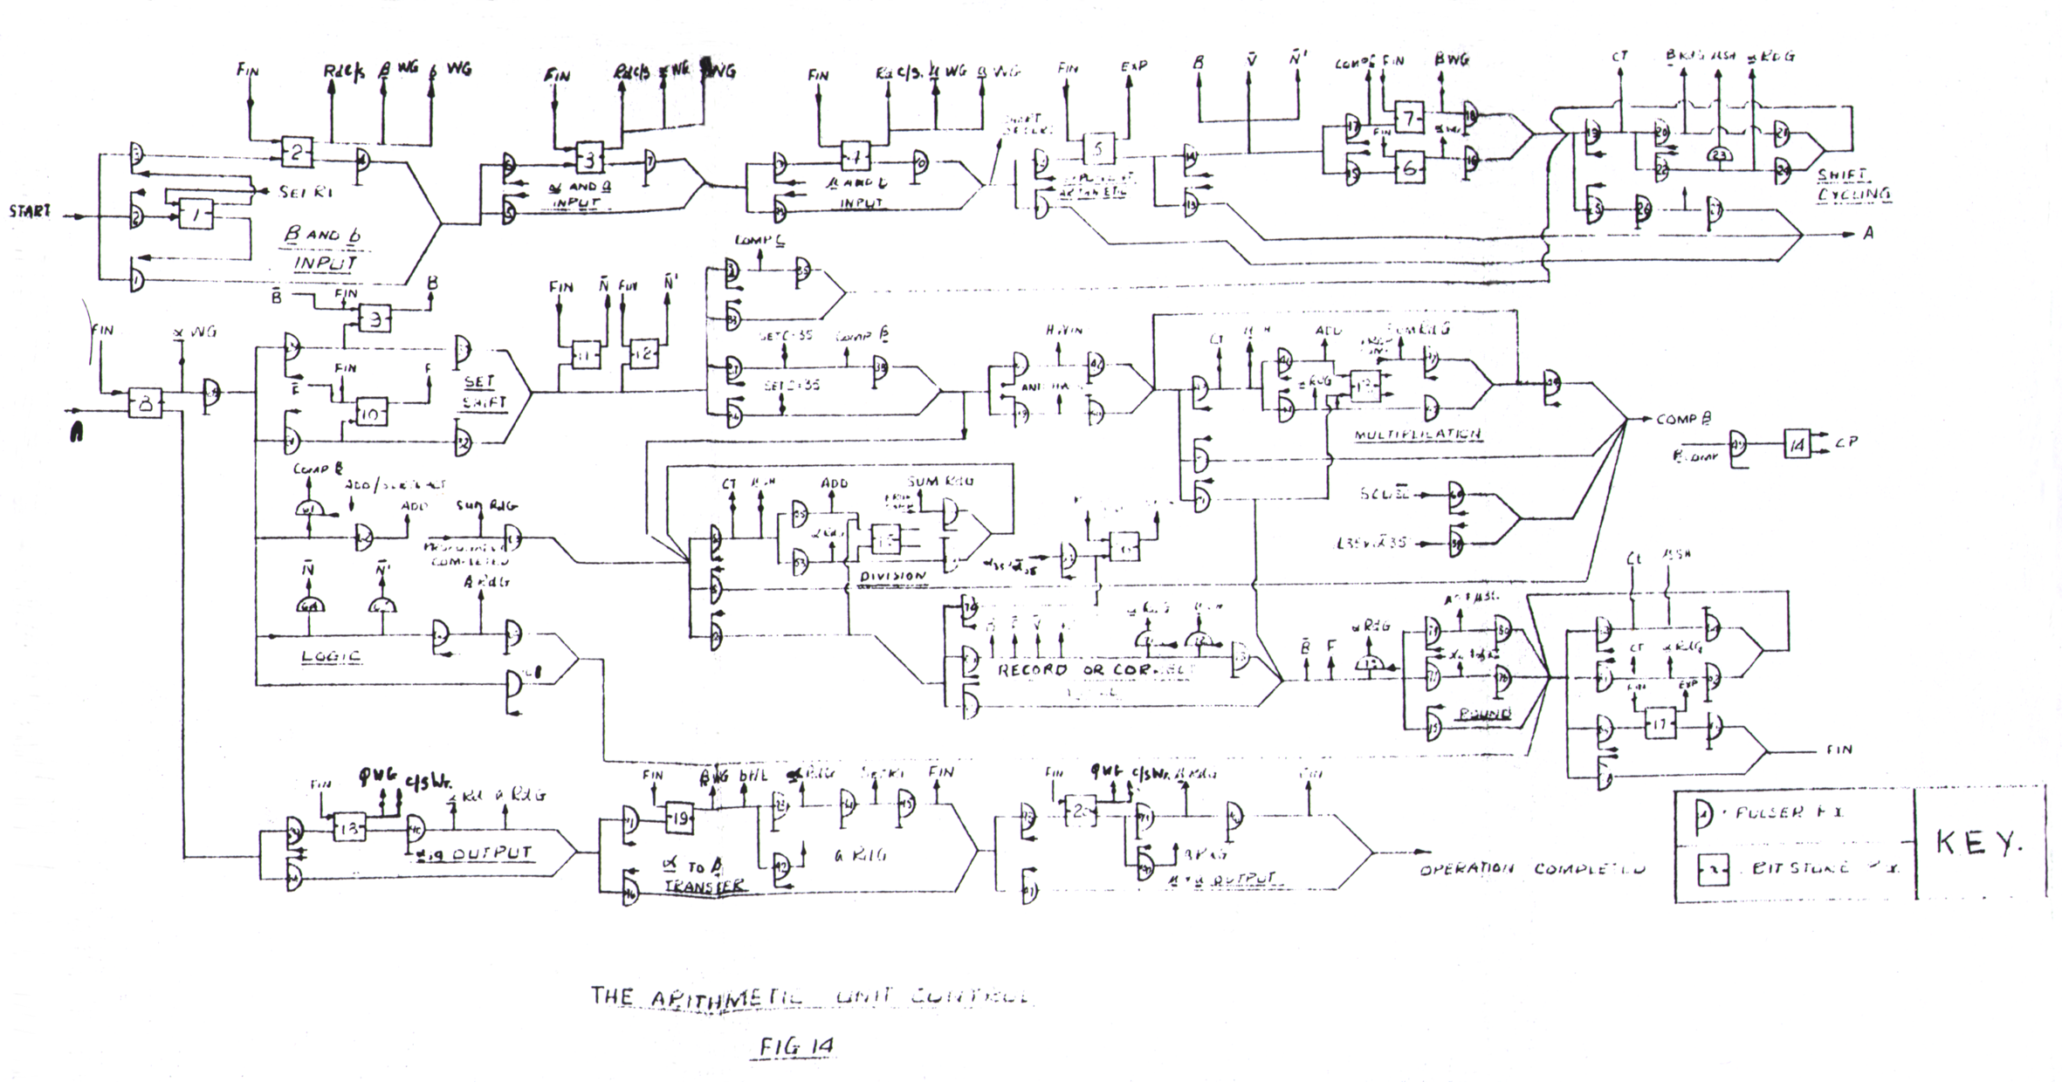
ICCE II Long Arithmetic Unit Logic
Switching/gate speeds - 1 µsec to yield:
Addition/subtraction: 3.5 µsec, Modified short cut multiplic.: 40 - 160 µsec
Short cut division: 130 - 240 µsec Shifts: 1.2 µsec / bit

Slide 7
ICCE II, Phase 2 Planned Extension
Fixed and floating (36 bit mantissa + 12 bit exponent) point arithmetic
Variable address 12 bit per byte instructions to facilitate use of 64x64 core data store and additional functional capabilities -
  - 5 bits provide direct selection of alternative versions of instructions such as :
  rounded/unrounded
  fixed/floating
  single/double length
  address modification (~B-line)
  number of address modifiers
Improved circuitry
1956 - All these plans came to nothing with the retirement of Levy and the appointment of a new HoD who, believing that "Mathematicians should not get their hands dirty", shut down the project
Meanwhile I had obtained my PhD

Slide 8
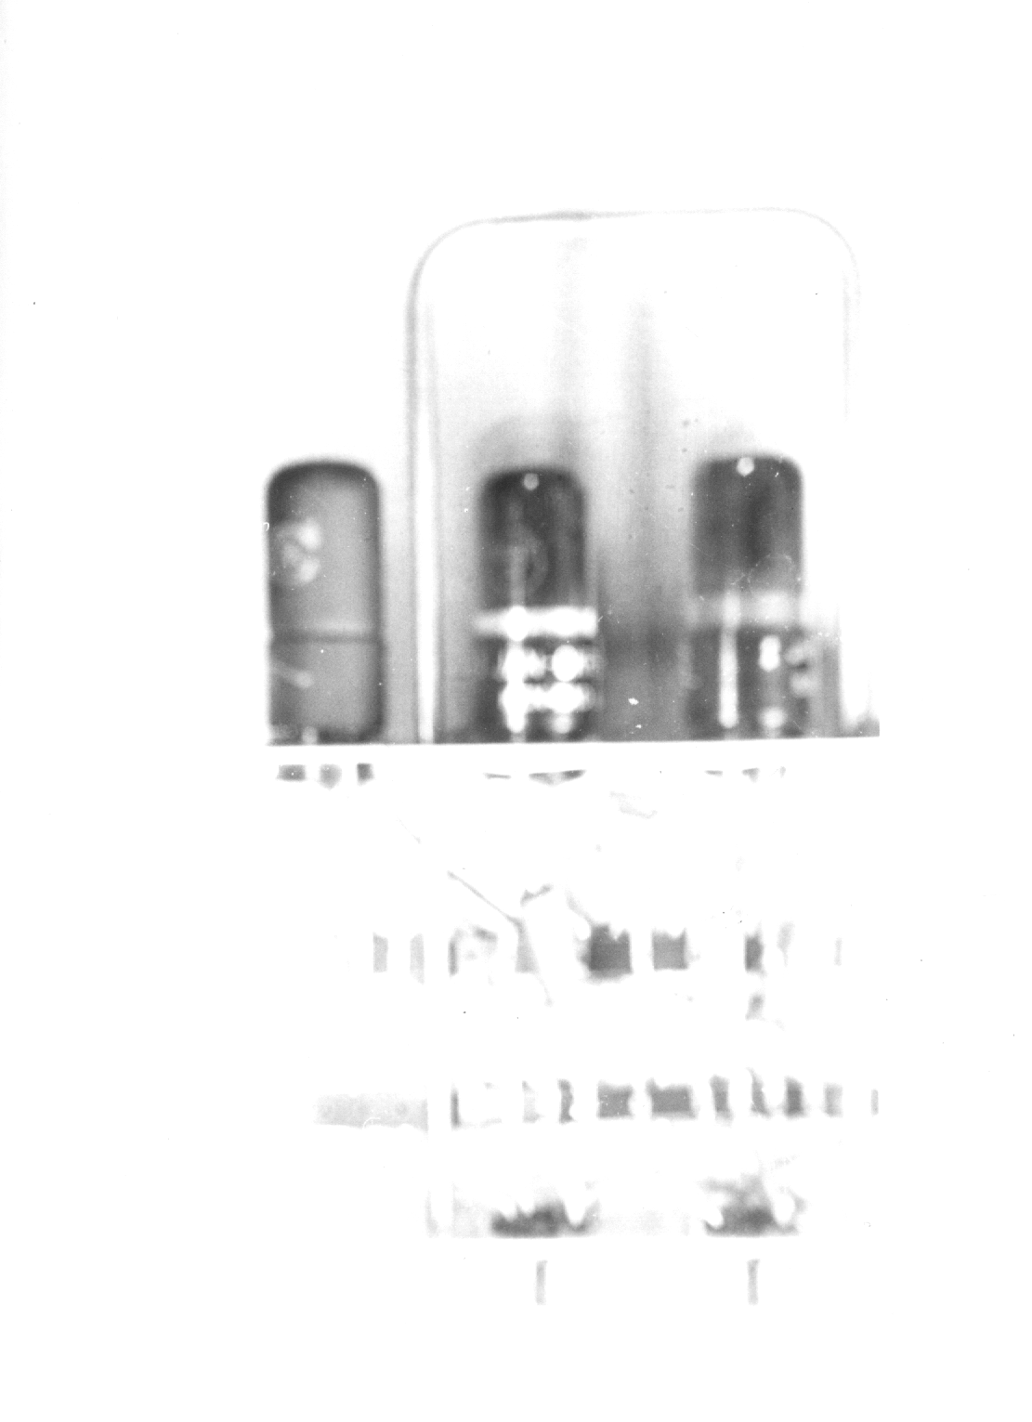
ICCE II Flip Flop Store

Slide 9
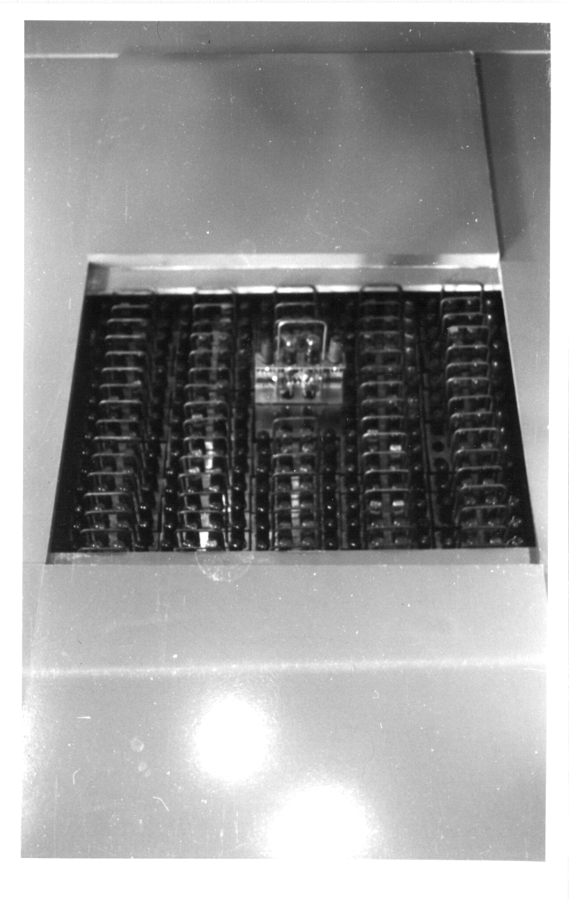
ICCE II Plug In Units

Slide 10
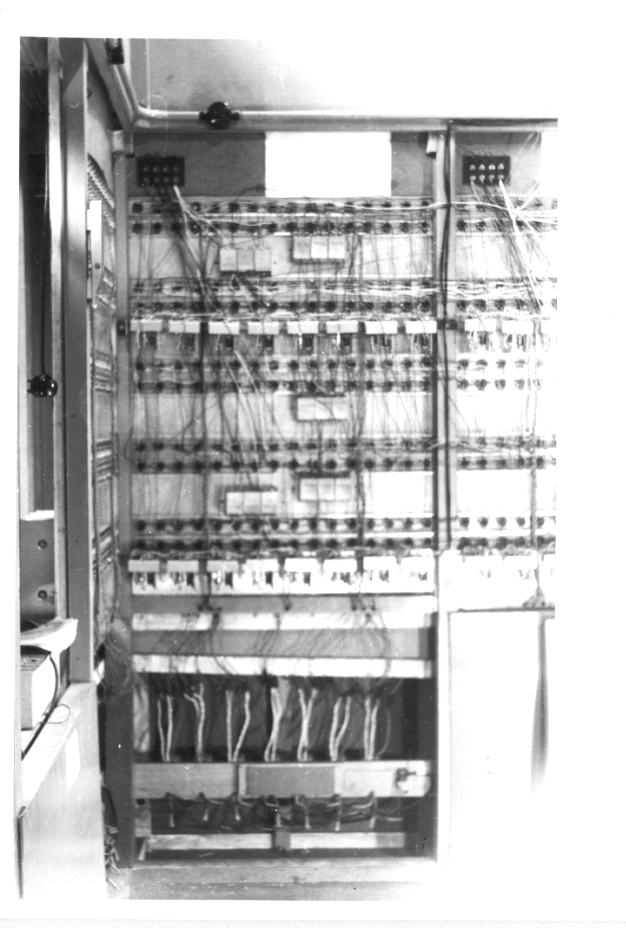
ICCE II Arithmetic Unit Back Plane

Slide 11
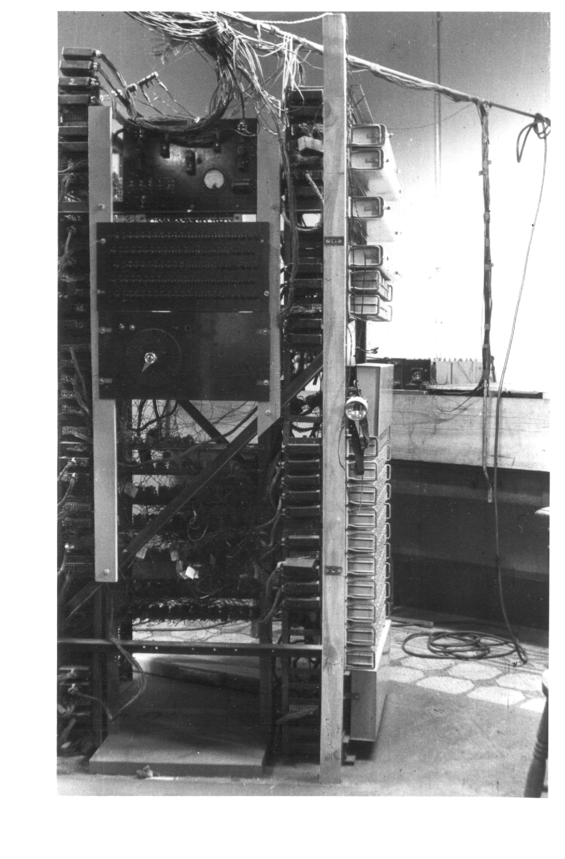
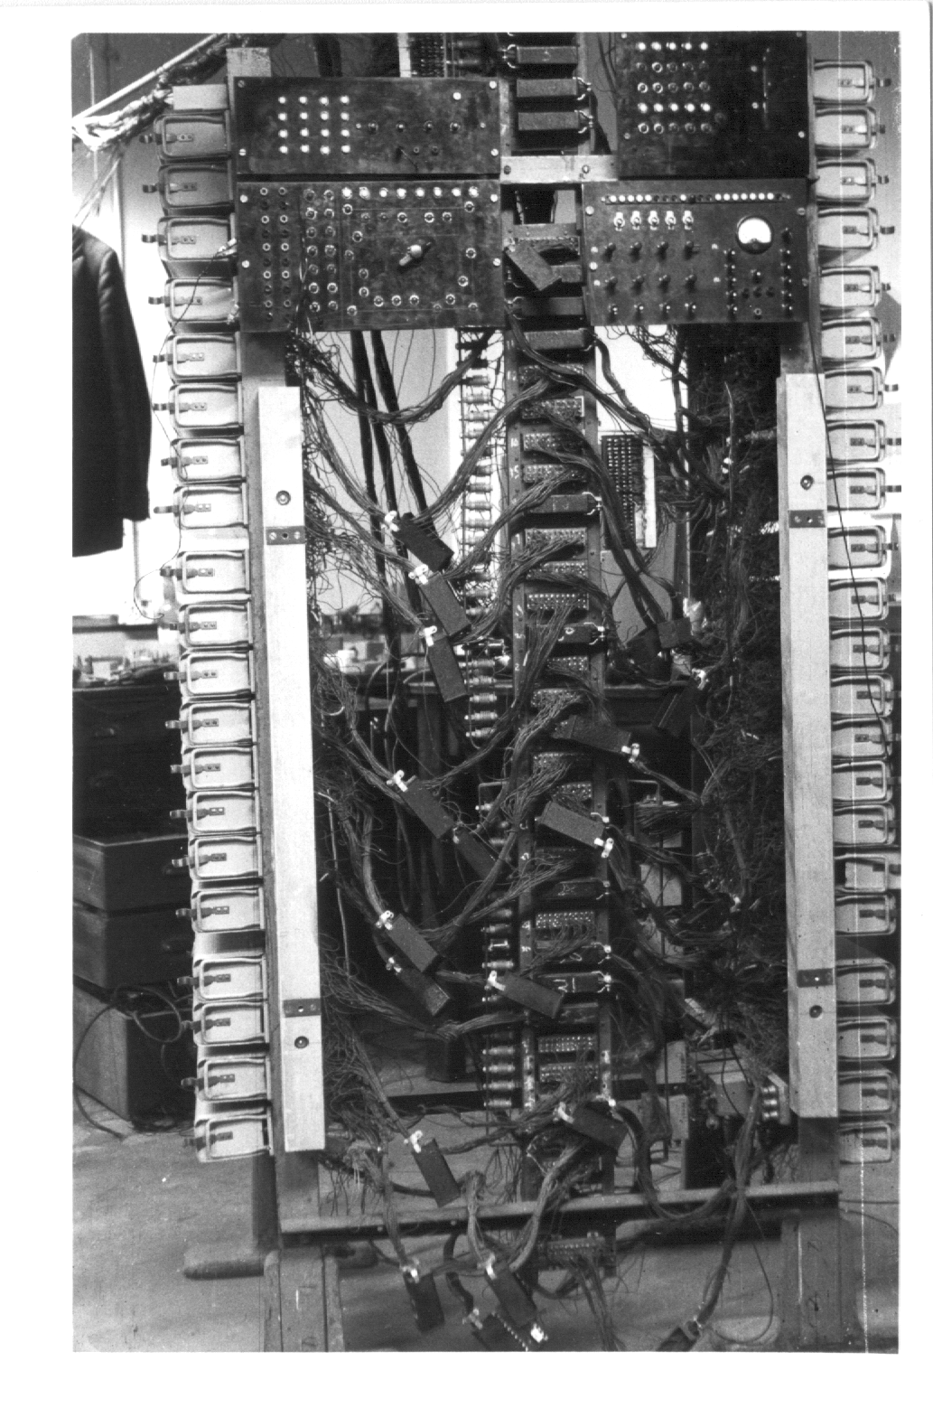
ICCE II Power Supply

Slide 12
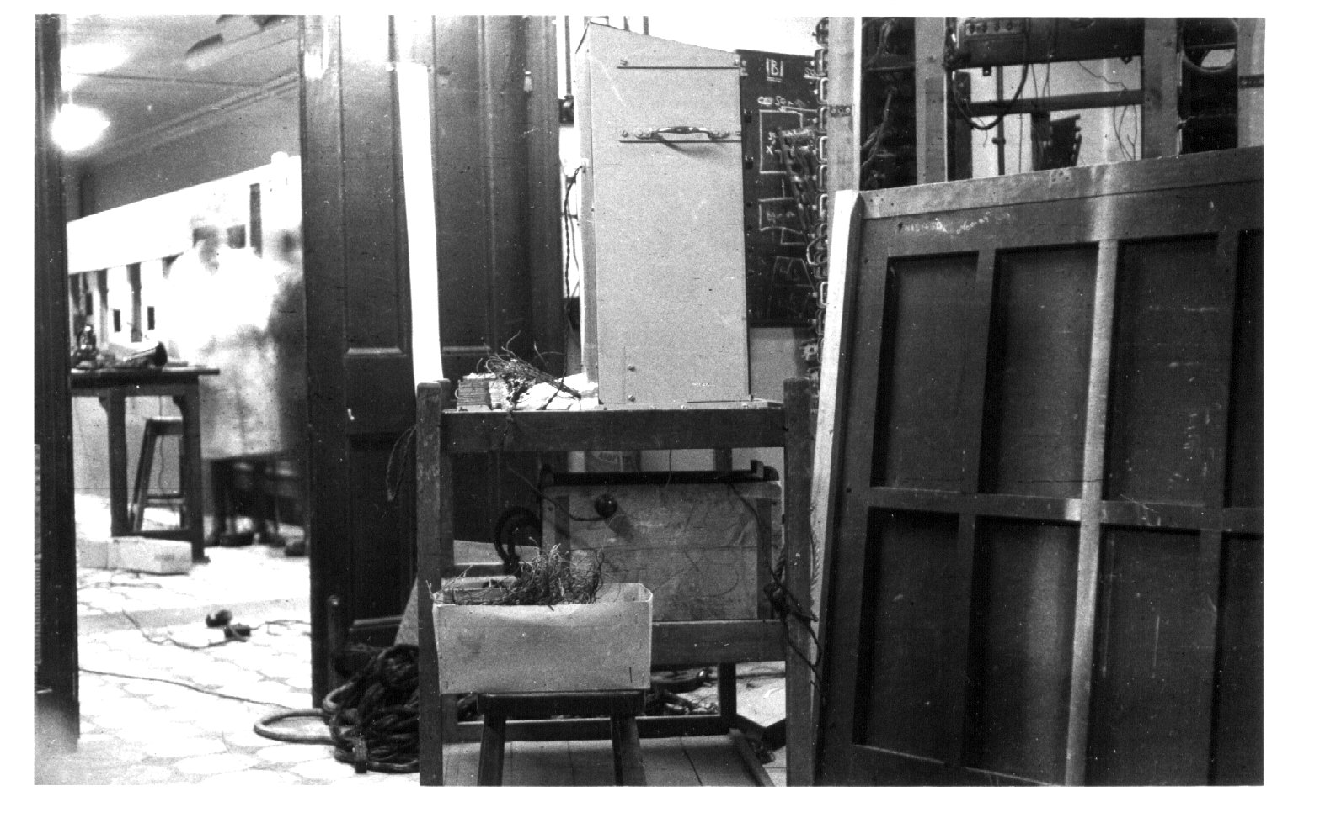
General View of ICCE II

Slide 13
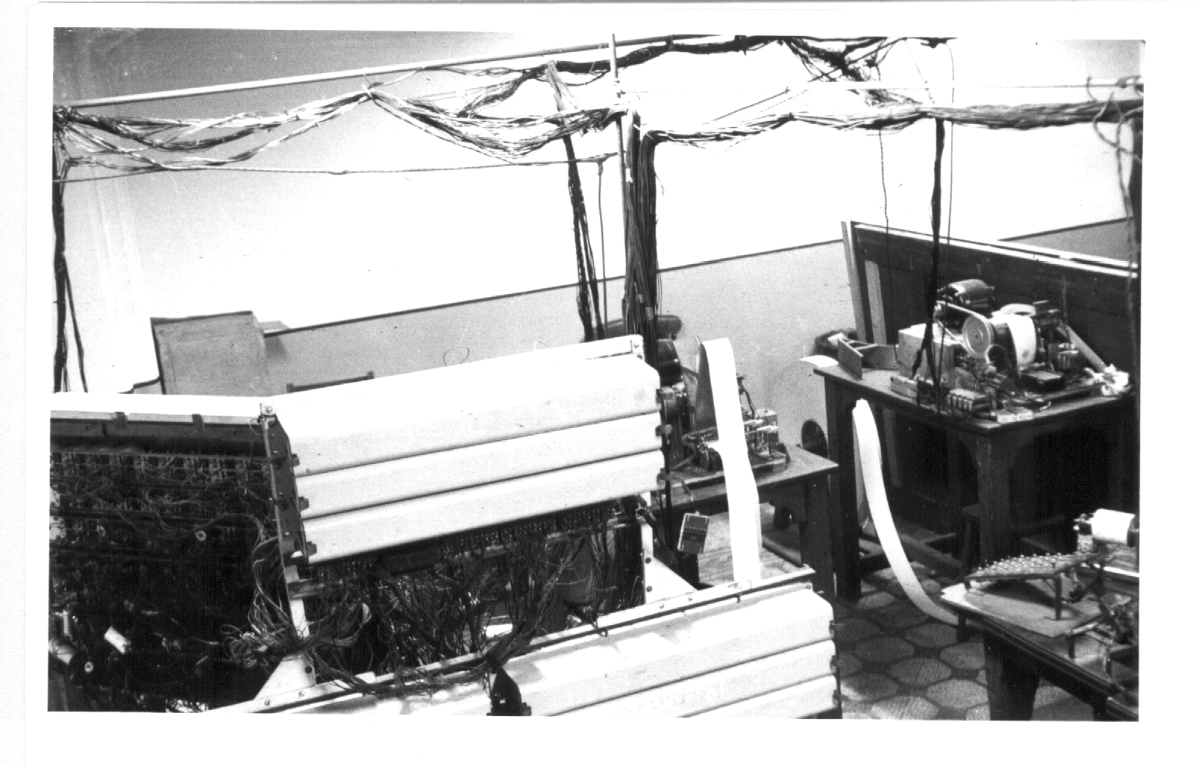
ICCE II I/O

Slide 14
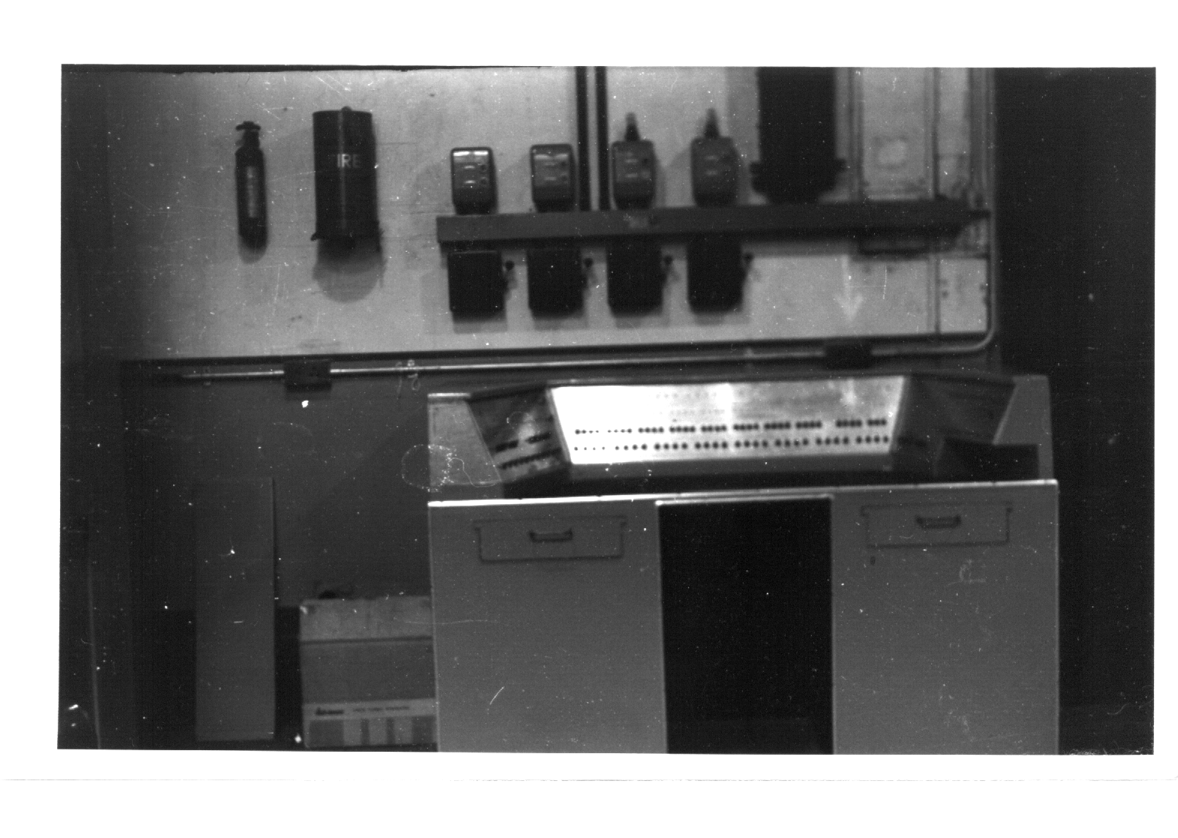
ICCE II Console

Slide 15
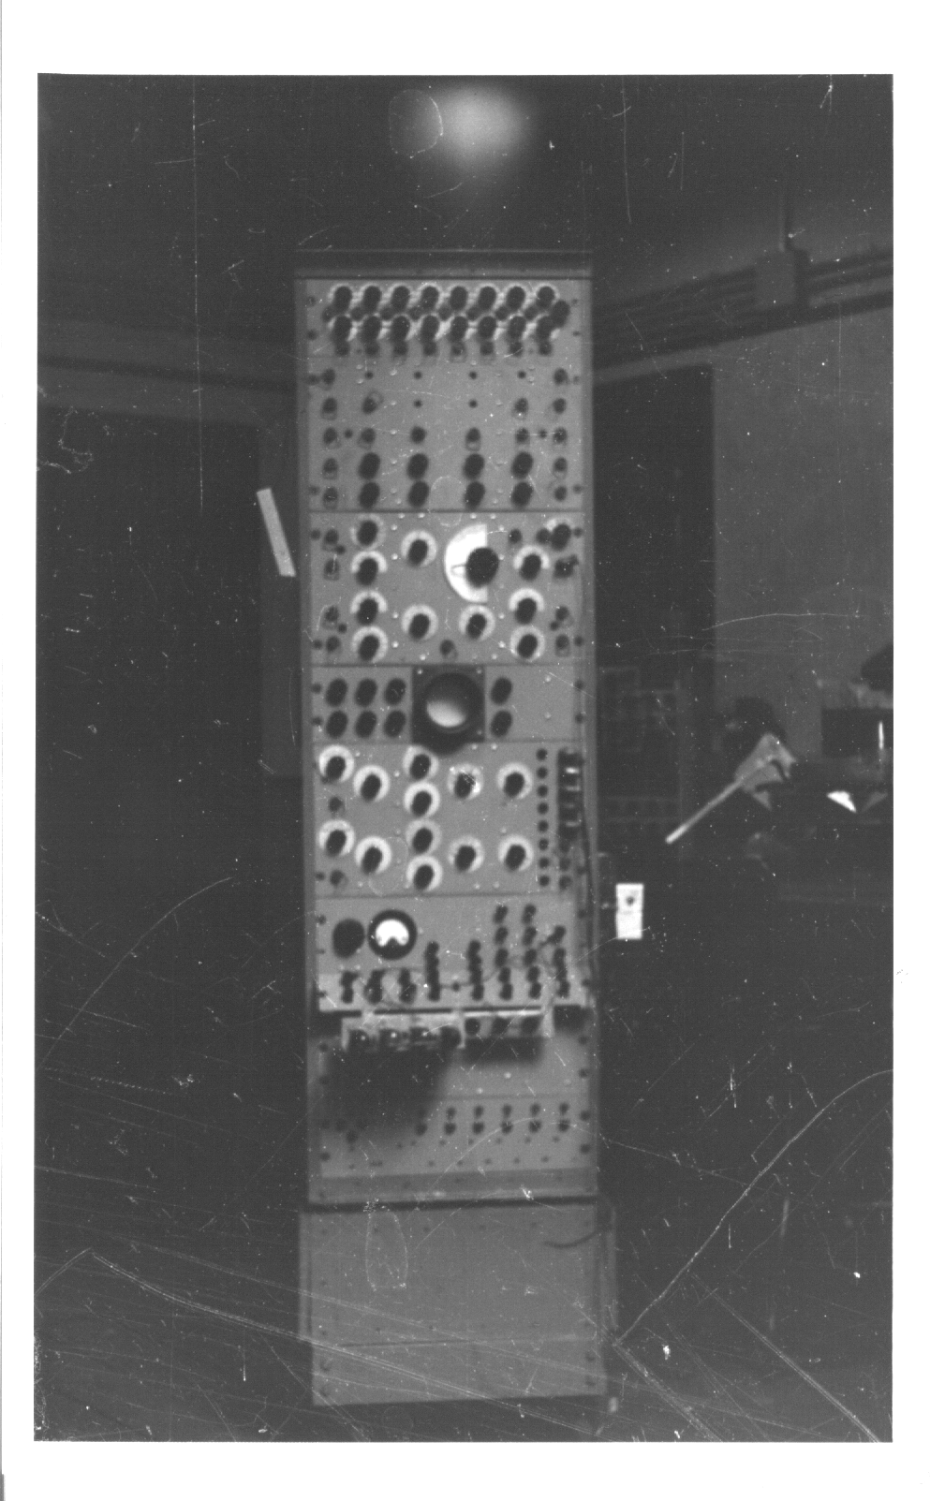
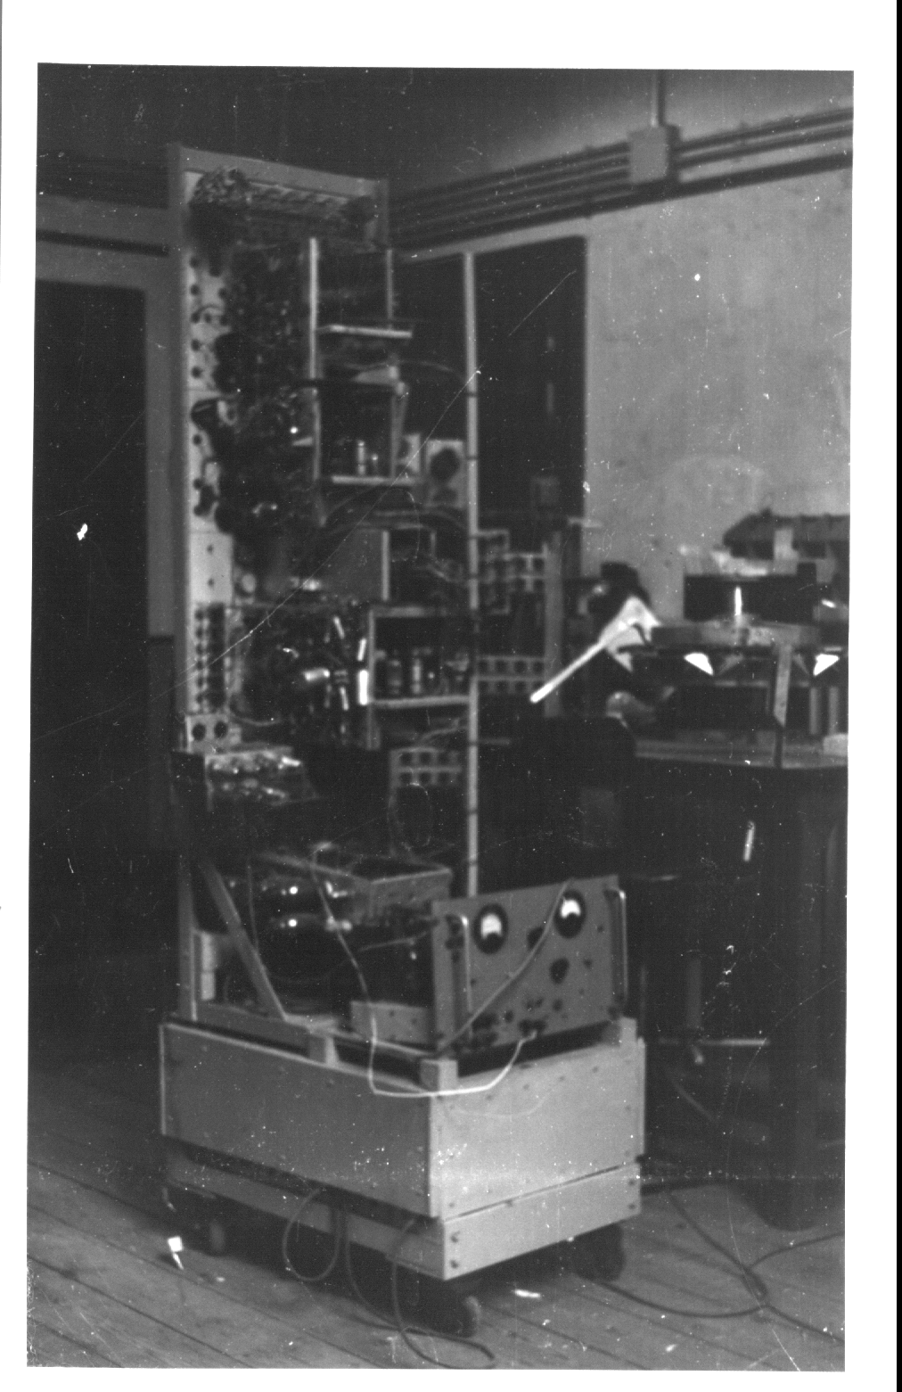
ICCE II Test Rig - Variable Pulse Generator

Slide 16
Historical Summary
Shoestring budget
Late 1953 - start of circuit and logical design with myself full time and Tocher, Michaelson and technician all (very) part time
1954 - physical construction of room, console and racks and started
1955 - construction of plug-in units started
1956 - wiring of AU completed and awaiting initial tests
  PhD for thesis entitled "Arithmetic Units and their Control" but whose content addressed many other aspects of ICCE II
1956/7 - project forcibly terminated
Shortly thereafter Tocher resigned joining Stafford Beer of the Cybernetics group of British Steel
Michaelson resigned in 1963 joining the U. of Edinburgh

Slide 17
Sabrac - Historical Introduction
1957 - Invited to join Israeli MoD Scientific Department, (now Rafael, a privatised defence systems company) to set up a digital computer group
Had spent previous year at the Ferranti London Labs under Hugh Devonald, in Stan Gill's group, where I became familiar with Pegasus and Mercury
The Department had several years experience in the construction and operation of an analogue computer but none in the digital field
Only digital computer in Israel at that time was the Weizac, a locally constructed copy, of the Princeton Johniac
1958 - An outline proposal for the construction of a small computer was accepted and I was assigned two electrical engineering graduates as assistants and told to go ahead
No specific budget assigned, all purchases to come from a computer section budget in competition with the analogue computer and other projects

Slide 18
Features
Determined by limited funding expected to be available and fact that project was first Israeli use of transistors and printed circuits
110 kc serial, 36 bit, fixed point, asynchronous, 18 and 32 bit instructions
5120 drum store comprising 4096 word main storage and 1024 word library
224 word serial core store used as below to avoid need for optimum coding,
Two each I/O channels to 300c/s paper tape readers, and 110c/s punches feeding a teleprinter or 300 points/sec plotter
Parallel execution: I/O or core/drum transfer + multiplication/division + other instruction
Eight flip flop registers each available for shifting, as accumulator or address modification with some assigned specific roles - eg. multiplication, division
Seven index and one second modifier register for relative addressing
Eight one bit stores with various special functions and programmable access
Transistorised, printed circuit plug-in units

Slide 19
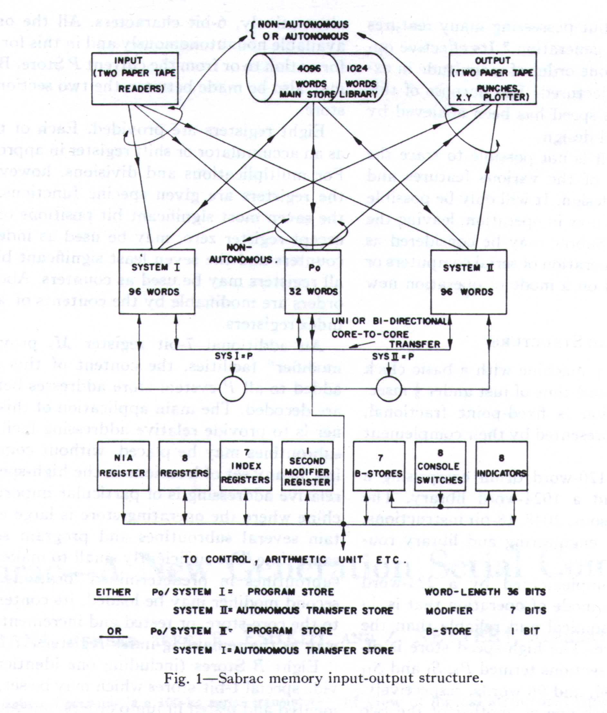
Sabrac Architecture
Input, drum store, output
Seven 32 word pages in
3 + 1 + 3 structure providing
sys. 1, Po (program), sys. 2
Page and variable length
transfer orders
Registers and register-like
devices including second
modifier

Slide 20
More Features
32 basic instructions, expanding to over 200 variations selected by three low order function bits, eg:
Execute to insert instruction sequence - derivative of ICCE insert
Machine defined by 630 equations in normal disjunctive form followed by delay or bit store
Cost of "speed-up" facilities
some 22% of the total
Reliability: In first year of operation the only malfunctions were due to two dry joints. Only one precautionary adjustment of clock and strobe generators

Slide 21
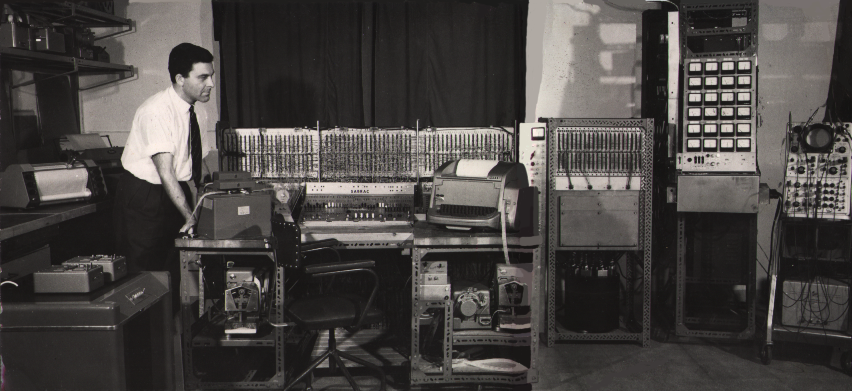
Sabrac
Final total component cost (1958 - 63 prices) under $25K of which more than $10K was for the magnetic drum
Machine believed to have been in daily use for over ten years
First real job, early in 1964 was design of the optical guidance system for Israel's first air to sea (or was it sea to air?) Gavriel guided missile

Slide 22
Acknowledgements and Thanks
Some Sabrac features were adaptations of or inherited from Pegasus and ICCE, many unconscious and difficult to isolate
I trust that, even if posthumously , this talk serves as recognition of and a tribute to, Tocher and Michaelson as pioneers who made significant contributions, not widely publicised and, hence, not widely known or acknowledged
TO Greg Michaelson of Herriot Watt U. who kindly scanned and provided the ICCE II photographs and also other information
To Siew Lim for scanning the Sabrac material and for "cleaning" and touching up the photographs and generally assissting with the preparation of the presentation
And last but not least, to Juan Ramil for his transfer of the slides from a safe and friendly Macintosh environment to the fragile and inhospitable domain of Windows and to him and Goel Kahen for their continuing support

Slide 23
References
ICCE
Tocher KD, Report on the Work of the Computer Group, Dept. of Maths., Imp. Col, London, 1952
Wilks MV and Stringer LJB, Micro-Programming and the Design of the Control Circuits in an Electronic Computer, Proc. Camb. Phil. Soc., vol 49, no. 2, 1953
Tocher KD, Proposed Code for ICCE II, Dept. of Maths., Imp. Col., London 1955
Tocher KD, Classification and Design of Operation Codes for Automatic Computers, Proc. IEE, 103B, Supplement 1, Apr. 1956
Tocher KD and Lehman MM, A Fast Parallel Arithmetic Unit, Proc. IEE 103B, Supplement 3, Apr. 1956, pp. 520 - 527
Lehman MM, Parallel Arithmetic Units and Their Control, PhD Thesis, University of London, Feb. 1957, 160pps.+
Lehman MM, Short-Cut Multiplication and Division in Automatic Binary Digital Computers with Special Reference to a New Multiplication Process, Proc. IEE, vol 105, Part B, No 23, Sept 1958 , pps. 496 - 504
Tocher KD, Techniques of Multiplication and Division for Automatic Binary Computers, Quart. J. of Mechanics and Appl. Maths., v. 11, p. 3, 1958, pps. 364 - 384
Cunningham RJ, Computing, in A Centenary History of the City & Guilds College, 1885 - 1985, ICST, 1984,
pp. 169 - 188
SABRAC
Lehman MM, Design Specification of a Cost Limited Digital Computer, Proc. Int. Conf. on Info. Proc., Paris, June 1959, UNESCO, Oldenbourg, Butterworth, Paris, 1960, pp. 365, 374
Lehman MM, Eshed R and Netter Z, SABRAC, A Time Sharing, Low-Cost Computer, Comm. ACM, vol. 6, no. 8, Aug 1963, pp. 427, 429
Lehman MM, Eshed R and Netter Z, SABRAC, A New Generation Serial Computer, with R Eshed and Z Netter, Comp. Sys. Iss., IEEE Trans. Electr. Comp., vol. 12, no. 5, Dec. 1963, pp. 618, 628

