Slide 1
The unique challenges of producing compilers for GPUs
Andrew Richards

Slide 2
The GPU is taking over from the CPU
Why? How?
And what does this mean for the compiler developer?

Slide 3
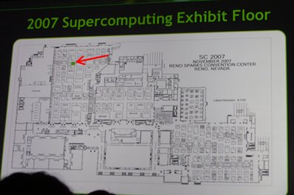
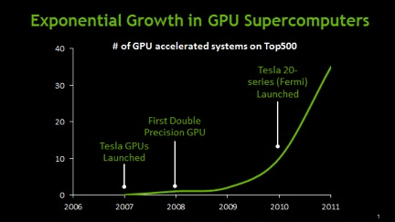
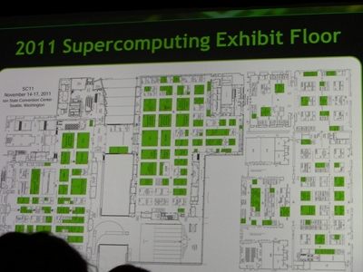
Growth of the GPU in HPC
GPU Computing taking over Supercomputing conference floor
Source: NVIDIA
http://blogs.nvidia.com/2011/11/gpu-supercomputers-show-exponential-growth-in-top500-list/

Slide 4
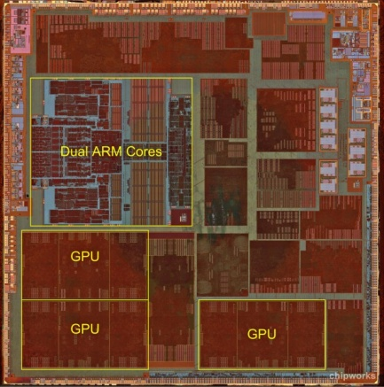
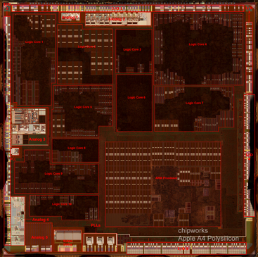
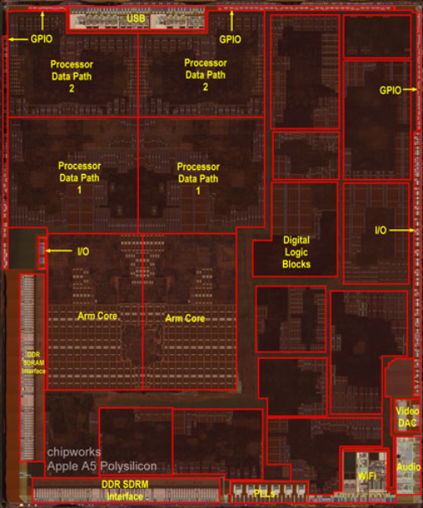
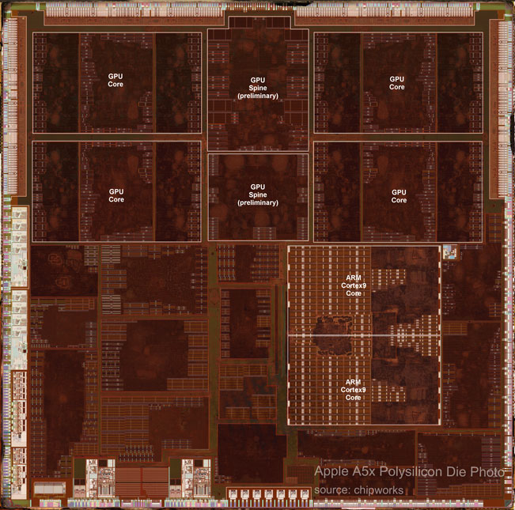
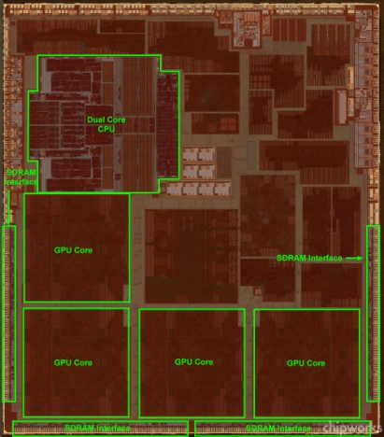
The growth of the GPU in mobile:
Apple’s A4-A6X
CPU
A6
GPU
GPU
GPU
GPU
CPU
CPU
GPU
CPU
A4
CPU
A5
GPU
A6X
Source: Chipworks
http://www.chipworks.com/en/technical-competitive-analysis/resources/recent-teardowns/2012/03/the-apple-a5x-versus-the-a5-and-a4-%E2%80%93-big-is-beautiful/
GPU
A5X

Slide 5
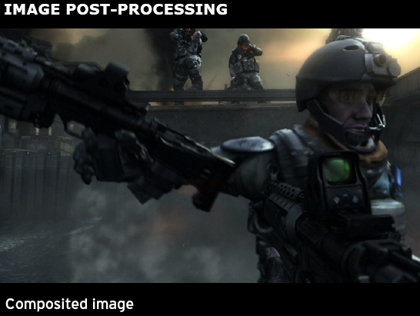
What is all this power being used for?
Motion blur
Depth of field
Bloom
1920x1080x60fps
x 3 (RGB) x 4x4 (sample) x 4 (flops) = ~23 GFLOPS & ~23GB/s
This is just a simple example!
Source: Guerrilla Games, Killzone 2

Slide 6
Why is this happening?
Because once software is parallel, it might as well be very parallel
  The ease of programming reason
Because GPUs run existing graphics software much faster, whereas CPUs only run existing parallel software faster
  The business reason
Because of power consumption

Slide 7
History of Power consumption
Power consumption over time
Increase in CPU clock frequency over time
We have probably hit peak power consumption with current console generation. Unlikely to hit >180W launch of next console generation. Also, hit peak clock frequency. Increases above 3.2GHz will happen slowly. Therefore, all future increases in performance will come from parallelism

Slide 8
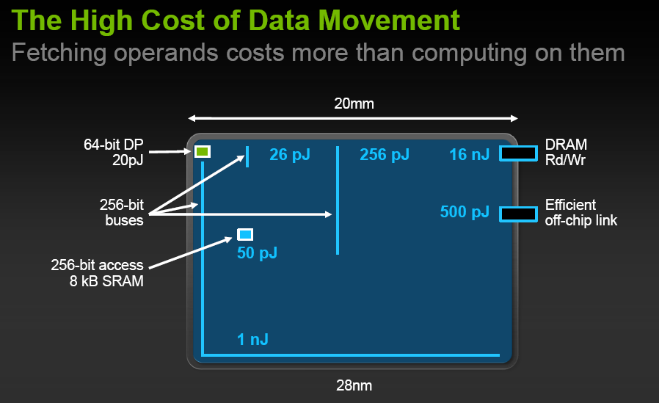
How do we keep GPU power efficiency high?
Cost of data movement is much higher than computation cost
GPUs control data movement distances carefully
Preserve locality explicitly instead of caching
Source: NVIDIA: Bill Dally’s presentation at SC10

Slide 9
What does this mean for the compiler developer?
CPUs
Widely understood and standardized
Can test by running existing software
Instruction sets only add new instructions
Separated from hardware by OS
Only data-movement compiler needs to handle is register/mem
GPUs
New technologies and standards every year
Need to write new test software for new features
New GPUs completely change ISAs
Compilers, drivers and OS tightly integrated and developed rapidly
Need to handle data movement explicitly

Slide 10
New Technologies and Standards
New graphics standards need to be implemented very fast to be competitive
Need to write new front-ends, libraries and runtimes very quickly
OpenCL/OpenGL
DirectX/C++ AMP/
HLSL/DirectCompute
Renderscript
Proprietary graphics technologies

Slide 11
Need to write new tests for new features
When writing a compiler for existing language, can run existing software as tests
With a new standard, need to write new tests
GPUs have varying specifications of accuracy, meaning testing needs to show whether ‘good enough’
Tests need to cover full graphics pipeline, as well as compute capability, so not just purely compiler tests
Graphics and compiler test processes are very different

Slide 12
New GPUs completely change ISAs
GPUs are programmed in high-level languages, or in virtual ISAs
  So can change ISA and run old software
  But correctness is a critical problem
Need to write GPU back-ends very fast (1-2 years, instead of 1-20 years of CPU back-ends…)
GPU back-ends are complex because of extent of optimizations for power and area

Slide 13
Compilers, drivers & OS tightly integrated
We have not standardized the interface between GPU compilers and the OS or drivers
  Instead, we standardize the API, compiler and driver as a whole
CPU compilers can be written independently of the OS (mostly) and with little to no runtime API
  But GPU compilers must be written in tandem with runtime API, driver and OS

Slide 14
Need to handle data movement explicitly
Register allocation in a GPU compiler is complex because of trade-offs for power and area
  Typically there are multiple register files with different rules
Memory handling is more complex
  Typically there are multiple memory spaces with different instructions
  Affects both compiler front-end and back-end

Slide 15
What problems is Codeplay working on?
Higher-level C++ programming model for GPUs
  Generic programming: parallel reduce algorithms
  Abstracting details of GPU hardware: memory sizes, tile sizes, execution models
  Data structures shareable between host and device
  Performance portability
  Standardization

Slide 16
Conclusions
GPU compilers are little understood but critical to future innovation and performance
Don’t forget that GPUs are mostly for graphics!

Slide 17
Questions?

