Slide 1
Heterogeneous Computing using openCL lecture 4
F21DP Distributed and Parallel Technology
Sven-Bodo Scholz

Slide 2
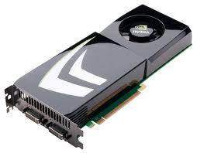
The Big Picture
Introduction to Heterogeneous Systems
OpenCL Basics
Memory Issues
Scheduling

Slide 3
Memory Banks
Memory is made up of banks
  Memory banks are the hardware units that actually store data
The memory banks targeted by a memory access depend on the address of the data to be read/written
  Note that on current GPUs, there are more memory banks than can be addressed at once by the global memory bus, so it is possible for different accesses to target different banks
    Bank response time, not access requests, is the bottleneck
Successive data are stored in successive banks (strides of 32-bit words on GPUs) so that a group of threads accessing successive elements will produce no bank conflicts

Slide 4
Bank Conflicts – Local Memory
Bank conflicts have the largest negative effect on local memory operations
  Local memory does not require that accesses are to sequentially increasing elements
Accesses from successive threads should target different memory banks
  Threads accessing sequentially increasing data will fall into this category

Slide 5
Bank Conflicts – Local Memory
On AMD, a wavefront that generates bank conflicts stalls until all local memory operations complete
  The hardware does not hide the stall by switching to another wavefront
The following examples show local memory access patterns and whether conflicts are generated
  For readability, only 8 memory banks are shown

Slide 6
Bank Conflicts – Local Memory
If there are no bank conflicts, each bank can return an element without any delays
  Both of the following patterns will complete without stalls on current GPU hardware
0
0
0
0
1
1
1
1
2
2
2
2
3
3
3
3
4
4
4
4
5
5
5
5
6
6
6
6
7
7
7
7
Thread
Memory Bank
Thread
Memory Bank

Slide 7
Bank Conflicts – Local Memory
If multiple accesses occur to the same bank, then the bank with the most conflicts will determine the latency
  The following pattern will take 3 times the access latency to complete
Conflicts
0
0
1
1
2
2
2
1
3
3
4
4
3
5
5
6
6
1
7
7
1
Thread
Memory Bank

Slide 8
Bank Conflicts – Local Memory
If all accesses are to the same address, then the bank can perform a broadcast and no delay is incurred
  The following will only take one access to complete assuming the same data element is accessed
0
0
1
1
2
2
3
3
4
4
5
5
6
6
7
7
Thread
Memory Bank

Slide 9
Bank Conflicts – Global Memory
Bank conflicts in global memory rely on the same principles, however the global memory bus makes the impact of conflicts more subtle
  Since accessing data in global memory requires that an entire bus-line be read, bank conflicts within a work-group have a similar effect as non-coalesced accesses
    If threads reading from global memory had a bank conflict then by definition it manifest as a non-coalesced access
    Not all non-coalesced accesses are bank conflicts, however
The ideal case for global memory is when different work-groups read from different banks
  In reality, this is a very low-level optimization and should not be prioritized when first writing a program

Slide 10
Summary
GPU memory is different than CPU memory
  The goal is high throughput instead of low-latency
Memory access patterns have a huge impact on bus utilization
  Low utilization means low performance
Having coalesced memory accesses and avoiding bank conflicts are required for high performance code
Specific hardware information (such as bus width, number of memory banks, and number of threads that coalesce memory requests) is GPU-specific and can be found in vendor documentation

Slide 11
The Big Picture
Introduction to Heterogeneous Systems
OpenCL Basics
Memory Issues
Optimisations

Slide 12
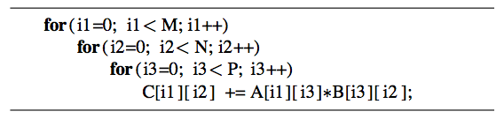
Thread Mapping
Consider a serial matrix multiplication algorithm
This algorithm is suited for output data decomposition
  We will create NM threads
    Effectively removing the outer two loops
  Each thread will perform P calculations
    The inner loop will remain as part of the kernel
Should the index space be MxN or NxM?

Slide 13
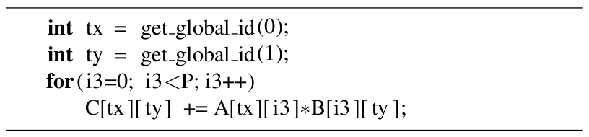
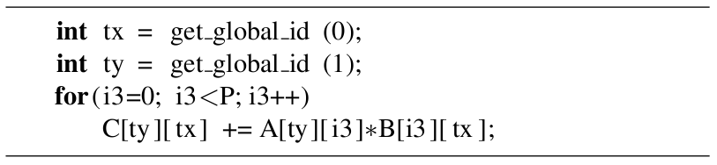
Thread Mapping
Thread mapping 1: with an MxN index space, the kernel would be:
Thread mapping 2: with an NxM index space, the kernel would be:
Both mappings produce functionally equivalent versions of the program

Slide 14
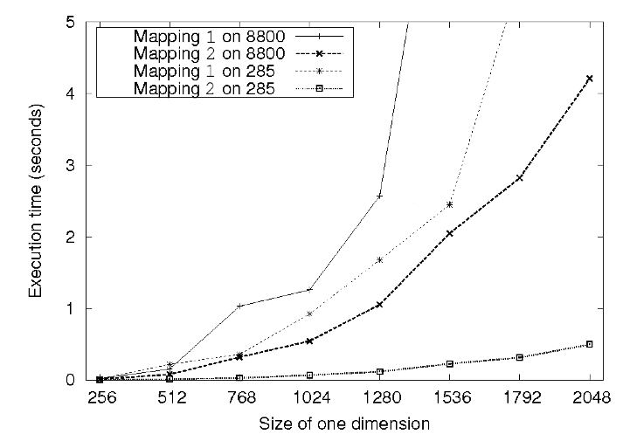
Thread Mapping
This figure shows the execution of the two thread mappings on NVIDIA GeForce 285 and 8800 GPUs
Notice that mapping 2 is far superior in performance for both GPUs

Slide 15
Thread Mapping
In mapping 1, consecutive threads (tx) are mapped to different rows of Matrix C, and non-consecutive threads (ty) are mapped to columns of Matrix B
  The mapping causes inefficient memory accesses

Slide 16
Thread Mapping
In mapping 2, consecutive threads (tx) are mapped to consecutive elements in Matrices B and C
  Accesses to both of these matrices will be coalesced
    Degree of coalescence depends on the workgroup and data sizes

Slide 17
Thread Mapping
In mapping 2, consecutive threads (tx) are mapped to consecutive elements in Matrices B and C
  Accesses to both of these matrices will be coalesced
    Degree of coalescence depends on the workgroup and data sizes

Slide 18
Matrix Transpose
A matrix transpose is a straightforward technique
  Out(x,y) = In(y,x)
No matter which thread mapping is chosen, one operation (read/write) will produce coalesced accesses while the other (write/read) produces uncoalesced accesses
  Note that data must be read to a temporary location (such as a register) before being written to a new location
In
Out
In
Out
coalesced
uncoalesced
uncoalesced
coalesced
Threads
0
1
2
3
0
1
2
3

Slide 19
Matrix Transpose
If local memory is used to buffer the data between reading and writing, we can rearrange the thread mapping to provide coalesced accesses in both directions
  Note that the work group must be square
In
Out
coalesced
coalesced
0
1
2
3
Local memory
4
5
6
7
8
9
10
11
12
13
14
15
Threads
0
1
2
3
0
1
2
3
global mem index
0
1
2
3
0
1
2
3
local mem index
0
1
2
3
0
4
8
12

Slide 20

Matrix Transpose
The following figure shows a performance comparison of the two transpose kernels for matrices of size NxM on an AMD 5870 GPU
  “Optimized” uses local memory and thread remapping

Slide 21
Runtimes on Fermi
 | CR | CW | SH-no | SH-all
16x16 | 21 | 23 | 34 | 18
32x32 | 57 | 44 | 110 | 46
1x256 | 101 | 98
1x512 | 221 | 113
1x1024 | 289 | 117
256x1 | 100 | 160
512x1 | 112 | 208
1024x1 | 117 | 298
HOST: 302/683 !!!
All times in msec.
Matrix size: 4096x4096

Slide 22
What happened?
In
Out
uncoalesced
coalesced
Threads
0
1
2
3
Thread 0 issues read
0
1
2
3
Thread 1 issues read
4
5
6
7
Thread 2 issues read
Cache (local memory)
8
9
10
11
Thread 3 issues read
12
13
14
15

Slide 23
What happened?
In
Out
uncoalesced
coalesced
Threads
0
1
2
3
Coalesced write!
0
1
2
3
Coalesced read from cache!
4
5
6
7
Coalesced write!
Cache (local memory)
8
9
10
11
Coalesced read from cache!
12
13
14
15
…

Slide 24
Summary
When it comes to performance, memory throughput and latency hiding are key!
Main Tools are:
  Memory choice (global/local/ private)
  Memory layout (coalescing & indexing)
  Thread Mapping
  Workgroup size (synchronisation &latency hiding)

