Slide 1
Heterogeneous Computing using openMP lecture 1
F21DP Distributed and Parallel Technology
Sven-Bodo Scholz

Slide 2
Introduction to OpenMP
What is OpenMP?
Open specification for Multi-Processing
“Standard” API for defining multi-threaded shared-memory programs
openmp.org – Talks, examples, forums, etc.
High-level API
Preprocessor (compiler) directives ( ~ 80% )
Library Calls ( ~ 19% )
Environment Variables ( ~ 1% )

Slide 3
A Programmer’s View of OpenMP
OpenMP is a portable, threaded, shared-memory programming specification with “light” syntax
Exact behavior depends on OpenMP implementation!
Requires compiler support (C or Fortran)
OpenMP will:
Allow a programmer to separate a program into serial regions and parallel regions
Hide stack management
Provide synchronisation constructs
OpenMP will not:
Parallelize automatically
Guarantee speedup
Provide freedom from data races

Slide 4
Digging in
int main() {
// Do this part in parallel
printf( "Hello, World!\n" );
return 0;
}

Slide 5
Motivation – OpenMP
#include <omp.h>
int main() {
omp_set_num_threads(16);
// Do this part in parallel
#pragma omp parallel
{
printf( "Hello, World!\n" );
}
return 0;
}
compile with –fopenmp !!!!

Slide 6
Programming Model
fork
join
…

Slide 7
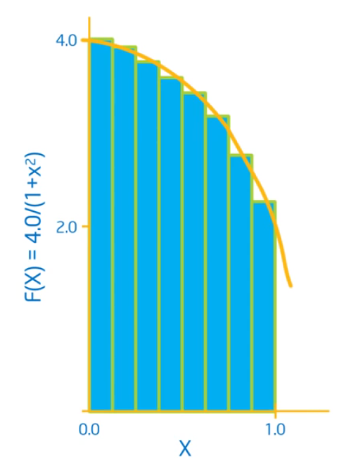
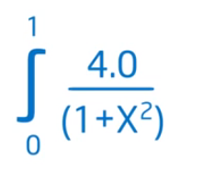
Computation of π

Slide 8
C implementation
int num_steps = 10000;
double step;
int main()
{
int i; double x, pi, sum=0.0;
step = 1.0/(double)num_steps;
for( i=0; i<num_steps; i++) {
x = (i+0.5) * step;
sum += 4.0/(1.0+x*x);
}
pi = step * sum;
...
}

Slide 9
Exposing Concurrency
#include<omp.h>
omp_set_num_threads( 10);
#pragma_omp_parallel
{
}
int num_steps = 10000;
double step;
int main()
{
int i; double x, pi, sum=0.0;
step = 1.0/(double)num_steps;
for( i=0; i<num_steps; i++) {
x = (i+0.5) * step;
sum += 4.0/(1.0+x*x);
}
pi = step * sum;
...
}
shared!!!

Slide 10
Exposing Concurrency
omp_set_num_threads( 10);
#pragma_omp_parallel
{
}
int main()
{
int i; double x, pi, sum=0.0;
step = 1.0/(double)num_steps;
for( i= ; i<num_steps; i ) {
x = (i+0.5) * step;
sum += 4.0/(1.0+x*x);
}
int i, id;
double x;
id = omp_get_thread_num();
id =i+10
int i, id, num_threads;
double x;
id = omp_get_thread_num();
num_threads = omp_get_num_threads();
id =i+num_threads
0 ++
race condition!!!

Slide 11
Elimination of the Race Condition
int main()
{
int i; double x, pi, sum =0.0;
step = 1.0/(double)num_steps;
omp_set_num_threads( 10);
#pragma_omp_parallel
{ int i, id, num_threads;
double x;
id = omp_get_thread_num();
num_threads = omp_get_num_threads();
for( i= id ; i<num_steps; i = i + num_threads ) {
x = (i+0.5) * step;
sum += 4.0/(1.0+x*x);
}
}
}
[10]
[id]
int num_t;
UGLY !!!
if( id==0) num_t = num_threads;
not in scope!!!
for(i=0; i< num_threads; i++)
pi += sum[i] * step;
for(i=0; i<num_t; i++)

Slide 12
Adding Insult to Injury
int main()
{
int i; double x, pi, sum [10] =0.0; int num_t;
step = 1.0/(double)num_steps;
omp_set_num_threads( 10);
#pragma_omp_parallel
{ int i, id, num_threads;
double x;
id = omp_get_thread_num();
num_threads = omp_get_num_threads();
if( id==0) num_t = num_threads;
for( i= id ; i<num_steps; i = i + num_threads ) {
x = (i+0.5) * step;
sum [id] += 4.0/(1.0+x*x);
}
}
for(i=0; i< num_t; i++)
pi += sum[i] * step;
}
slow !!!

Slide 13
False Sharing!
sum [0] += 4.0/(1.0+x*x);
....
sum [num_t - 1] += 4.0/(1.0+x*x);
Cache core #0
Cache core #(num_t – 1)
Cache invalidation on every single write!!!

Slide 14
Summary so far
Introduction of concurrency is easy!
Pitfalls:
scope of variables (global/local)
race conditions
false sharing
=> constructs introduced so far are too rudimentary!!

