Slide 1
The Powers of Array Programming
AiPL – Edinburgh
20.8.2014
Sven-Bodo Scholz

Slide 2
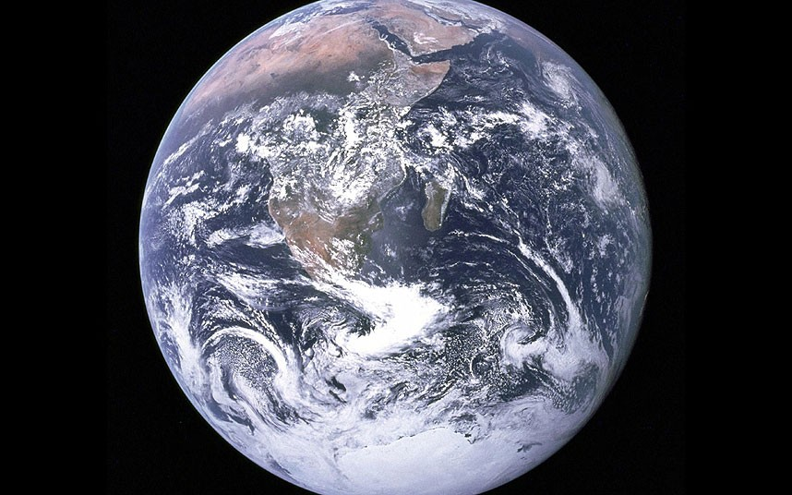


Slide 3
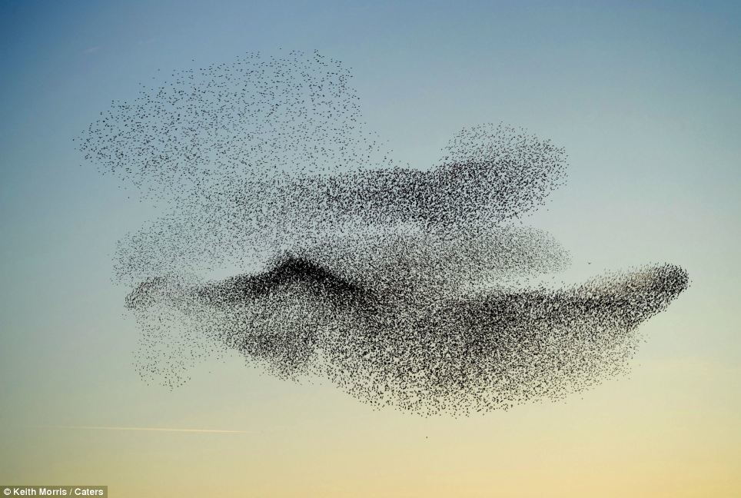
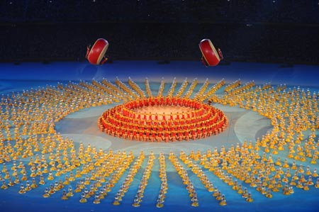
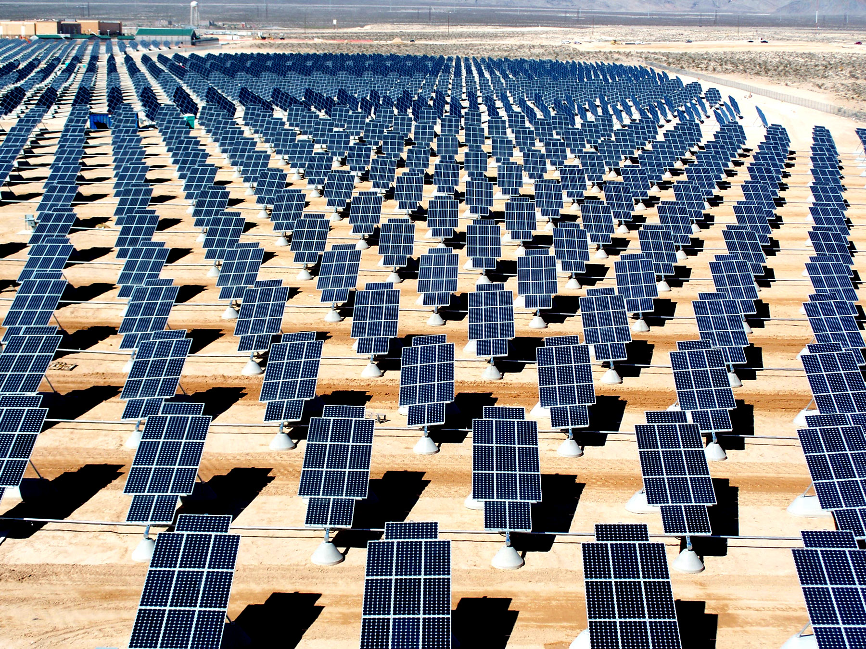

Slide 4
Everything is an Array
Think Arrays!
Vectors are arrays.
Matrices are arrays.
Tensors are arrays.
........ are arrays.

Slide 5
Everything is an Array
Think Arrays!
Vectors are arrays.
Matrices are arrays.
Tensors are arrays.
........ are arrays.
Even scalars are arrays.
Any operation maps arrays to arrays.
Even iteration spaces are arrays
Graphs are arrays.
Streams are arrays.
…

Slide 6
Some History
APL (Iverson’68)
SISAL(McGraw’83)
Nial (Jenkins’81)
Matlab(’84)
NESL(Blelloch’94)
J (Iverson’90)
K(Whitney’93)
ZPL (Chamb.’93)
SaC (‘94)
DpH(Chak.’07)
Julia(MIT’12)
NOVA(Nvidia’13)

Slide 7
The Big Picture
Single Assignment C (SaC)
sac2c auto-parallelising
compiler
> 250.000 loC
> 15 years development
> 30 contributors
highly optimised sequential C code
MPI code for distributed systems
POSIX threaded code for SMP
CUDA code for GPGPUs
μTC code for the Microgrid
Application specific FPGA accelerators

Slide 8
SaC: HP² Driven Language Design
High-Productivity
easy to learn
  C-like look and feel
easy to program
  Matlab-like style
  OO-like power
  FP-like abstractions
easy to integrate
  light-weight C interface
High-Performance
no frills
  lean language core
performance focus
  strictly controlled side-effects
  implicit memory management
concurrency apt
  data-parallelism at core
&

Slide 9
Data-Parallelism, First Steps
Formulate algorithms in space rather than time!
prod = prod( iota( 10)+1)
prod = 1;
for( i=1; i<=10; i++) {
prod = prod*i;
}

Slide 10
Why is Space Better than Time?

Slide 11
Another Example: Fibonacci Numbers
if( n<=1)
return n;
} else {
return fib( n-1) + fib( n-2);
}

Slide 12
Another Example: Fibonacci Numbers
if( n<=1)
return n;
} else {
return fib( n-1) + fib( n-2);
}

Slide 13
Fibonacci Numbers – now linearised!
if( n== 0)
return fst;
else
return fib( snd, fst+snd, n-1)

Slide 14
Fibonacci Numbers – now data-parallel!
matprod( genarray( [n], [[1, 1], [1, 0]])) [0,0]

Slide 15
Multi-Dimensional Arrays

Slide 16
Basic Operations
dim(42) == 0
dim( [1,2,3]) == 1
dim([[1, 2, 3],
[4, 5, 6]] ) == 2
shape( 42) == []
shape( [1, 2, 3]) == [3]
shape( [[1, 2, 3],
[4, 5, 6]] ) == [2, 3]
a = [[1, 2, 3],
[4, 5, 6]];
a[[1,0]] == 4
a[[1]] == [1,5,6]
a[[]] == a

Slide 17
The Usual Suspects
a = [1,2,3];
b = [4,4,2];
a+b == [5,6,5];
a<=b == [true, true, false];
sum(a) == 6
...

Slide 18
Matlab/ APL stuff
a = [[1,2,3],
[4,5,6]];
take( [2,1], a) == [[1],
[4]]
take( [1], a) == [[1,2,3]] != [1,2,3]
take( [], a) == a
take( [-1, 2], a) == [[4,5]]
...

Slide 19
Set Notation
{ iv -> a[iv] + 1 } == a + 1
{ [i,j] -> mat[[j,i]] } == transpose( mat)
{ [i,j]->(i==j? mat[[i,j]]: 0)}

Slide 20
Example: Matrix Multiply

Slide 21
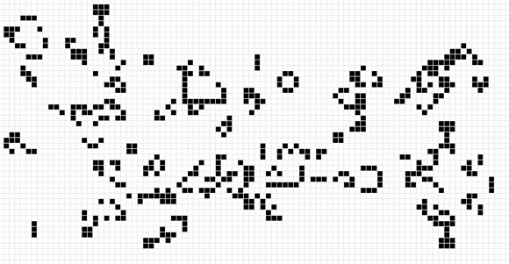
Example: Game Of Life
a = with {
( . < iv < .) {
nbs = sum ( tile( [3,3], iv-1, a));
state = toi( (nbs == 3) || ((a[iv] ==1) && (nbs == 4)));
} : state;
} : modarray( a);

Slide 22
Example: Relaxation
/ 8d

Slide 23
Index-Free Combinator-Style Computations
sqrt( sum( square( A)))
L2 norm:
Convolution step:
Convergence test:
W1 * shift(-1, A) + W2 * A + W1 * shift( 1, A)
all( abs( A-B) < eps)

Slide 24
Shape-Invariant Programming
l2norm( [1,2,3,4] )
sqrt( sum( sqr( [1,2,3,4])))
sqrt( sum( [1,4,9,16]))
sqrt( 30)
5.4772

Slide 25
Shape-Invariant Programming
l2norm( [[1,2],[3,4]] )
sqrt( sum( sqr( [[1,2],[3,4]])))
sqrt( sum( [[1,4],[9,16]]))
sqrt( [5,25])
[2.2361, 5]

Slide 26
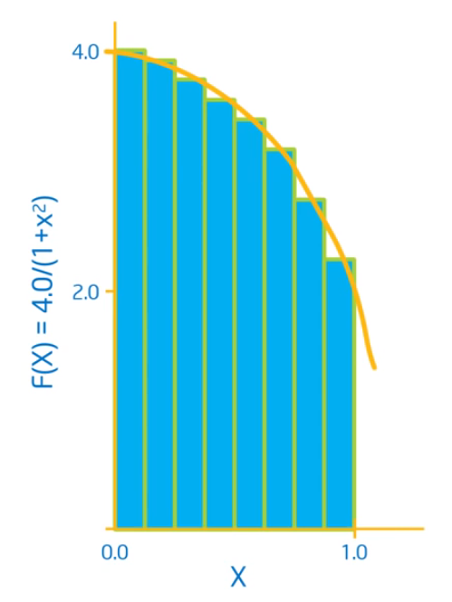
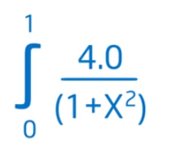
Computation of π

Slide 27
Computation of π
double f( double x)
{
return 4.0 / (1.0+x*x);
}
int main()
{
num_steps = 10000;
step_size = 1.0 / tod( num_steps);
x = (0.5 + tod( iota( num_steps))) * step_size;
y = { iv-> f( x[iv])};
pi = sum( step_size * y);
printf( " ...and pi is: %f\n", pi);
return(0);
}

Slide 28
Arrays and Streams
RAM
L3 cache
L2 cache
CPU
L1 cache

Slide 29
Target-Specific Streaming

Slide 30
Streaming as High-Level Code Transformation
a = reshape( [M,N], iota( M*N));
b = reshape( [N,K], iota( N*K));
res = matmul(a, b);
sa = reshape( [2,M/2,N], a);
sb = reshape( [N,2,K/2], b);
res3tp = { [i,j] -> matmul( sa[i,.,.], sb[.,j,.]) };
res3 = reshape( [M,K], { [a,b,c,d] -> res3tp[ a,c,b,d] } );
print( all( res == res3));
sa = reshape( [2,M/2,N], a);
sb = b;
res2 = reshape( [M,K], { [i] -> matmul( sa[i,.,.], sb) });
print( all( res == res2));

Slide 31
…. Then streaming boils down to…..
implementing one or more axes of the array in time rather than in space!
What if we add infinite axes??

Slide 32
Alternative Layouts - Vectorisation
1 | 2 | 3 | 4 | 5 | 6 | 7
8 | 9 | 10 | 11 | 12 | 13 | 14
15 | 16 | 17 | 18 | 19 | 20 | 21
22 | 23 | 24 | 25 | 26 | 27 | 28
29 | 30 | 31 | 32 | 33 | 34 | 35
36 | 37 | 38 | 39 | 40 | 41 | 42
Shape: [6,7]
Layout “2”
29 | 30 | 31 | 32
33 | 34 | 35
Shape: [6,2,4]
22 | 23 | 24 | 25
26 | 27 | 28
29 | 36
30 | 37
31 | 38
32 | 39
33 | 40
34 | 41
35 | 42
15 | 16 | 17 | 18
19 | 20 | 21
1 | 8 | 15 | 22
2 | 9 | 16 | 23
3 | 10 | 17 | 24
4 | 11 | 18 | 25
5 | 12 | 19 | 26
6 | 13 | 20 | 27
7 | 14 | 21 | 28
8 | 9 | 10 | 11
12 | 13 | 14
Layout “1”
1 | 2 | 3 | 4
5 | 6 | 7
Shape: [2,7,4]

Slide 33
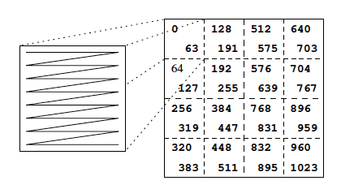
Alternative Layouts – Morton Order
Reshape from [32,32] into [4,4,8,8]…….

Slide 34
Programming Array-Style offers:
much less error-prone indexing!
combinator style
increased reuse
better maintenance
easier to optimise
huge exposure of concurrency!
(parallel) performance portability!
try it out: www.sac-home.org

