Slide 1
Parallel Programming with Swan
Hans Vandierendonck Queen’s University Belfast Summer School on Advances in Programming Languages 2014

Slide 2
TASK PARALLELISM
Section 1

Slide 3
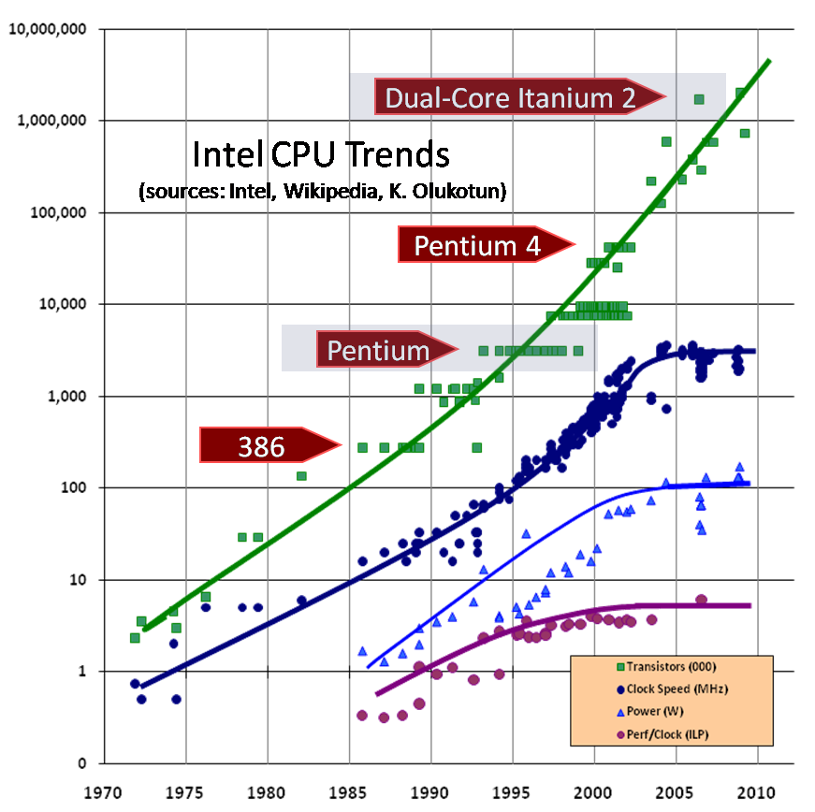
Parallelism: Motivated by Processor Architecture
Source: Herb Sutter
Moore’s Law alive and well
Traditional performance sources have run dry: clock frequency, instruction-level parallelism (ILP)

Slide 4
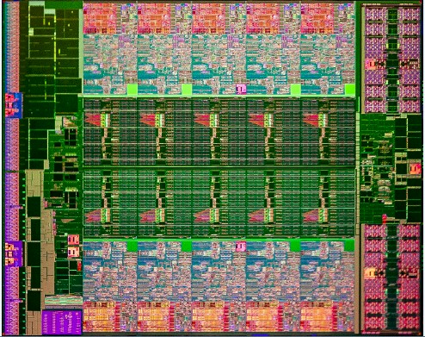
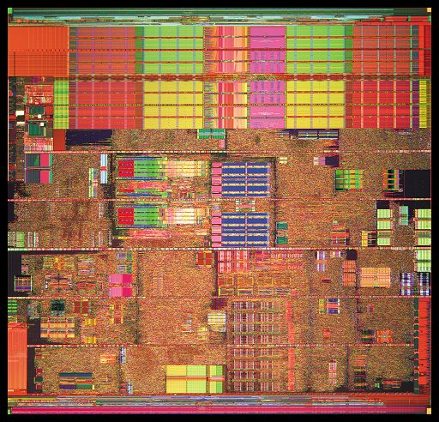
Processor Evolution: Towards Multi-Core CPUs
Prescott (Pentium 4)
90nm process
122mm² die size
125 M transistors
3.8 GHz clock speed
103W max TDP
1 CPU core
2-way hyper-threading
E5-4657LV2 (Ivy Bridge)
22nm process
160 mm² die size
4.3 G transistors
2.4/2.9 GHz clock speed
115W max TDP
Up to 12 cores
2-way hyper-threading

Slide 5
Amdahl’s Law: How Much Speedup Can Parallelism Bring?

Slide 6
Gunther’s Law: Adding in Overhead Due to Parallelism

Slide 7
Challenges of Parallel Programming
Multi-cores are everywhere
Applications of interest can be anything
Multimedia, games, desktop applications, …
Challenges
Inner loops (too small to parallelize effectively?) vs. outer loops contain most promising parallelism
Pipeline-parallel loops vs. DOALL loops
System calls, I/O, etc. in parallel loops
Timing variability
Dealing with parallel programming issues
Determinism, debugging, complexity
Limited programming overhead desired

Slide 8
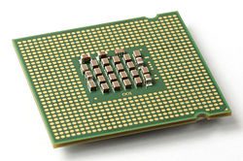
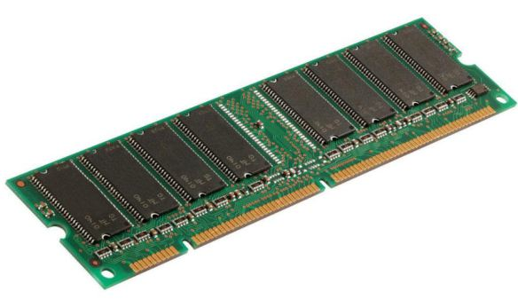
Parallel Processing At a Low Level of Abstraction
thread
thread
thread
thread
threads
interact

Slide 9
Concurrent vs. Parallel Programming
 | Concurrent Programming | Parallel Programming
Describes | Orchestration of parallel execution (thread interactions) | Declaration of parallelism
Abstraction | Threads + synchronisation | Tasks + dependences
Progress | Threads may block, spin | Tasks are composed of strands Strands execute until completion once initiated
Constructs | Threads, locks, semaphores, barriers, atomics, … | Skeletons (Intel TBB) Pragma’s (OpenMP) Keywords (Cilk, X10, Habanero Java)
Examples | POSIX threads, Java, MPI, OpenMP | TBB, OpenMP, Cilk, Swan

Slide 10
Task Parallelism
fib(1)
fib(2)
Tasks: structured code blocks, e.g., functions
Composed of strands: Maximum sequence of statements without spawn or sync
Example: int fib( int n ) { if( n <= 1 ) return n; else { int y = spawn fib(n-2);
int x = spawn fib(n-1);
sync;
return x+y;
}
}
fib(3)
fib(0)
fib(4)
fib(1)
fib(2)
fib(1)
fib(0)

Slide 11
Task Synchronization (1)
Generic DAG
Fully Strict DAG
Generic synchronization allowed, e.g., locks, synchronization vars
Tasks can synchronize only with their parent
E.g.: Cilk, Swan
lock(x)
unlock(x)
lock(x)
unlock(x)
set(y)
wait(y)
Source: Guy Blelloch, Parallel Scheduling Theory and Practice

Slide 12
Task Synchronization (2)
Strict DAG
Terminally Strict DAG
Tasks can synchronize only with an ancestor
Tasks can synchronize only with an ancestor A, but if this happens, then descendants of A cannot synchronize with an ancestor of A
E.g.: Habanero Java

Slide 13
Exercise
Classify this DAG

Slide 14
SWAN
Section 2

Slide 15
Swan: Motivation
Why Swan?
Cilk lacks support for important DAG structures
E.g., pipeline parallelism
Relaxes fully strict DAG model but maintains property that children complete before their parent
Cilk ignores memory hierarchy
Dataflow descriptions provide helpful information
Race conditions lurking in the code
Need to declare memory locations accessed by tasks
Swan research goals
Explore how dataflow annotations can enhance the execution of parallel programs and/or improve ease of programming

Slide 16
Swan = Cilk + Dataflow
"Master” spawns tasks in program order
Annotations of arguments indicate usage of argument
All side effects must be captured
Roots of DAG:
executing or
waiting on
worker queues
void master() {
data_type x, y, z;
spawn A( in x, out y );
spawn B( in y, out z );
spawn C( inout x, in z );
sync; }
ready
tasks
A
y
x
B
z
C

Slide 17
Swan = Cilk + Dataflow
"Master” spawns tasks in program order
Annotations of arguments indicate usage of argument
All side effects must be captured
Roots of DAG:
executing or
waiting on
worker queues
void master() {
data_type x, y, z;
spawn A( in x, out y );
spawn B( in y, out z );
spawn C( inout x, in z );
sync; }
ready
tasks
A
y
x
B
z
C

Slide 18
Swan Language Definition as a C++ Extension
Versioned objects
versioned<T> obj;
Argument annotations
indep<T> read-only
outdep<T> read/write but no exposed reads
inoutdep<T> read/write
cinoutdep<T> commutative
reduction<M> reduction
-- T is a C++ type
-- M is a C++ structure describing the monoid with type T, an identity value and a reduction operator
Independent fork/join int x; spawn f(x); …
sync;
Dependency-aware fork/join versioned<int> x; spawn f( (indep<int>)x ); … sync;
Retain implicit sync at end of procedure

Slide 19
From Side Effects to Dependences
 | First Task
Second Task |  | input | output | in/out | commutative in/out | reduction
 | input | none | true | true | true | true
 | output | anti | output | output | output | output
 | in/out | anti | true | true | true | true
 | commutative in/out | anti | true | true | none^{(x)} | true
 | reduction | anti | true | true | true | none^{(r)}
Assumption: Two tasks access the same variable with annotations as in table
Notes:
none^{(x)}: no dependence, except for enforcement of mutual exclusion
none^{(r)}: no dependence, except for privatization of variables and final reduction
Renaming (new copy of variable), applied only on output annotation

Slide 20
Example: NxN Blocked Matrix Multiply
typedef float (*block_t)[16]; // 16x16 tile
typedef versioned<float[16][16]> vers_block_t;
typedef indep<float[16][16]> in_block_t;
typedef inoutdep<float[16][16]> inout_block_t;
void mul_add(in_block_t A, in_block_t B,
inout_block_t C) {
// Recover pointers to the raw data from
// the versioned objects
block_t a = (block_t) A;
block_t b = (block_t) B;
block_t c = (block_t) C;
// serial implementation on 16x16 tile
…
}
void matmul(vers_block_t * A,
vers_block_t * B,
vers_block_t * C,
unsigned n ) {
for( unsigned i=0; i < n; ++i ) {
for( unsigned j=0; j < n; ++j ) {
for( unsigned k=0; k < n; ++k ) {
spawn mul_add( (in_block_t)A[i*n+j],
(in_block_t)B[j*n+k],
(inout_block_t)C[i*n+k] ); } } }
sync;
}

Slide 21
Unified Scheduler
Typical Cilk spawn tree
Typical task dataflow spawn tree
Shallow spawn tree
Dataflow dependencies between children
Every task in the spawn tree may organize its children in a dataflow graph
Arbitrary nesting of fork/join and task graphs
Deep spawn tree

Slide 22
Unified Scheduler
Qualitative properties
Mixed fork/join – dataflow spawn tree
Cannot maintain busy-leaves principle
Non-ready tasks are non-busy leaves
Maintains work-first principle
Execute task immediately if data dependencies allow it
Keeps the task graph small
Extend work-stealing rules
Take pending tasks into account
When returning from a procedure (provably-good-steal)
In random work stealing
Work stealing in dataflow graphs more frequent then in fork/join
task graph 1
task graph 2

Slide 23
Versioned Objects: Fast Metadata Determination
versioned<T> blk;
Data
Metadata
spawn f( (indep<T>) blk );
write-after-read
dependency
spawn g( (outdep<T>) blk );
read-after-write
dependency
spawn h( (indep<T>) blk );

Slide 24
Versioned Objects: Versioning (a.k.a. Renaming)
versioned<T> blk;
Data
Metadata
spawn f( (indep<T>) blk );
write-after-read
dependency
spawn g( (outdep<T>) blk );
Data
Metadata
read-after-write
dependency
spawn h( (indep<T>) blk );

Slide 25
Linear Algebra: QR Decomposition
typedef versioned<float[]> block_t;
typedef indep<float[]> bin;
typedef outdep<float[]> bout;
typedef inoutdep<float[]> binout;
// Initialise matrices using blocked matrix representation
versioned<float[]> A[N][N]; A[i][j] = new versioned<float[]>(D*D); …;
versioned<float[]> T[N][N]; …;
// QR dedomposition: A contains Q and R; T is temporary storage
for( k=0; k < N; ++k ) {
spawn dgeqrt((binout)A[k][k], (bout)T[k][k]);
for( m=k+1; k < N; ++k ) {
spawn dtsqrt( (binout)A[k][k], (binout)A[m][k], (binout)T[m][k] );
for( n=k+1; n < N; ++n )
spawn dormqr((bin)A[k][k], (bin)T[k][k], (binout)A[k][n] );
for( m=k+1; m < N; ++m )
spawn dssmqr( (bin)A[m][k], (bin)T[m][k], (binout)A[k][n], (binout)A[m][n] );
}
sync;
Source: http://icl.cs.utk.edu/parsec/

Slide 26
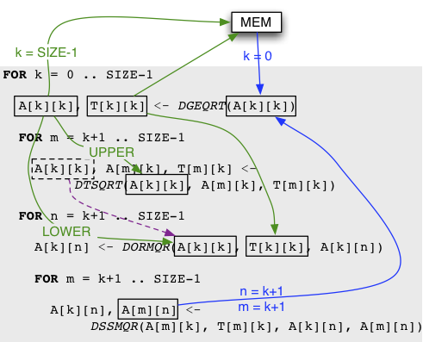
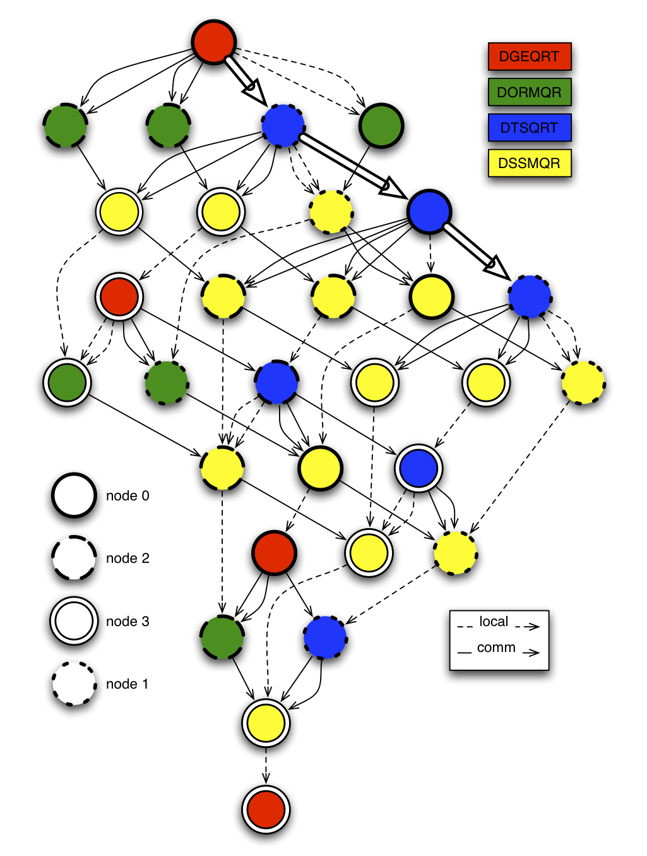
Linear Algebra: QR Decomposition
Source: http://icl.cs.utk.edu/parsec/

Slide 27
Pipeline Parallelism
Section 3

Slide 28
A Pipeline-parallel Loop
int stage_A(int * ab, struct S * a);
void stage_B(int * ab, float * bc);
void stage_C(float * bc, struct S * c);
void a_pipeline() {
struct S a, c;
int[100] ab;
float[200] bc;
while( 1 ) {
if(stage_A(ab, a))
break;
stage_B(ab, bc);
stage_C(bc, c);
}
}
Recurrent dependency on a
Parallel stage pipeline
Pass ab from A to B
A1
A2
B1
Pass bc from B to C
A3
B2
Recurrent dependency on c
B3
C1
C2
Exploiting all parallelism requires multiple copies of ab and/or bc
C3
Notes:
Show where the dependencies are

Slide 29
Half-a-Pipeline in Cilk++
int stage_A(int * ab, struct S * a);
void stage_B(int * ab);
void half_a_pipeline() {
struct S a, c;
int[100] ab;
while( 1 ) {
if(stage_A(ab, a))
break;
stage_B(ab);
}
}
int stage_A(int * ab, struct S * a);
void stage_B(int * ab);
void stage_B_bis(int * ab) {
stage_B(ab, bc);
delete[] ab;
}
void half_a_pipeline() {
struct S a;
while( 1 ) {
int * ab = new int[100];
if(stage_A(ab, &a)) {
delete[] ab;
break;
}
spawn stage_B_bis(ab);
}
sync;
}
A1
A2
B1
Stage A is sequential,
stage B is parallel
A3
B2
B3

Slide 30
Expressing a Pipeline in Cilk++ Using Reducer Hyperobjects
#include “reducer_seq.h” // 130 lines of code
int stage_A(int * ab, struct S * a);
void stage_B(int * ab, float * bc);
void stage_C(float * bc, struct S * c);
struct wrap_C {
struct S * c;
wrap_C(struct S * c_) : c(c_) { }
void operator()(float *bc) {
stage_C(bc, &c);
delete[] bc;
}
};
void stage_BC(int * ab,
reducer_seq<wrap_C, float *> &stage_C) {
float * bc = new float[200];
stage_B(ab, bc);
delete[] ab;
stage_C(bc); // a deferred function call
}
void a_pipeline() {
struct S a, c;
reducer_seq<wrap_C, float *> serial_stage_C(c);
while( 1 ) {
int * ab = new int[100];
if(stage_A(ab, &a)) {
delete[] ab;
break;
}
spawn stage_BC(ab, serial_stage_C);
}
sync;
}
Merged parallel + sequential stage
Manual versioning (always)
Reducer serializes stage C
Manual versioning (always)
Functor to execute a stage C instance
Doesn’t look like a pipeline…
Totals 34 lines of code + 130 reusable

Slide 31
Expressing a Pipeline in Intel Threading Building Blocks
int stage_A(int * ab, struct S * a);
void stage_B(int * ab, float * bc);
void stage_C(float * bc, struct S * c);
void a_pipeline() {
struct S a, c;
parallel_pipeline( 16 /* needs tuning */,
make_filter<void, int *>( filter::serial,
[&](flow_control& fc) -> int * {
int * ab = new int[100];
if(stage_A(ab, &a)) {
fc.stop();
delete[] ab;
return 0;
} else
return ab;
}
) &
make_filter<int *, float *>(
filter::parallel,
[](int * ab) -> float * {
float * bc = new float[200];
stage_B(ab, bc);
delete[] ab;
return bc;
}
) &
make_filter<float *, void>(
filter::serial,
[&](float * bc) {
stage_C(bc, &c);
delete[] bc;
}
)
);
}
Maximum simultaneous iterations
Manual versioning (always)
C++ lambdas
Manual versioning (always)
Filter is single-input single-output
Totals 36 lines of code

Slide 32
Expressing a Pipeline in a Task-Based Dataflow Language
int stage_A(outdep<int[]> ab, inoutdep<struct S> a);
void stage_B(indep<int[]> ab, outdep<float[]> bc);
void stage_C(indep<float[]> bc, inoutdep<struct S> c);
void a_pipeline() {
versioned<struct S> a, c;
versioned<int[100]> ab;
versioned<float[200]> bc;
while( 1 ) {
if(stage_A(ab, a))
break;
spawn stage_B(ab, bc);
spawn stage_C(bc, c);
}
sync;
}
Task argument usage annotations
Automatic versioning (on-demand)
Dense and readable code
Cilk style spawn/sync
Totals 16 lines of code

Slide 33
Pipelines in Swan …
Are concise and easy to write
Perform automatic memory management
Are not tied to strict patterns
I.e., if your code pattern deviates you can still write it
Except for a fixed number of arguments per task
Reflect the structure and intent of the code
Compose well with other parallel constructs

Slide 34
THE HyperQueuE
Section 4

Slide 35
Pipeline Parallelism With Task Dataflow
struct data { … };
void pipeline( int N ) { versioned<data> v;
versioned<int> state;
for(int i=0; i<N; ++i ){ spawn prod(outdep<data>v);
spawn cons(indep<data>v,
inoutdep<int> state);
} sync;
}
Dataflow-like notation
Similar to OpenMP 4.0
Automatic variable renaming on v
Generates instances v₀, v₁, v₂, …
DAG created during execution:
v₀
prod₀
cons₀
state
v₁
prod₁
cons₁
state
v₂
prod₂
cons₂

Slide 36
The Hyperqueue
struct data { … };
void pipeline( int N ) { hyperqueue<data> q;
versioned<int> state;
spawn prod(pushdep<data>q, N);
spawn cons(popdep<data> q,
inoutdep state); sync;
}
void prod(pushdep q, int N){
for(int i=0; i<N; ++i)
q.push( … );
}
Push/pop access mode
Deterministic & scale-free
Free of deadlock
Single-producer single-consumer
Execute with multiple concurrent producers
Pops can see only pushes before them in program order
q
prod
cons

Slide 37
Parallelism vs. Correctness
Two conflicting requirements
Retaining program order (FIFO property)
Achieving parallelism
Serial elision (program order) to the rescue
Any parallel execution respecting semantics of spawn and sync computes same outcome as program order
True for any Cilk and Swan program in the absence of data races

Slide 38
Parallelism: Push
Parallelism of push() operations
Build on Cilk++ reducer hyperobjects
Queue push/list append is a reduction operation
Every task has its own view (i.e., reduction variable)
Program order retained when all pushes in parallel
Appending to a list is a reduction operation [Reducers, Frigo et al, SPAA’09]
(Q : a) : b = (Q : a) + (ε : b)
Q is a list (FIFO queue)
+ concatenate lists
: append element (Q : a) = (Q + (a))
ε is an empty queue
Append lists (Q : a) and (ε : b)
so push a and b
in parallel

Slide 39
Parallelism: Pop
Program order defines visibility of values
A pop() operation on a queue may only see values pushed before it in program order
View shared between consumer and producer
All tasks with pop access mode are serialized
When prior popdep task active:
We do not yet know how many items it will pop()
We can’t tell how far to scan ahead in the queue
No parallelism

Slide 40
Hyperqueue Data Structure
hyperqueue<int> queue;
A composite data structure:
Linked list of segments
Circular buffers of elements
Combine O(1) append with more efficient push/pop
list of segments
queue is a
pointer
tail segment
head
next
head
next
head segment
tail
tail
values

Slide 41
Views
hyperqueue<int> queue;
Views describe part of queue constructed
Linked list of queue segments
Private or shared
View is a linked list of segments
Head & tail pointer
Private view
Accessible by exactly 1 task
Shared view
Accessible by 1 producer and 1 consumer
task
Q
C
U
R
head
next
tail
Notes:
Split over multiple slides
say that push operates on user (only tail needed) and pop operates on queue (only head needed)

Slide 42
Views
hyperqueue<int> queue;
Queue view
Only if pop access mode
Head segment of queue
Head-only view
pop() and empty() operate on head of queue view
User view
Constructed by task, or inherited from parent
push() operates on tail of user view
task
Q
C
U
R
head
next
tail
Notes:
Split over multiple slides
say that push operates on user (only tail needed) and pop operates on queue (only head needed)

Slide 43
Views Describe Sub-Results
hyperqueue<int> queue;
spawn prod1(pushdep queue); spawn prod2(pushdep queue);
sync;
Children view
Only if push access mode
Captures pushes performed by left-most children
Captures queue contents not popped by children
Right view
Captures pushes performed by right siblings (later in program order)
parent
Q
C
U
R
prod1
prod2
C
U
R
C
U
R
Notes:
Split over multiple slides
say that push operates on user (only tail needed) and pop operates on queue (only head needed)

Slide 44
Example
hyperqueue<int> queue;
spawn prod1(pushdep queue);
spawn prod2(pushdep queue);
spawn cons(popdep queue);
sync;
parent
Child tasks with pop access mode inherit user & queue view
Q
C
U
R
prod1
prod2
cons
C
U
R
C
U
R
Q
U
R
SC’13 – 20 November 2013

Slide 45
Example
hyperqueue<int> queue;
spawn prod1(pushdep queue);
spawn prod2(pushdep queue);
spawn cons(popdep queue);
sync;
parent
Q
C
U
R
Hyperqueue is initialised with an empty segment
SC’13 – 20 November 2013

Slide 46
spawn prod1(…)
hyperqueue<int> queue;
spawn prod1(pushdep queue);
spawn prod2(pushdep queue);
spawn cons(popdep queue);
sync;
parent
Q
C
U
R
prod1
Child tasks inherit the user view
C
U
R
SC’13 – 20 November 2013

Slide 47
spawn prod2(…)
hyperqueue<int> queue;
spawn prod1(pushdep queue);
spawn prod2(pushdep queue);
spawn cons(popdep queue);
sync;
parent
Q
C
U
R
push() creates segment if user view is empty
prod1
prod2
C
U
R
C
U
R
SC’13 – 20 November 2013

Slide 48
prod2: q.push()
hyperqueue<int> queue;
spawn prod1(pushdep queue);
spawn prod2(pushdep queue);
spawn cons(popdep queue);
sync;
parent
Newly created view reduced with latest predecessor view in program order
Q
C
U
R
prod1
prod2
C
U
R
C
U
R
SC’13 – 20 November 2013

Slide 49
spawn cons(…)
hyperqueue<int> queue;
spawn prod1(pushdep queue);
spawn prod2(pushdep queue);
spawn cons(popdep queue);
sync;
parent
Child tasks with pop access mode inherit user & queue view
Q
C
U
R
prod1
prod2
cons
C
U
R
C
U
R
Q
U
R
SC’13 – 20 November 2013

Slide 50
prod1: complete
hyperqueue<int> queue;
spawn prod1(pushdep queue);
spawn prod2(pushdep queue);
spawn cons(popdep queue);
sync;
parent
Q
C
U
R
Reduce views children + user + right
prod1
prod2
cons
C
U
R
C
U
R
Q
U
R
SC’13 – 20 November 2013

Slide 51
Another Example
hyperqueue<int> queue;
spawn prod1(pushdep queue);
spawn cons(popdep queue);
spawn prod2(pushdep queue);
sync;
parent
Q
C
U
R
prod1
cons
prod2
C
U
R
Q
U
R
C
U
R
push() creates segment if user view is empty
SC’13 – 20 November 2013

Slide 52
Another Example
hyperqueue<int> queue;
spawn prod1(pushdep queue);
spawn cons(popdep queue);
spawn prod2(pushdep queue);
sync;
parent
Q
C
U
R
right view is inaccessible to pop() – respects program order
prod1
cons
prod2
C
U
R
Q
U
R
C
U
R
SC’13 – 20 November 2013

Slide 53
Discussion
Programs using hyperqueues are free of deadlock
Pop() is a blocking operation
Suspending tasks is much harder in the context of a Cilk-like scheduler due to busy-leaves property
Similar observations for empty()
Blocking in theory but not necessarily in practice…
Hyperobjects and the “special optimisation”
Thread-local views are created only when stealing tasks
Equally applicable to hyperqueues with the necessary modifications

Slide 54
Evaluation
Evaluation goal
Programmability but also performance
Non-trivial pipeline parallel codes
Benchmarks
PARSEC: ferret, dedup
Compare to POSIX threads [Bienia’11] and Intel TBB [Reed’11]
bzip2 compression in the paper
Platform
2x (2x8)-core AMD 6272 (Bulldozer)
6144 KB L3 cache / 8 cores
4 NUMA nodes
Ubuntu 12.04.1 LTS ; gcc 4.6.3
Comparison to Intel TBB 4.1 20130314oss

Slide 55
Ferret
Pthreads, TBB and hyperqueue all perform the same!
Knack in curves due to FPU sharing in Bulldozer architecture
This is what happens when the input stage is not overlapped with the pipeline

Slide 56
Dedup
Swan (dataflow) version isn’t bad either
Hyperqueues provide best performance
Pthreads: manual coarsening
TBB version not effective in our experiments
Output task stalls on pop()

Slide 57
Further Reading
Hans Vandierendonck, George Tzenakis, Dimitrios S. Nikolopoulos. Analysis of Dependence Tracking Algorithms for Task Dataflow Execution. In: ACM Transactions on Architecture and Code Optimization, January 2014.
Hans Vandierendonck, Kallia Chronaki, Dimitrios S. Nikolopoulos. Deterministic and Scale-Free Pipeline Parallelism with Hyperqueues. SC'13: High-Performance Computing, Networking, Storage and Analysis, November 2013.
George Tzenakis, Angelos Papatriantafyllou, Hans Vandierendonck, Polyvios Pratikakis and Dimitrios S. Nikolopoulos. BDDT: Block-level Dynamic Dependence Analysis for Deterministic Task-Based Parallelism. International Conference on Advanced Parallel Processing Technology (APPT). August 2013, pp. 17-31.
Hans Vandierendonck, George Tzenakis and Dimitrios S. Nikolopoulos. A Unified Scheduler for Recursive and Task Dataflow Parallelism. IEEE Conference on Parallel Architectures and Compilation Techniques (PACT). pages 1-11. October 2011.
Polyvios Pratikakis, Hans Vandierendonck, Spyros Lyberis and Dimitrios S. Nikolopoulos. A programming model for deterministic task parallelism. In 6th Workshop on Memory Systems Performance and Correctness (MSPC) in conjunction with PLDI. pages 7-12. June 2011.
Hans Vandierendonck, Polyvios Pratikakis and Dimitrios S. Nikolopoulos. Parallel programming of general-purpose programs using task-based programming models. In 3rd USENIX Workshop on Hot Topics in Parallelism (HotPar), Berkeley, California. May 2011.

Slide 58
Ongoing Work
NovoSoft (EC Marie Curie Fellowship)
Utilise task arguments annotations to steer data placement and migration in hybrid memory hierarchies, composed of DRAM and byte-addressable non-volatile memory
ASAP (EU FP7, Adaptive, Scalable Analytics Platform)
Apply Swan to big data processing (map/reduce, graph analysis) on clusters (distributed memory)
Hybrid static/dynamic scheduling (EPSRC)
Investigate schedulers supporting both static and dynamic scheduling, investigate compiler support for generating statically scheduled code
Hyperqueues
Follow-up on hyperqueue work to enable non-blocking consumers and multiple concurrent consumers

Slide 59
The End
Acknowledgments:
Dimitris S. Nikolopoulos, George Tzenakis (QUB)
Polyvios Pratikakis (FORTH ICS)
Kallia Chronaki (BSC)
Available for your experimentation:
http://github.com/hvdieren/swan/
http://github.com/hvdieren/parsec-swan/

