Slide 1
A Study of Garbage Collector Scalability on Multicores
LokeshGidra, Gaël Thomas, JulienSopena and Marc Shapiro
INRIA/University of Paris 6

Slide 2











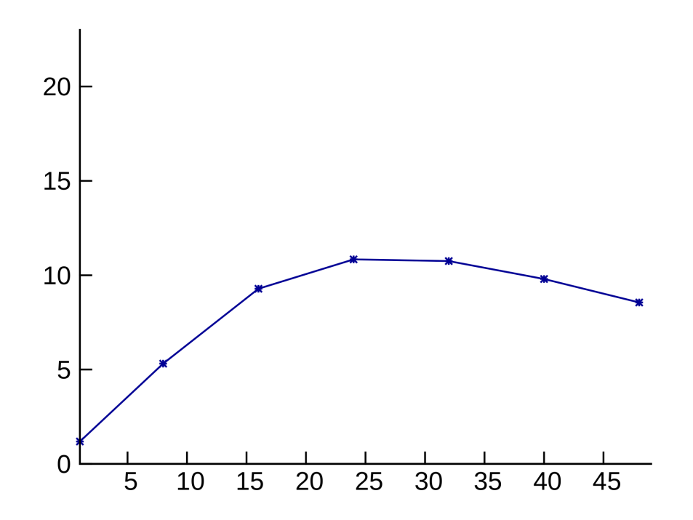
Garbage collection on multicore hardware
14/20 most popular languages have GC
but GC doesn’t scale on multicore hardware
Parallel Scavenge/HotSpot scalability on a 48-core machine
Better ↑
Degrades after 24 GC threads
SPECjbb2005 with
48 application threads/3.5GB
GC Throughput (GB/s)
GC threads
Notes:
As you know, GCs reclaim automatically memory + used in many language
They don’t scale.
Show the problem, we have evaluated the hotspot JVM on a 48 cores
We have tested the SpecJBB Web server and, in order to observe the GC behavior, we have fixed the workload
Evaluate the parallel garbage collector called Parallel Scavenge/multiple threads
We have tested different number of GC threads, pined
We report the GC throughput, number of bytes collected by second
Should increase with the number of GC threads, but as you can see, after 24 GC threads, adding new GC threads degrades performance
* As you know, since twenty years, many languages provides garbage collectors to automatically reclaim unused memory.
* But we made a small experiment with the hotspot java virtual machine and we have observed that know of its garbage collectors are able to scale when we increase the number of cores.
The figure report one of our experiment with the default garbage collector of hotspot on a 48 cores machine. This collector is parallel scavenge, it’s a parallel garbage collector, which means that it use parallel GC threads to collect the memory.
So, we have evaluated specjbb, it’s a classical Java benchmark that simulates a web server with a large heap. For this experiment, we have fixed the number of application thread to 48 to fix the workload.
We have tested different number of GC threads, each of the gc thread is pined on a core. We have measured the garbage collector throughput, it’s the number of bytes that the garbage collector is able to collect per time unit.
And what we have observed is that after twenty four GC threads, the performance of the garbage collector degrades when we add new threads. This result shows that the garbage collector is unable to scale on machine with many cores.

Slide 3
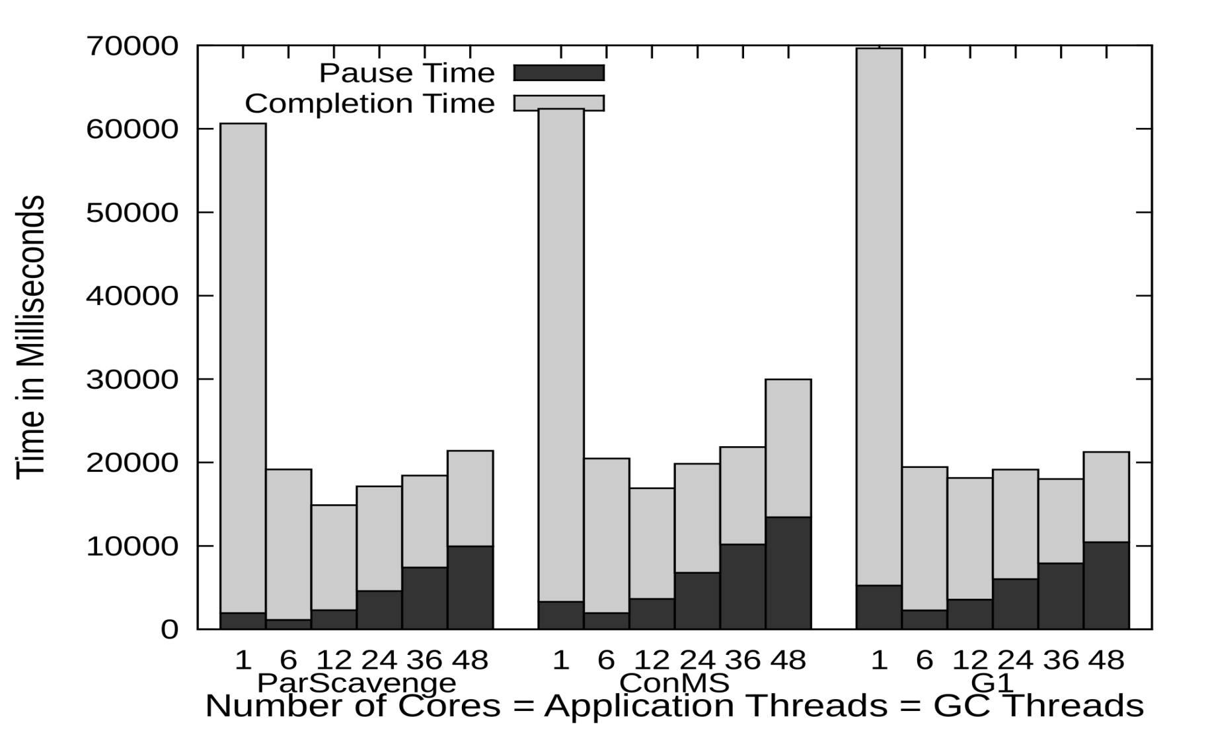
Scalability of GC is a bottleneck
By adding new cores, application creates more garbage per time unit
And without GC scalability, the time spent in GC increases
~50% of the time spent in the GC
at 48 cores
Lusearch
[PLOS’11]
Notes:
Having a good GC scalability is important because processor frequency is stagnantsince 10 years
As the memory size continues to increase if we can not make the GC scales, it means that we will spend more and more time in GC
It’s a problem for application that use a lot of memory such as application servers, scientific applications and more generaly application that analyses big data set
However, as you also know, processor frequency is stagnant since ten years, but memory size continue to increase. If we can not have a good scalability for the garbage collector, it will be unable to collect the large heap of modern hardware.
As a result, it means that for the moment, we can not use garbage collectors to collect large heap and that garbage collectors are unsuitable for data intensive applications such as application servers or scientific applications.

Slide 4
Where is the problem?
Probably not related to GC design:
the problem exists in ALL the GCs of HotSpot 7
  (both, stop-the-world and concurrent GCs)
What has really changed:
Multicores are distributed architectures, not centralized anymore
Notes:
we can propose different hypothesis. GCs are not well parallized.
It’s probably not the case because parallel GCs exists since 30 years and are largely optimized. Graph traversal
3. We can also suppose that Parallel Scavenge is not well designed.
4. none of the GC of hotspot scales with the number of cores. Even Garbage first,
5. So, our hypothesis is that what have really changed these last years is the fact that multicores are real distributed architecture and that it changes the behavior of memory accesses.

Slide 5
From centralized architectures to distributed ones
A few years ago…
Now…
Inter-connect
Node 0
Node 1
Memory
Memory
Memory
System Bus
Memory
Memory
Cores
Node 2
Node 3
Cores
Uniform memory access machines
Non-uniform memory access machines
Notes:
To avoid the saturation of the bus when we increase the number of cores, new architectures are more distributed. It means that sets of cores are grouped in nodes. Each node manages its own memory bank. In this kind of machine, we have multiple nodes connected by an interconnect, it’s the network between the nodes.
The hardware directly simulates a distributed shared memory. It means that the hardware directly dispatch a memory request to the appropriate node. If the access is local, it is not costly, otherwise, the access is forwarded through the interconnect to a remote node. In this case, the latency becomes more important, that’s why we call this kind of architecture Nun-Uniform Memory Access architectures.

Slide 6
From centralized architectures to distributed ones
Our machine: AMD Magny-Cours with 8 nodes and 48 cores
  12 GB per node
  6 cores per node
Node 0
Node 1
Memory
Memory
Memory
Memory
Node 2
Node 3
Local access: ~ 130 cycles
Remote access: ~350 cycles
Notes:
For example, our machine is AMD MagnyCour with 8 nodes and 48 cores. Each node has 6 cores and twelve GB of memory. If the node 1 access to the physical address 0 which is on the node 0, the hardware directly forward the request of the node 1 to the node 0 to simulates a single address space machine.

Slide 7
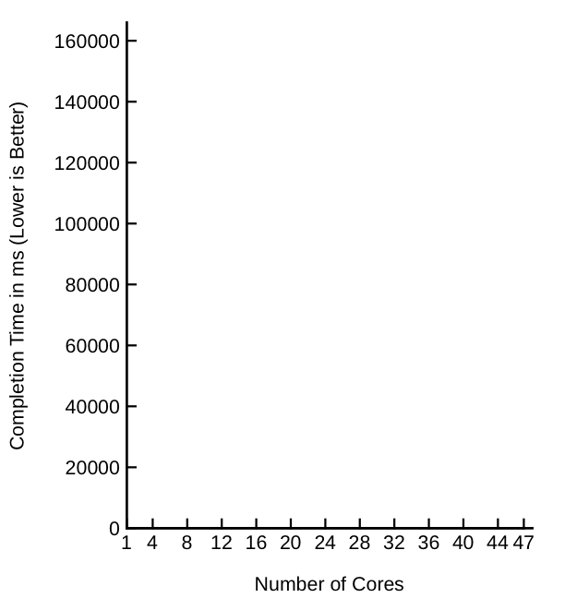
From centralized architectures to distributed ones
Our machine: AMD Magny-Cours with 8 nodes and 48 cores
  12 GB per node
  6 cores per node
Node 0
Node 1
Time to perform a fixed
number of reads in //
Memory
Memory
Completion time (ms)
Memory
Memory
Node 2
Node 3
Local access: ~ 130 cycles
Remote access: ~350 cycles
Better↓
#cores = #threads
Notes:
For example, our machine is AMD MagnyCour with 8 nodes and 48 cores. Each node has 6 cores and twelve GB of memory. If the node 1 access to the physical address 0 which is on the node 0, the hardware directly forward the request of the node 1 to the node 0 to simulates a single address space machine.

Slide 8
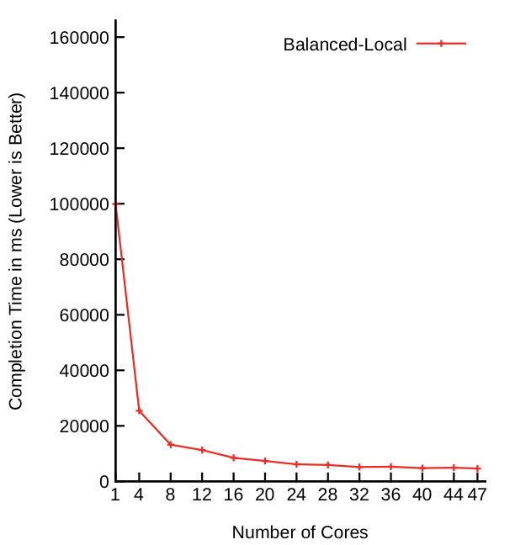
From centralized architectures to distributed ones
Our machine: AMD Magny-Cours with 8 nodes and 48 cores
  12 GB per node
  6 cores per node
Node 0
Node 1
Time to perform a fixed
number of reads in //
Memory
Memory
Completion time (ms)
Memory
Memory
Node 2
Node 3
Local access: ~ 130 cycles
Remote access: ~350 cycles
Local
Access
Better↓
#cores = #threads
Notes:
For example, our machine is AMD MagnyCour with 8 nodes and 48 cores. Each node has 6 cores and twelve GB of memory. If the node 1 access to the physical address 0 which is on the node 0, the hardware directly forward the request of the node 1 to the node 0 to simulates a single address space machine.

Slide 9
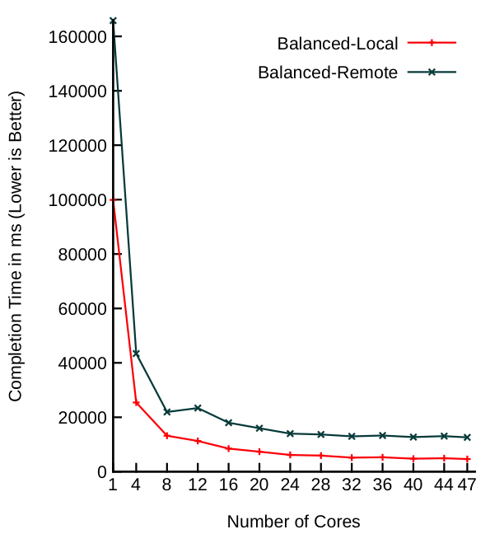
From centralized architectures to distributed ones
Our machine: AMD Magny-Cours with 8 nodes and 48 cores
  12 GB per node
  6 cores per node
Node 0
Node 1
Time to perform a fixed
number of reads in //
Memory
Memory
Completion time (ms)
Memory
Memory
Node 2
Node 3
Random access
Local access: ~ 130 cycles
Remote access: ~350 cycles
Local
Access
Better↓
#cores = #threads
Notes:
For example, our machine is AMD MagnyCour with 8 nodes and 48 cores. Each node has 6 cores and twelve GB of memory. If the node 1 access to the physical address 0 which is on the node 0, the hardware directly forward the request of the node 1 to the node 0 to simulates a single address space machine.

Slide 10
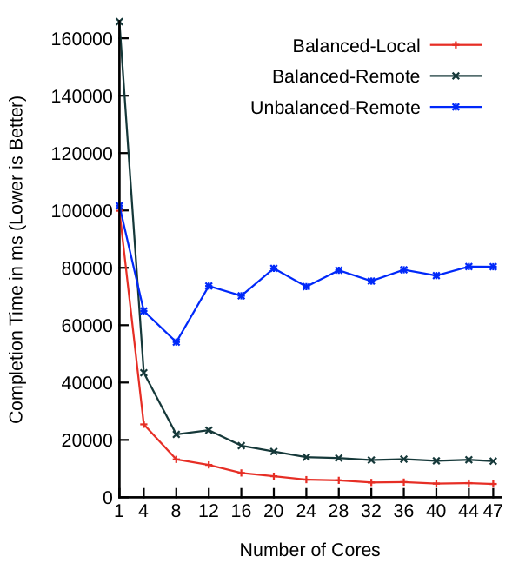
From centralized architectures to distributed ones
Our machine: AMD Magny-Cours with 8 nodes and 48 cores
  12 GB per node
  6 cores per node
Node 0
Node 1
Time to perform a fixed
number of reads in //
Memory
Memory
Single node access
Completion time (ms)
Memory
Memory
Node 2
Node 3
Random access
Local access: ~ 130 cycles
Remote access: ~350 cycles
Local
Access
Better↓
#cores = #threads
Notes:
For example, our machine is AMD MagnyCour with 8 nodes and 48 cores. Each node has 6 cores and twelve GB of memory. If the node 1 access to the physical address 0 which is on the node 0, the hardware directly forward the request of the node 1 to the node 0 to simulates a single address space machine.

Slide 11
Parallel Scavenge Heap Space
Parallel Scavenge
First-touch allocation policy
Kernel’s lazy first-touch page allocation policy
Virtual address space
Notes:
We have observed exactly the problem of bad memory access balance in Parallel Scavenge.
By default, when the java virtual machine starts, it reserves a large virtual address spaces for the heap. The pages of the virtual address space are mapped lazily by the kernel when they are accessed the first time.

Slide 12
Parallel Scavenge Heap Space
Parallel Scavenge
First-touch allocation policy
Kernel’s lazy first-touch page allocation policy
⇒ initial sequential phase maps most pages on first node
Initial
application
thread
Notes:
It means that during the sequential initialisation phase of a multi-threaded application, a lot of pages of the virtual address space will be allocated from the node where the initial thread runs.

Slide 13
Parallel Scavenge Heap Space
Parallel Scavenge
First-touch allocation policy
Kernel’s lazy first-touch page allocation policy
⇒ initial sequential phase maps most pages on its node
But during the whole execution,
the mapping remains as it is
(virtual space reused by the GC)
Initial
application
thread
A severe problem for generational GCs
Notes:
The problem is that most of the GC heap is now mapped from a single node. And this GC heap is reused during the whole execution of the application. It means that during the whole execution of the application and of the garbage collector, we will have a high memory imbalance to the node 0.

Slide 14
Parallel Scavenge Heap Space
Parallel Scavenge
First-touch allocation policy
Bad balance
Bad locality
95% on a single node
Better ↑
SpecJBB
GC Throughput (GB/s)
PS
GC threads
Notes:
We have evaluated this phenomenon on SpecJBB and we have observed that the sequential phase of the application maps 95% of the heap to a single node. We have therefore a very bad memory balance and a very bad memory locality for the application and for the garbage collector.

Slide 15
NUMA-aware heap layouts
Parallel Scavenge
Interleaved
Fragmented
First-touch allocation policy
Round-robin allocation policy
Node local object
allocation and copy
Bad balance
Bad locality
Targets balance
Targets locality
95% on a single node
Better ↑
SpecJBB
GC Throughput (GB/s)
PS
GC threads
Notes:
To solve the problem, we are using two different heap layouts. The first one is the interleaved layout. In this case, we maps in round-robin the page from all the nodes when the java virtual machine starts.
The second one is the fragmented space. To understand the space, you have to know that we are studying a copying garbage collector. It means that when the garbage collector finds an object, it copies it in a different place to avoid memory fragmentation. With a fragmented space, we ensure that a thread allocates memory only from its node. It’s the case for the application threads that will allocate memory from their node, but also for the garbage collector that will copy objects to their running nodes.

Slide 16
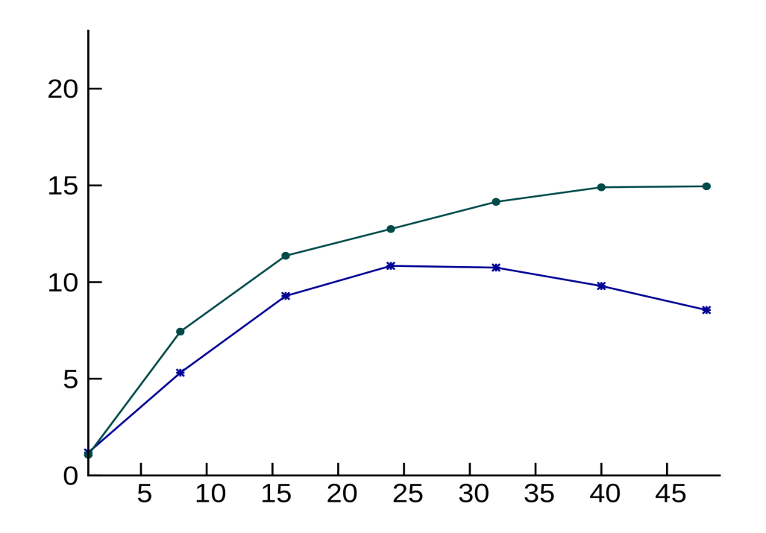
Interleaved heap layout analysis
Parallel Scavenge
Interleaved
Fragmented
First-touch allocation policy
Round-robin allocation policy
Node local object
allocation and copy
Bad balance
Perfect balance
Bad locality
Bad locality
95% on a single node
7/8 remote accesses
Better ↑
SpecJBB
Interleaved
GC Throughput (GB/s)
PS
GC threads
Notes:
The interleaved space solves the problem of balance, and gives substentially a better throughput than the parallel scavenge. However, the interleaved space it is useless for locality because memory access are essentially random. We have observed that 7 out of 8 memory access of the GC are random.

Slide 17
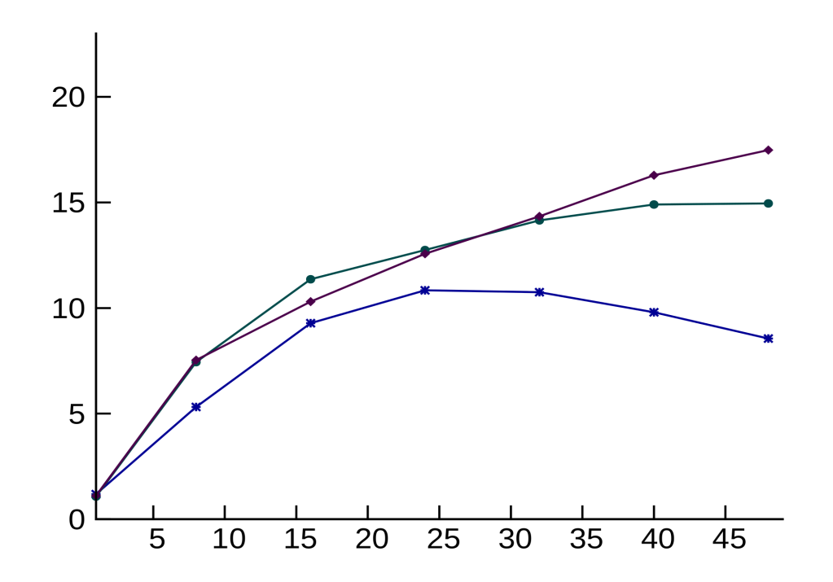
Fragmented heap layout analysis
Parallel Scavenge
Interleaved
Fragmented
First-touch allocation policy
Round-robin allocation policy
Node local object
allocation and copy
Bad balance
Perfect balance
Good balance
Bad locality
Bad locality
Average locality
95% on a single node
7/8 remote accesses
Bad balance if a single
thread allocates for the others
Better ↑
100%
local copies
7/8 remote scans
SpecJBB
Fragmented
Interleaved
GC Throughput (GB/s)
PS
GC threads
Notes:
Fragmented space is good for both the balance and the locality for most of the applications. For the balance, if we suppose that the allocation rate of all the threads is the same, it means that we will find almost the same number of objects on each node. In this case, we will have a good balance. However, for an application where a single thread mostly allocates memory for the other threads, we will have a problem of balance because all the objects will comes from a single node. We have observed this pattern in the H2 database.
For the locality of the garbage collector, fragmented space is average. GC threads will still scans objects from random node because the object graph is application-dependent, but with the node-local allocation pattern, we ensure that a GC thread will systematically perform local copies.
As a result, fragmented space provides better performance when the number of GC threads become high, mainly because fragmented space avoids the saturation of the interconnect caused by the bad locality of the interleaved space.

Slide 18
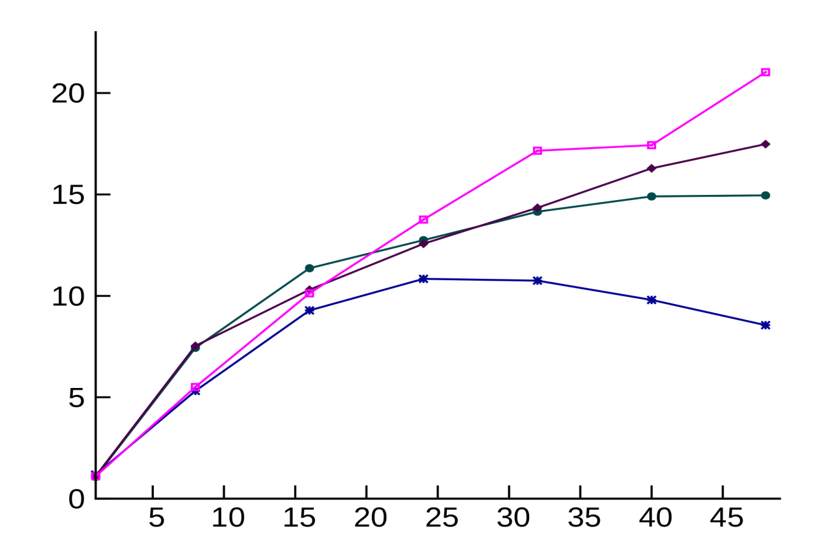
Synchronization optimizations
Removed a barrier between the GC phases
Replaced the GC task-queue with a lock-free one
Synchro optimization
has effect with high contention
Better ↑
Fragmented + synchro
SpecJBB
Fragmented
Interleaved
GC Throughput (GB/s)
PS
GC threads
Notes:
To be exhaustive, we have also improved the internal synchronizations of parallel scavenge with simple techniques. We have removed some barriers between the gc threads and replaced a synchronized queue by a lock free one. As you can see, a better synchronization provides better performance when the number of cores becomes high, mainly because we avoid a lot of cache misses on the interconnected to synchronize the threads.

Slide 19
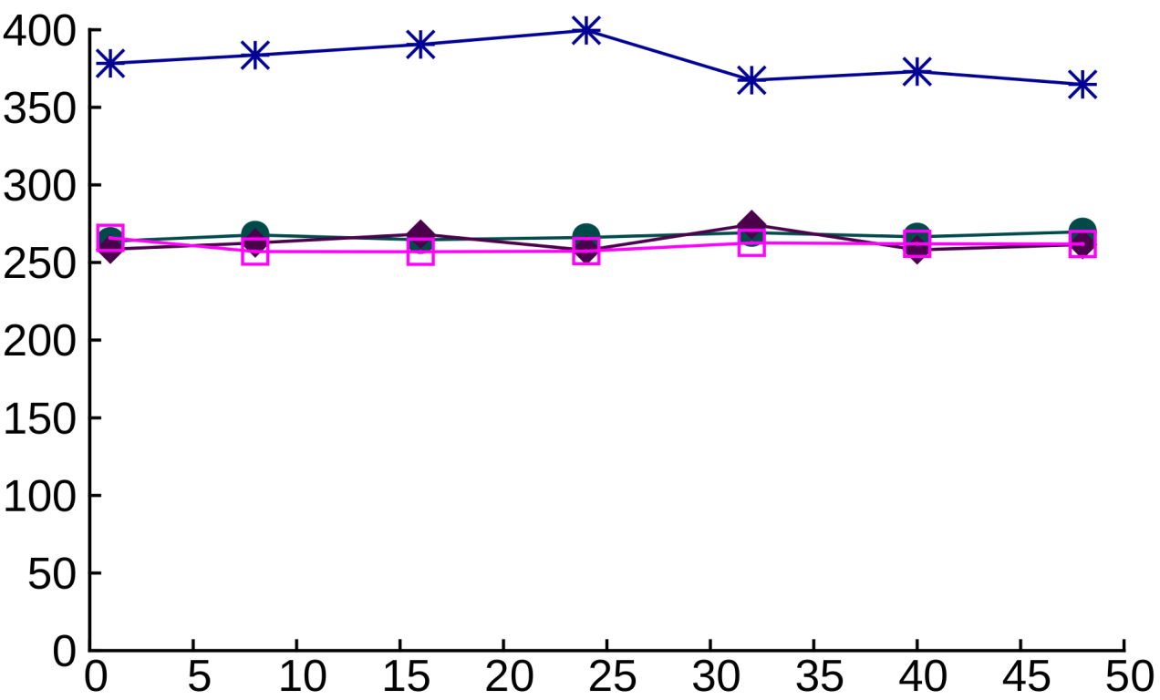
Effect of Optimizations on the App (GC excluded)
A good balance improves a lot application time
Locality has only a marginal effect on application
  While fragmented space increases locality for application over interleaved space
  (recently allocated objects are the most accessed)
PS
Other heap layouts
Application time
Better↓
XML Transform from SPECjvm
GC threads
Notes:
Finally, our optimization have also an effect on the application that also suffers from a bad balance and a bad locality. We have evaluated XML transform for this purpose. We have isolated the application from the garbage collection time for this purpose and reports only the application time. As you can show, when we use a fragmented or an interleaved space, we reduce substantially the application time as compared to the base line parallel Scavenge.
You can also observe that using a fragmented or an interleaved space does not change the performance of the application. A fragmented space increases the locality for the application because objects are allocated to the local node. As recently allocated objects are the most used, application have a better locality. And as you can see, having a better locality does not change anything for the application. We can conclude from this result that probably, the latency cost of remote accesses is probably a marginal effect on our evaluated applications.

Slide 20
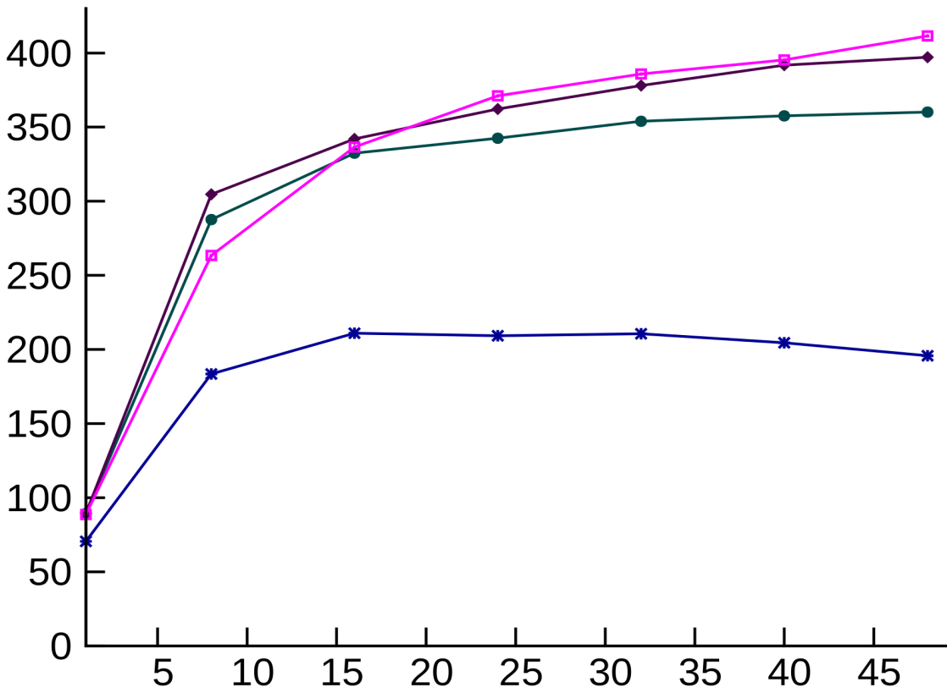
Overall effect (both GC and application)
Optimizations double the app throughput of SPECjbb
Pause time divided in half (105ms to 49ms)
Better ↑
Fragmented + synchro
Fragmented
Interleaved
Application
throughput (ops/ms)
PS
SpecJBB
GC threads
Notes:
Overall, if we cumulate the effect for both the GC and the application, you can see that on SpecJBB, using a better GC can have a huge impact. Our optimization double the application throughput of SpecJBB. Moreover, by having a scalable garbage collector, we divide by twothe individual pause time of a collection. This result shows that having a scalable garbage collector is indeed important to collect large heaps.

Slide 21
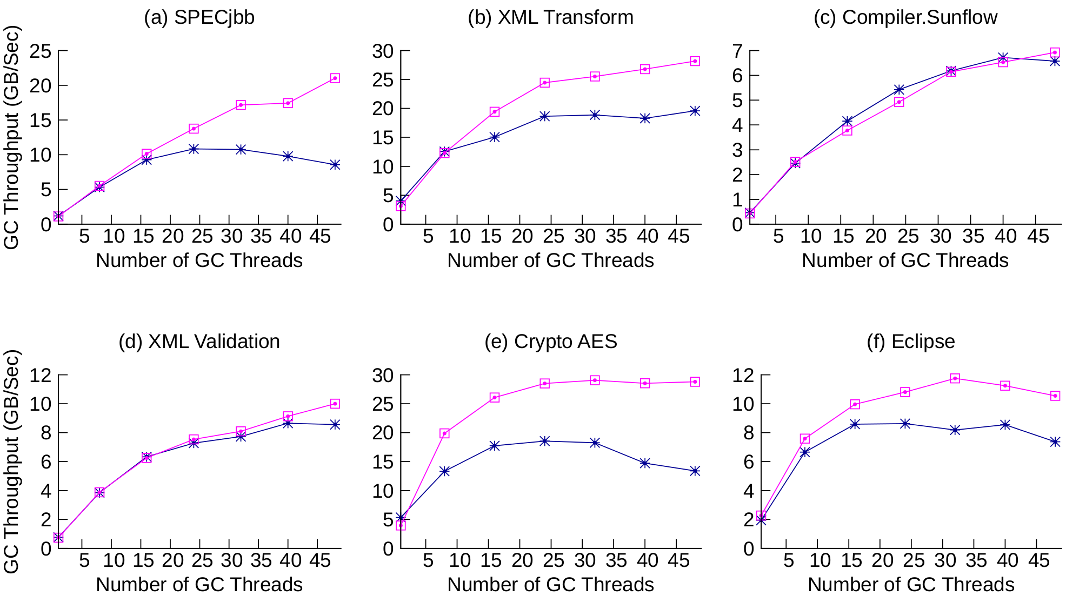
GC scales well with memory-intensive applications
3.5GB
1GB
2GB
2GB
1GB
512MB
PS
Fragmented + synchro
Notes:
Finally, we have evaluated a large set of applications. We report the GC throughput for all of them with their associate working set. As you can see, our optimizations always improve the performance of the garbage collector. Moreover, for most application, the GC throughput continues to increase when we add new cores, at least for memory intensive applications. For non-memory intensive applications such as eclipse, adding new GC threads is useless and can even degrades the performance. But I don’t see why we could runs non-memory intensive applications such as eclipse with so many threads.

Slide 22
Take Away
Previous GCs do not scale because they are not NUMA-aware
Existing mature GCs can scale with standard // programming techniques
Using NUMA-aware memory layouts should be useful for all GCs
(concurrent GCs included)
Most important NUMA effects
Balancing memory access
Memory locality only helps at high core count
Notes:
To conclude, we have observed that the current GCs were not able to scale on modern multicore because they are not NUMA-aware, not because they are not well designed. In particular, this scalability issue is not related to the way application threads and GC threads are synchronized, but mostly by problems of memory placement.
We can also conclude from our study that balancing memory access has a huge impact on performance and that ensuring a good memory locality helps to avoid a saturation of the interconnect. We can also say that improving locality to have better memory access latencies is probably useless.

Slide 23
Take Away
Previous GCs do not scale due to NUMA obliviousness
Existing mature GCs can scale with standard // programming techniques
Using NUMA-aware memory layouts should be useful for all GCs
(concurrent GCs included)
Most important NUMA effects
Balancing memory access
Memory locality at high core count
Thank You ☺
Notes:
To conclude, we have observed that the current GCs were not able to scale on modern multicore because they are not NUMA-aware, not because they are not well designed. In particular, this scalability issue is not related to the way application threads and GC threads are synchronized, but mostly by problems of memory placement.
We can also conclude from our study that balancing memory access has a huge impact on performance and that ensuring a good memory locality helps to avoid a saturation of the interconnect. We can also say that improving locality to have better memory access latencies is probably useless.

