Slide 1
Efficient Reference Counting for Nested Task- and Data-Parallelism
MMnet ’13
8. May., Edinburgh
Sven-Bodo Scholz

Slide 2

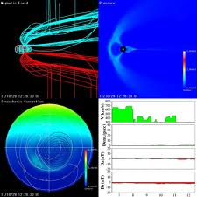
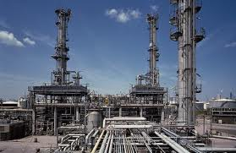
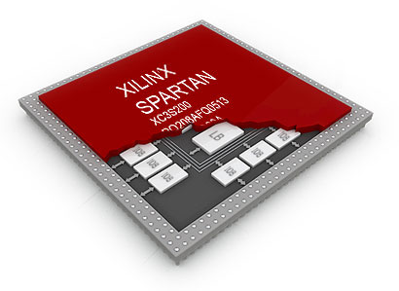


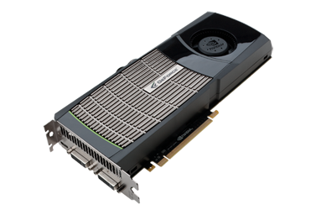



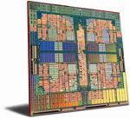


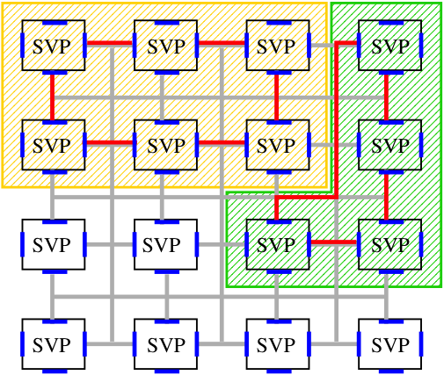
Context
High Portability
High Performance
High Productivity

Slide 3
Truly Implicit MM is Cool...
...
A = getLargeData( inData);
Z1 = incArrayBy( A, 1);
Z2 = incArrayBy( A, 2);
...
int[.,.] incArrayBy( int[.,.] A, int i)
{
return( A + i);
}
Stateless Arrays are Cool...

Slide 4
but Challenging!
...
A = getLargeData( inData);
Z1 = eraseDiagElem( A, 1);
Z2 = eraseDiagElem( A, 2);
...
int[.,.] eraseDiagElem( int[.,.] A, int i)
{
A[i,i] = 0;
return( A);
}
Aggregate Update
Problem!

Slide 5
Solutions
version trees
  eg. [AasaEtAL88]
single threading
  eg. Linear Types [Wadler90]
  Uniqueness Types [BarendsenSmetsers95]
non-delayed garbage collection
  eg. λ-calculus [Hudak84]
  SISAL [Cann89]
  SaC [Trojahner05, GrelckScholz08]

Slide 6
Design Space for MM
conceptual copies
f( a, b , c)
f( a, b ,c )
{
... a..... a....b.....b....c...
}
operation | non-delayed copy | delayed copy + delayed GC | delayed copy + non-delayed GC
read | O(1) + free | O(1) | O(1) + DEC_RC_FREE
update | O(1) | O(n) + malloc | O(1) / O(n) + malloc
reuse | O(1) | malloc | O(1) / malloc
funcall | O(1) / O(n) + malloc | O(1) | O(1) + INC_RC

Slide 7
Going Multi-Core I
single-threaded
data-parallel
rc-op
rc-op
rc-op
rc-op
rc-op
rc-op
rc-op
rc-op
...
...
rc-op
rc-op
rc-op
rc-op
local variables do not escape!
relatively free variables can only benefit from reuse in 1/n cases!
☺
=> use thread-local heaps
=> inhibit rc-ops on rel-free vars

Slide 8
Going Multi-Core II
single-threaded
task-parallel
rc-op
rc-op
rc-op
rc-op
rc-op
rc-op
rc-op
rc-op
rc-op
local variables do escape!
relatively free variables can benefit from reuse in 1/2 cases!
☹
=> use locking....

Slide 9

Going Many-Core
256 cores
500 threads in HW each
functional programmers
paradise, no?!
nested DP and TP
parallelism

Slide 10
RC in Many-Core Times
computational thread(s)
rc-op
RC-thread
rc-op
rc-op
rc-op

Slide 11
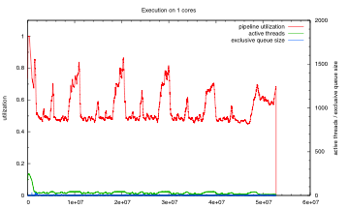
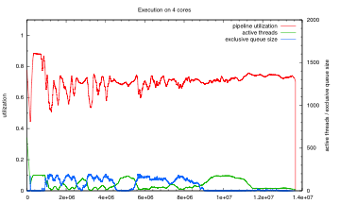
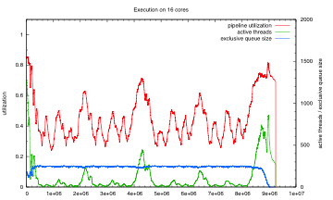
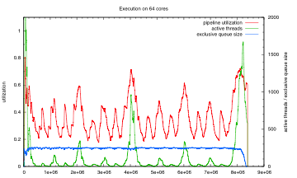
and here the runtimes

Slide 12
Multi-Modal RC:
spawn

Slide 13
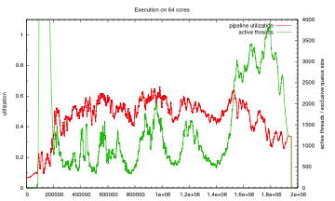
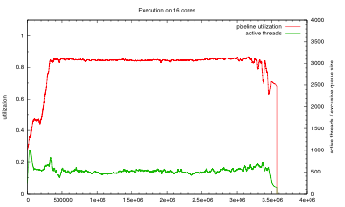
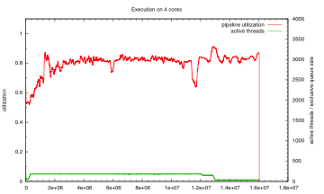
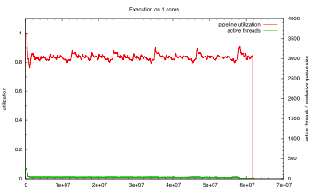
new runtimes:

Slide 14
Conclusions
The more cores we use the more MM matters
Avoiding copying of data can lead to bottlenecks in memory management
DP is particularly well behaved
Utilising application knowledge helps a lot
Multi-Modal-RC is well suited for highly nested parallel applications on large non-nested data structures!

Slide 15
Open Questions:
Can we improve on the multi-modal version?
  more modes?
  more static analysis?
How should we deal with smaller / nested structures ??
Can we integrate those techniques???

