Slide 1

Serious Modding
Game Design Exercise
Dr Sandy Louchart – s.louchart@gsa.ac.uk
Brian MacDonald – Brian.McDonald@gcu.ac.uk

Slide 2
Serious Mods
In videogame culture, modding refers to the editing of an existing game.
A mod is not a stand-alone game and needs an existing game.
In many cases, game modding is often confined to the editing of games for entertainment purposes.
However, not always the case and mods are sometimes developed with the intention to modify an existing game towards a specific topic, hence the term « Serious Mod ».

Slide 3
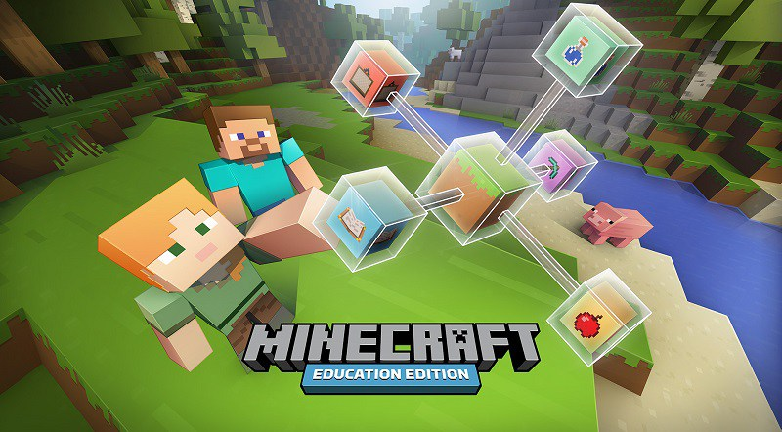
Serious Mods
http://education.minecraft.net/

Slide 4
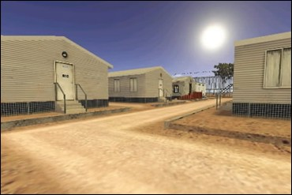
Serious Mods
https://julianoliver.com/escapefromwoomera/

Slide 5
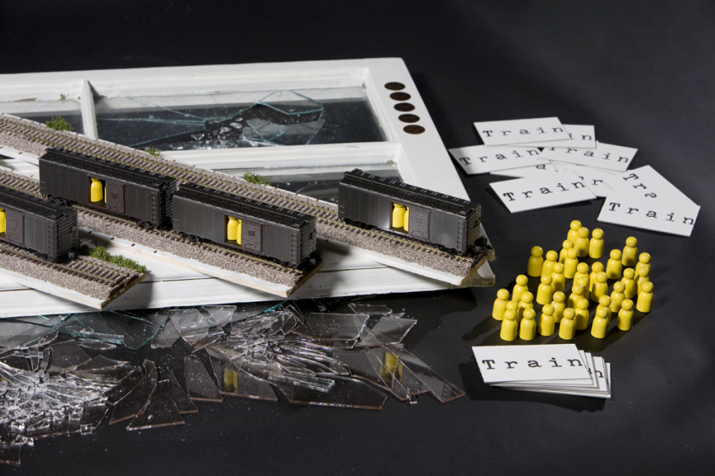
Serious Boardgames
http://www.blromero.com/train/

Slide 6
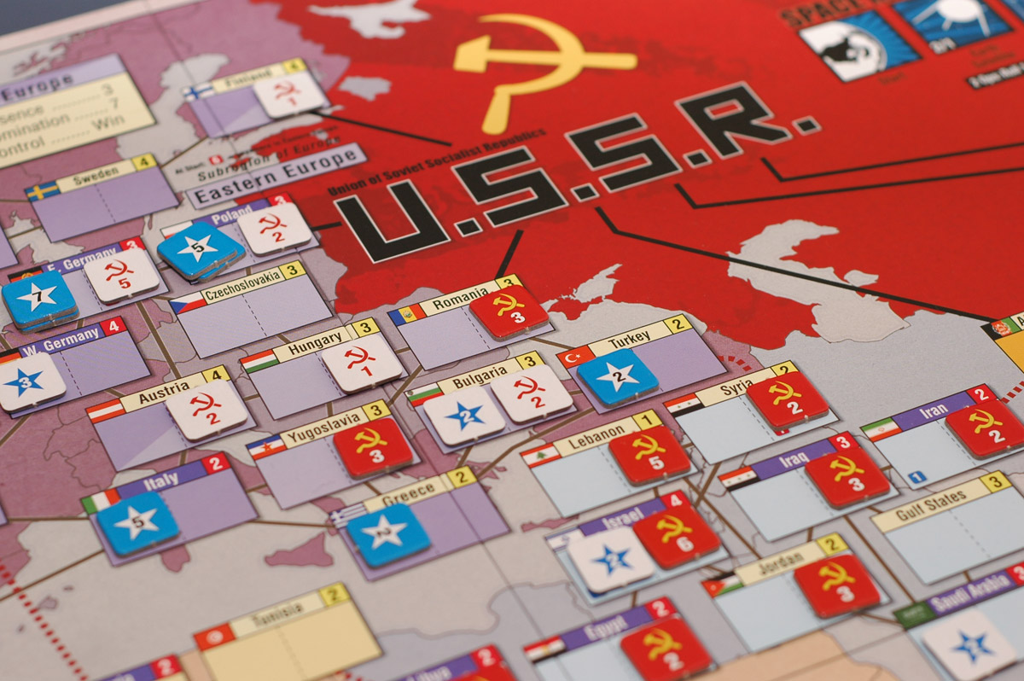
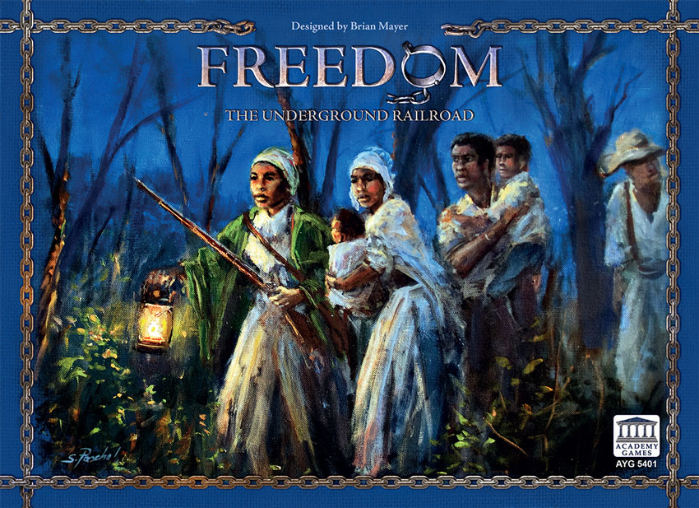

Serious Boardgames
http://www.gmtgames.com/p-588-twilight-struggle-deluxe-edition-2016-reprint.aspx
https://academygames.com/games/birth-of-america/product/freedom
https://www.kickstarter.com/projects/ludicreations/and-then-we-held-hands

Slide 7
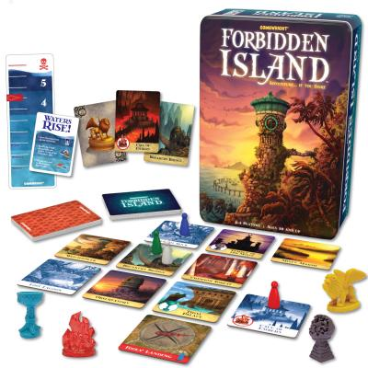
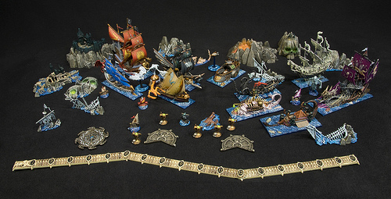
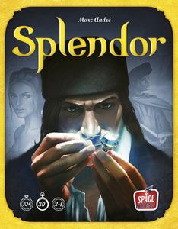
Board Games - Potential
https://www.games-workshop.com
http://gamewright.com/
https://www.asmodee.us

Slide 8
Board Games - Potential
https://www.games-workshop.com
http://gamewright.com/
Re-Enactment (strategy, events, conditions)
Collaboration in a changing environment (empire, international events)
Economy and trades (spices etc..)
https://www.asmodee.us

Slide 9
Board Games - Potential
https://www.games-workshop.com
http://gamewright.com/
Financial Crisis 1929/2008
Battle of Trafalgar
Building and Fall of Empires
Trade relationships (Spices, Tea) and links to historical events (American Independence)
Allied forces in conflicts (WW, current wars)
Oil situation in 70s’
https://www.asmodee.us

Slide 10
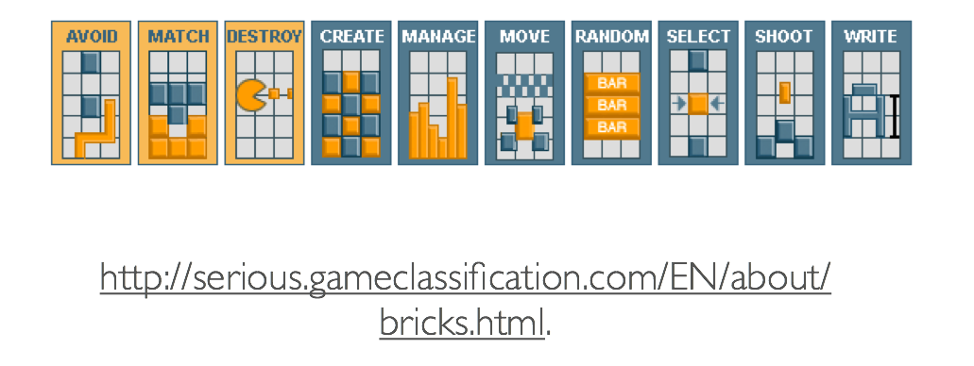
Game Mechanics

Slide 11
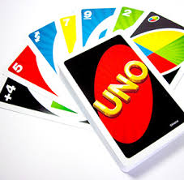



Game Mechanics
Numbers
Colours
Symbols
Cards
http://www.mattelgames.com/en-us/uno
Deck
Opponents

Slide 12
Game Mechanics
Numbers
Colours
MATHS
Symbols
Cards
http://www.mattelgames.com/en-us/uno
Deck
Opponents

Slide 13
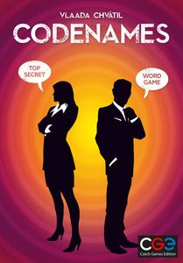
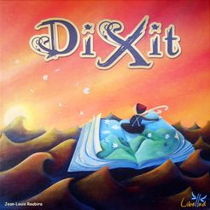
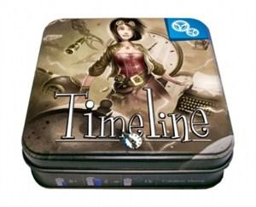
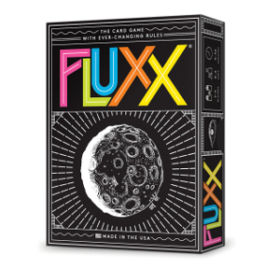

Potential - History

