Slide 1
Artificial Intelligence is not new so why all the fuss now?
Nick Taylor

Slide 2

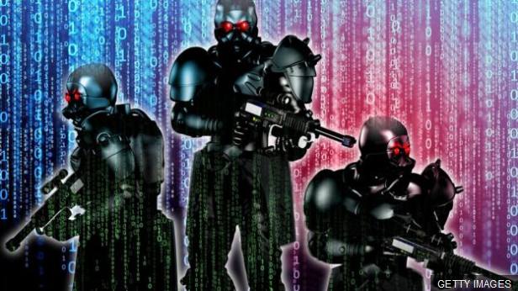
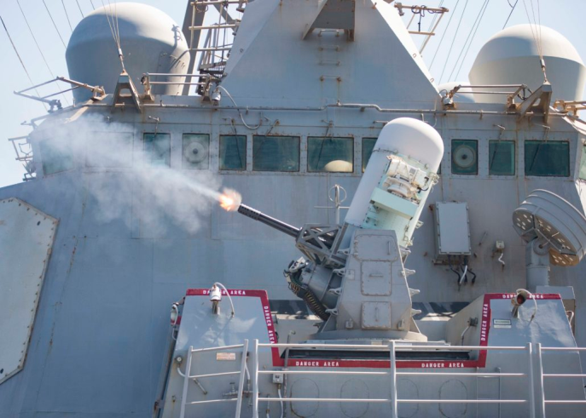
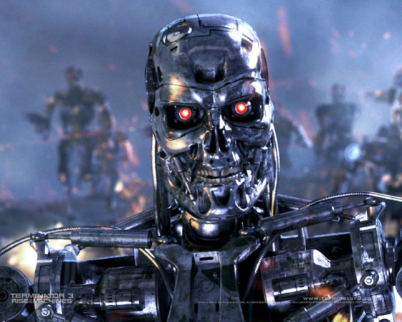
The Fuss
AI programs could end up doing battle in cyberspace
AI may take your job - in 120 years
The technological singularity
Variously predicted for 2030, 2040, 2045
Open letter calling on the UN to ban lethal autonomous weapons

Slide 3
Some Questions
What are we talking about?
  Achievability?
  Controllability?
  Desirability?
  Inevitability?

Slide 4
Weak AI, Strong AI & AGI
Turing Test (Imitation Game), 1950
Searle’s Chinese Room, 1980
Weak AI
  An AI system that can act like it thinks and has a mind
  Non-sentient
Strong AI
  An AI system that can think and has a mind
  Sentient ?
Artificial General Intelligence (AGI)
  Being smart
  Common sense

Slide 5
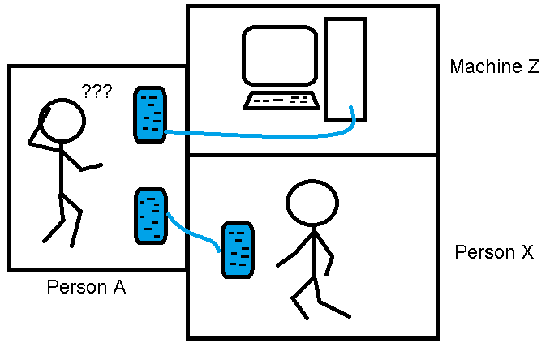
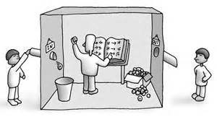
Turing’s Question:
Can a Machine Think?
A philosophical question?
Searle’s rebuttal
Is consciousness an emergent property?
Could a sentient machine be constrained to operate within predefined parameters?
Could even weak AI systems evolve beyond our intentions?

Slide 6
The Concerns
Artificial intelligence and robots taking human jobs
  What happens if the many become unemployed and the few who control the technology become squillionaires?
Military robots killing people
  Moral and practical objections
Artificial intelligence delivering unforeseen outcomes
  Inexorable logic and human error
Artificial intelligence outstripping human intelligence
  The Technological Singularity
Artificial intelligence being subverted to criminal purposes
  AI will be available to all, not just the noble minded

Slide 7
AI and Armaments
Why would anybody put a weapon in the hands of a robot?
  Robotic soldiers could minimise
    Body bags
    Collateral damage
Why would anybody put AI into a weapon?
  What about using AI to prevent a human-controlled weapon being discharged against a non-combatant?

Slide 8
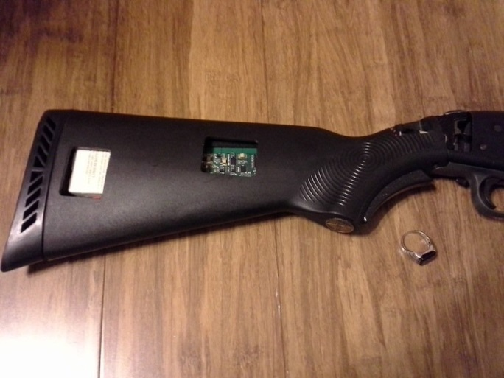
Smart Guns
Firearms that will only fire when activated by an authorised user
  RFID tags
  Fingerprints
How about using imaging of the target to detect a threat before enabling?

Slide 9
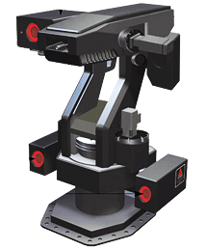
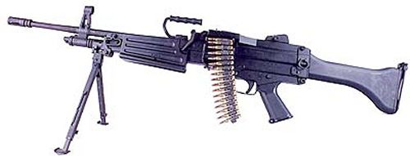
Samsung SGR-A1
Deployed by South Korea in the Korean Demilitarised Zone in 2007
Main value lies in its camera systems and software which enable it to identify genuine intruders and ignore false alarms
Human overseers can be alerted and decide on an appropriate response
No indication of any option to deliver a warning before opening fire
“With Southern birth rates projected to fall, the Koreans need to use their conscript army more efficiently, and SGR-A1s will save a lot of human sentries' man-hours.” Lewis Page, The Register, 14.3.2007
Daewoo K3
light machine gun

Slide 10
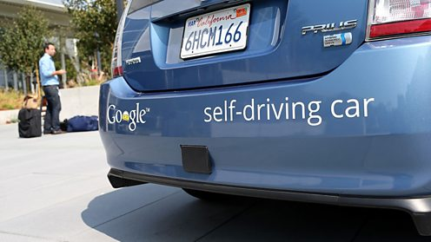
Driverless Cars
Globally 1.4m road deaths in 2016
  2.5% of total deaths
  8th most common cause of death
Out and about
  California
  Florida
  Michigan
  Nevada
Also …
  Bristol
  Coventry
  Greenwich
  Milton Keynes
NB For testing purposes only,
but driving around on public roads nonetheless.
The Trolley problem …

Slide 11
What do you make of this?

Slide 12
Demis Hassabis
DeepMind (Google)
“Terminator is one of those examples that is very iconic, but extremely unrealistic in a number of ways.
“Certainly that's not what I worry about.
“It's more where there are unintended things - something you might have missed, rather than people intentionally building systems to control weapons and other things.”
Interview with Kamal Ahmed, BBC, 16.9.2015

Slide 13
The Law of Unintended Consequences
If you want to write a truly impressive software system then you need the input of teams of developers (see Year 3 Group Project)
We re-use code to build even the simplest of applications these days (don’t you?)
Open source projects can have enormous numbers of contributors
There is just so much code out there now
… and it is inconceivable that it is all perfect

Slide 14
Past Experience – The Internet
Did we know what we were creating?
  We didn’t have a clue that it would become what it is today
  And we don’t have a clue what it will become in the future
Have we been able to control it?
  We haven’t really tried to control it because we kind of know that, even if we thought we should, it’s too late to do it now
  We’ve “chosen” to adapt to it
The Internet is not even sentient but we are in some sense subservient to it
  Accepting all the negative things that come with it (spam, phishing, viruses, cyberbullying, fake news, cybercrime, dark web, etc.)
  Because we want the positive things that it gives us even more (online shopping/banking, social media, games, videos, looking things up, etc.)
Lesson –
  We’ll put up with an awful lot of negatives from a technology if it satisfies our desires sufficiently

Slide 15
The Technological Singularity
Evolutionary Computing
  Evolution performs a semi-random walk, trying out alternatives
  The more “successful” individuals in a population survive and are combined with each other to generate even more successful individuals
  It has been enormously successful in generating complex life forms from the first single-celled organism but it took ages to do it
Genetic Programming
  Applies evolution to computer programs
  You could start with a random piece of code and, with a “fitness function” which emulates “success” in nature, evolve ever more complex and accomplished programs
  With today’s computing power we can run through hundreds of generations per second, much faster than natural evolution
We commonly use evolutionary computing to improve our AI systems
  Could they evolve beyond our own intelligence?
  If so, they would probably continue to evolve at such great speed that they would eclipse us in no time at all
  Once we start there would be no going back - and we’ve already started
  This is the Technological Singularity

Slide 16
Further Thoughts
Richard Dawkins’ Weasel program
  https://s3.amazonaws.com/files.nice/weasel2.html
Learning to walk (3:09)
  https://www.youtube.com/watch?v=xcIBoPuNIiw
Boston Dynamics robots (0:29 & 20:40)
  https://www.youtube.com/watch?v=LikxFZZO2sk
  https://www.youtube.com/watch?v=-e9QzIkP5qI
Robots building robots (2:20)
  https://www.youtube.com/watch?v=abthGNq4UZo

Slide 17
Any Questions?

